Slide 1
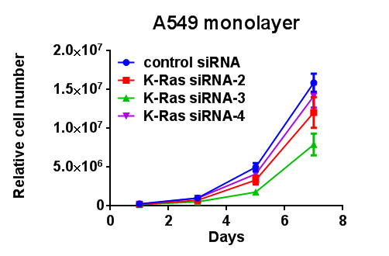
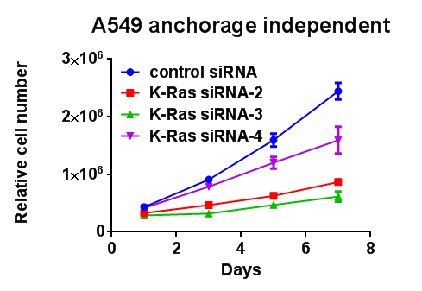
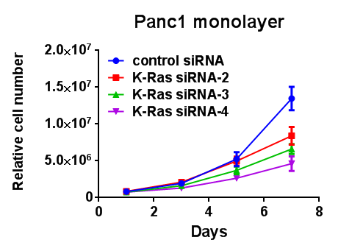
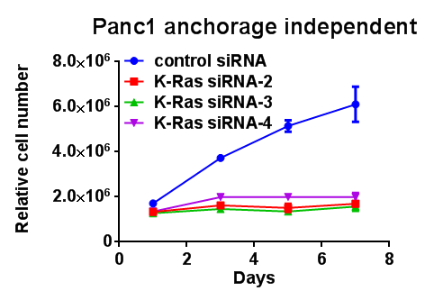
A
B
Cell line
Panc1
A549
siRNA
C
K2
K3
K4
C
K2
K3
K4
α-K-Ras
α-pMEK
α-MEK
Supplementary Fig. 1 Saori Fujita-Sato et al.

