Slide 1
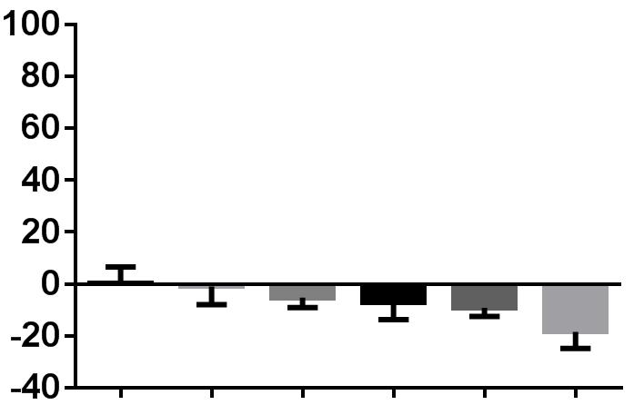
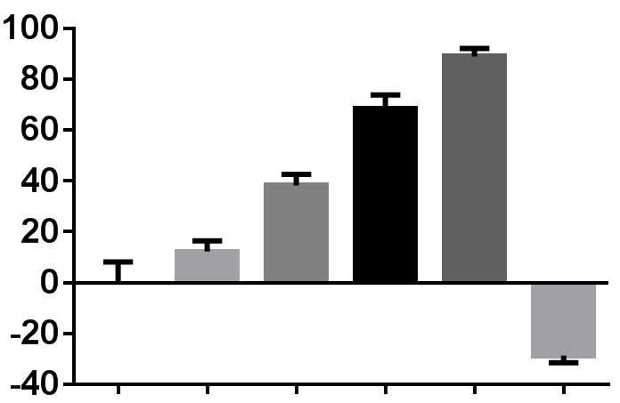
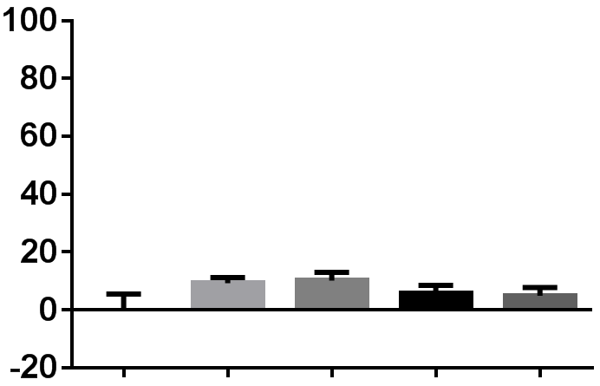
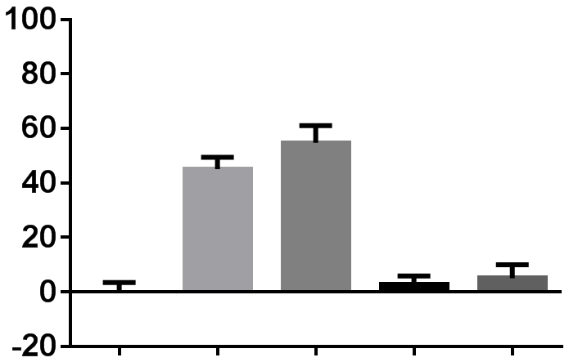
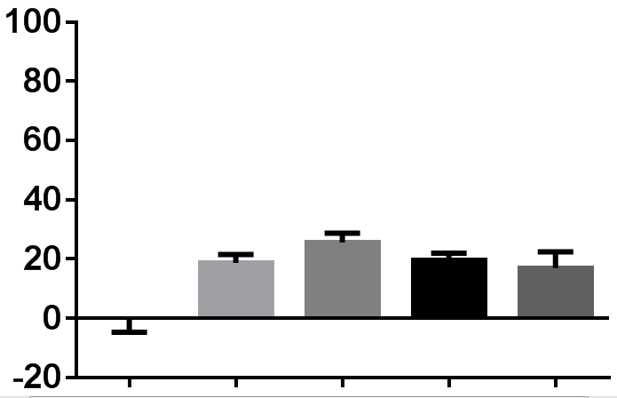
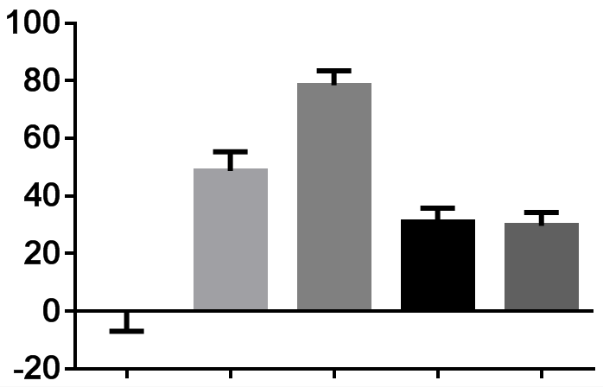
A
monolayer
anchorage independent
% increase
HGF (ng/ml)
PHA (1 µM)
0
–
0.1
–
1
–
10
–
50
–
50
+
0
–
0.1
–
1
–
10
–
50
–
50
+
B
monolayer (10% FBS)
anchorage independent
(10% FBS)
% increase
HGF (ng/ml)
EGF (ng/ml)
0
0
10
0
50
0
0
10
0
50
0
0
10
0
50
0
0
10
0
50
C
anchorage independent
(Serum free)
monolayer (Serum free)
% increase
HGF (ng/ml)
EGF (ng/ml)
0
0
10
0
50
0
0
10
0
50
0
0
10
0
50
0
0
10
0
50
Supplementary Fig. 3 Saori Fujita-Sato et al.

