Slide 1
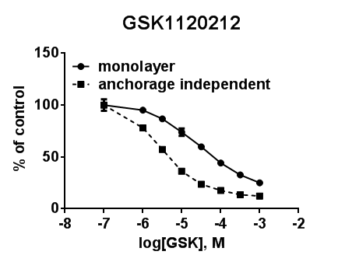
Supplementary Fig. 4 Saori Fujita-Sato et al.

