Slide 1
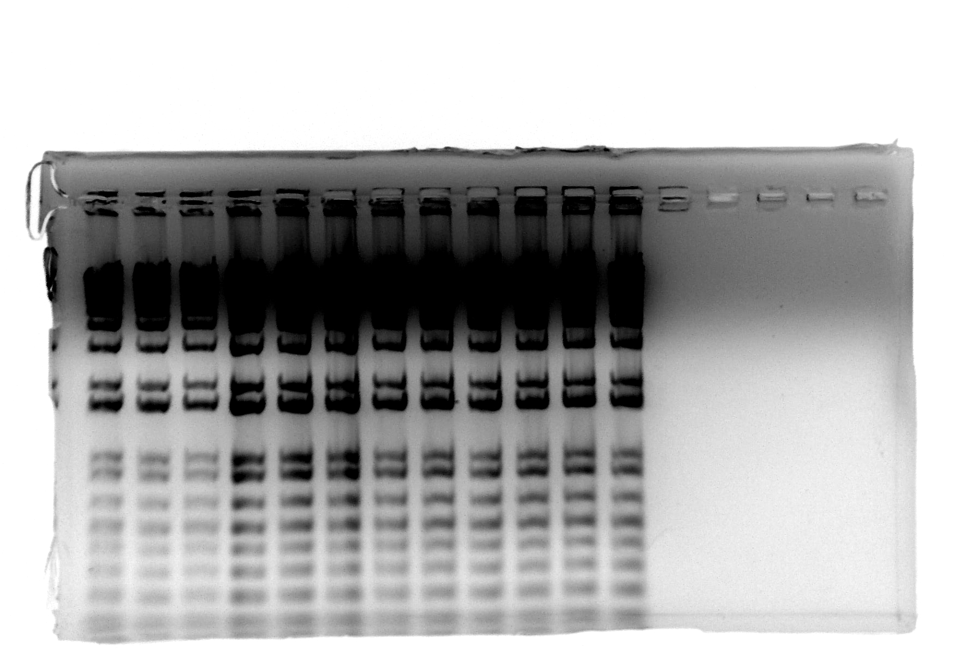
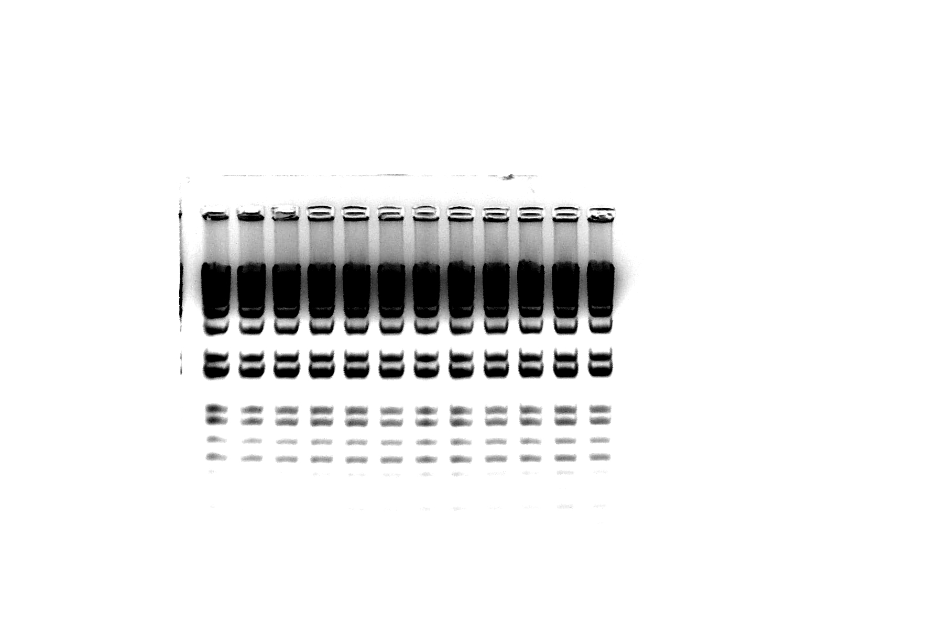
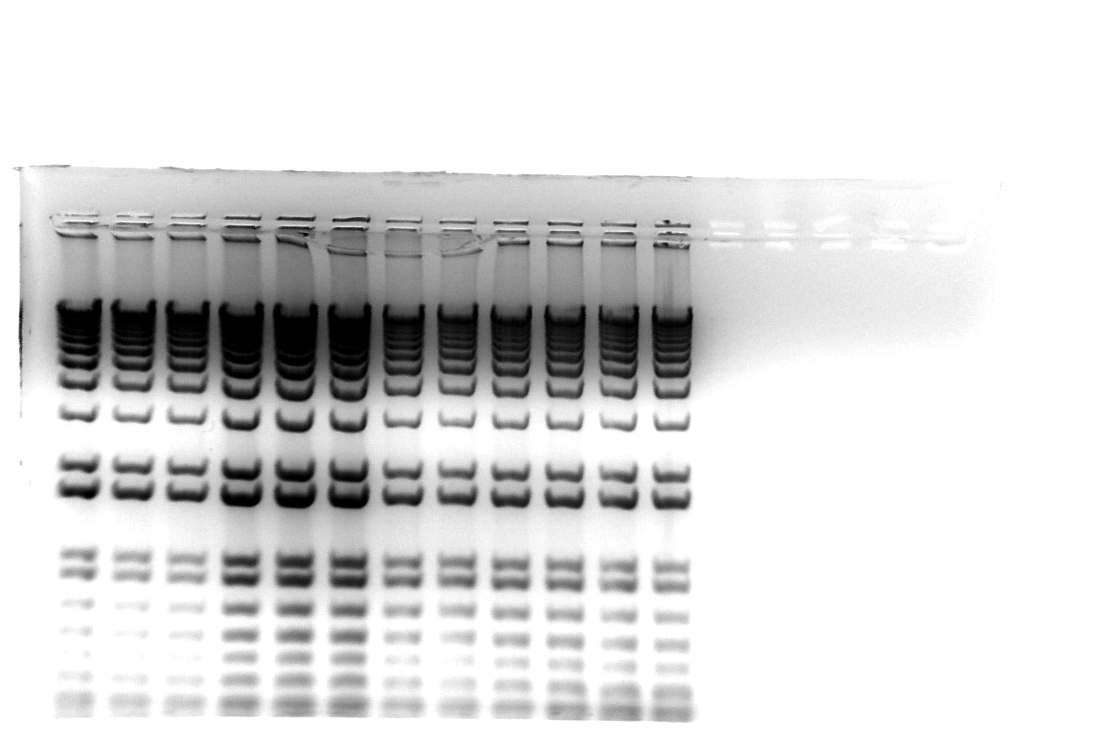
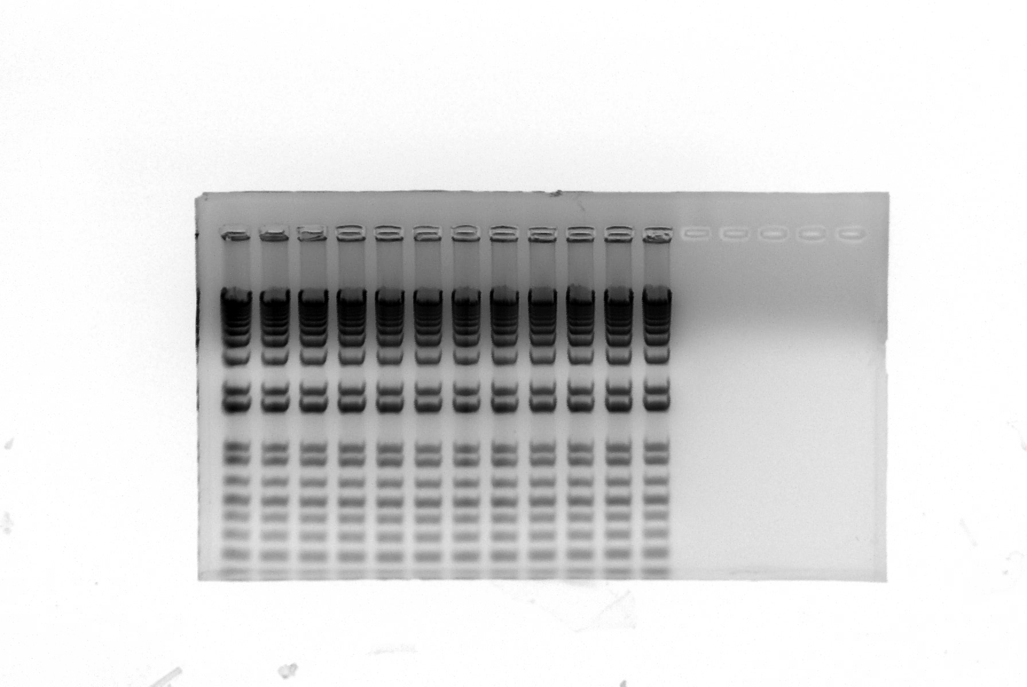
Figure S2A
WT-Sham
WT-TAC
AKAP13-∆PKD1 Sham
AKAP13-∆PKD1 TAC
α-actinin
Tubulin
*
Figure S2B
WT-Sham
WT-TAC
AKAP13-∆PKD1 Sham
AKAP13-∆PKD1 TAC
Myh7
Tubulin
*

