Slide 1
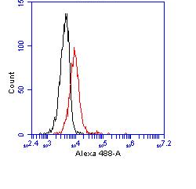
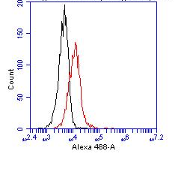
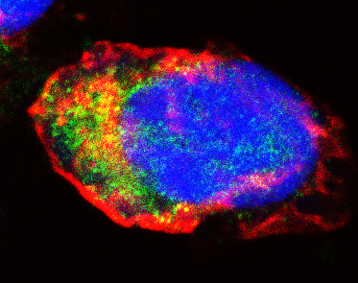
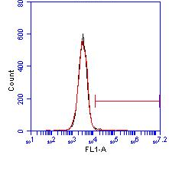
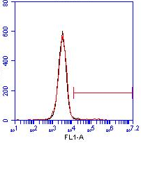
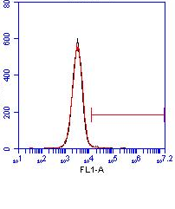
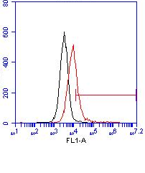
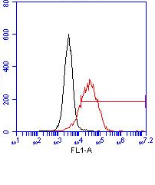
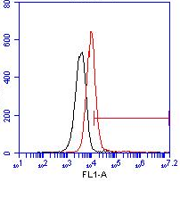
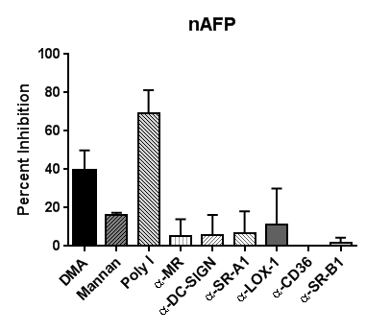
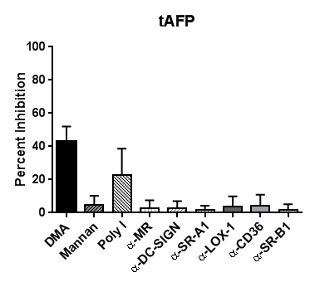
A
B
nAFP
tAFP
4°
37°
C
C-type lectin receptors
Scavenger receptors
MR:
1.0%
DC-SIGN:
1.8%
SR-A1:
0.9%
LOX-1:
29.8%
CD36:
83.2%
SR-B1:
29.4%
D
Supplementary Fig. S1. HepG2 cells endocytose AFP primarily via pinocytosis and scavenger receptors. (A) nAFP and tAFP were Alexa Fluor 488-labeled. HepG2 cells were co-cultured with AFP (10 μg/ml) for 1hr at 4°C or 37°C, and analyzed by flow cytometry. (B) HepG2 cells were co-cultured with fluorescently-labeled nAFP for 2hr, then fixed, stained for actin (described in Materials and Methods), and analyzed by confocal microscopy. (C) HepG2 cells were stained for flow cytometric analysis. Red histogram represents endocytic receptor staining; black histogram represents isotype control staining. Data from one representative experiment (of three total ) is shown. (D) HepG2 cells were pre-treated with inhibitors for 30min, and co-cultured with fluorescently-labeled nAFP (left panel) or tAFP (right panel) for an additional 1hr. Percent inhibition was calculated based on untreated control cells. Columns, mean of three independent experiments; bars, standard deviation.

