Slide 1
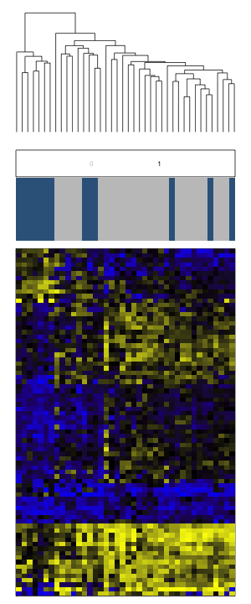
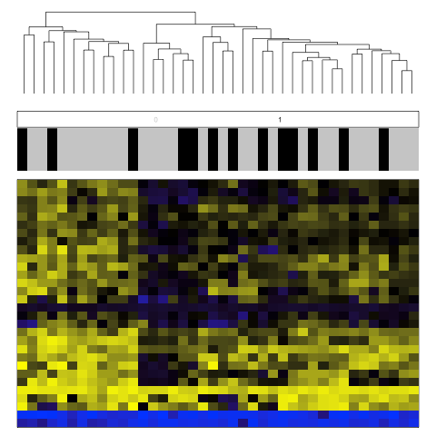
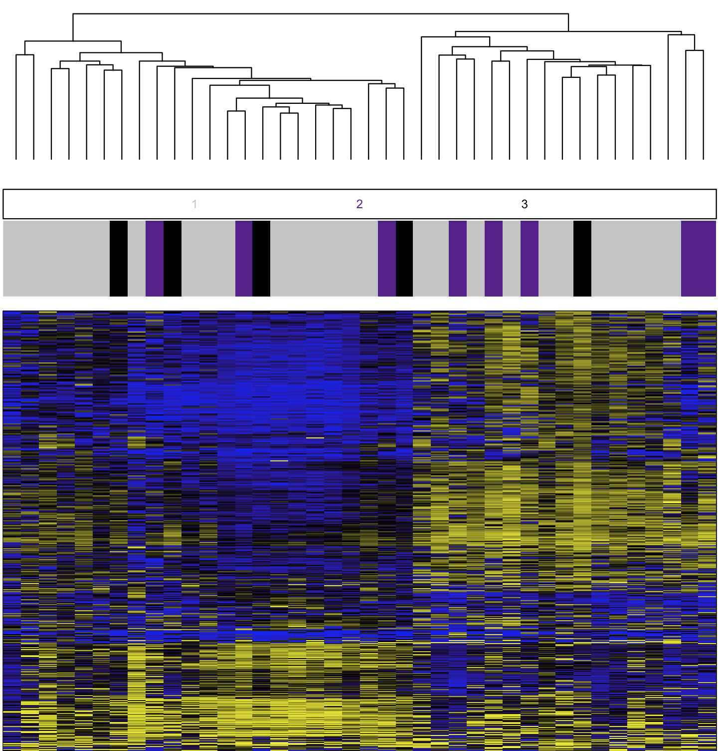
Unsupervised Clustering of 72 genes (77 CpGs)
Unsupervised Clustering of 28 genes (30 CpGs)
A
B
n=40
n=40
Developed Invasive Breast Cancer
Developed Invasive Breast Cancer
No
No
Yes
Yes
Unmethylated
Methylated
Notes:
Supplemental Figure 5. (A) Unsupervised clustering heat map based on Manhattan distance and average linkage of CpGs that track to the 72 genes (77 CpGs) whose methylation dysregulation exhibited an overlap in the two populations resulted in two main clusters (B) Unsupervised clustering 28 genes (30 CpGs) between the two cohorts that exhibited significant DNA methylation differences in the same direction of methylation and in the same genomic region.

