Slide 1
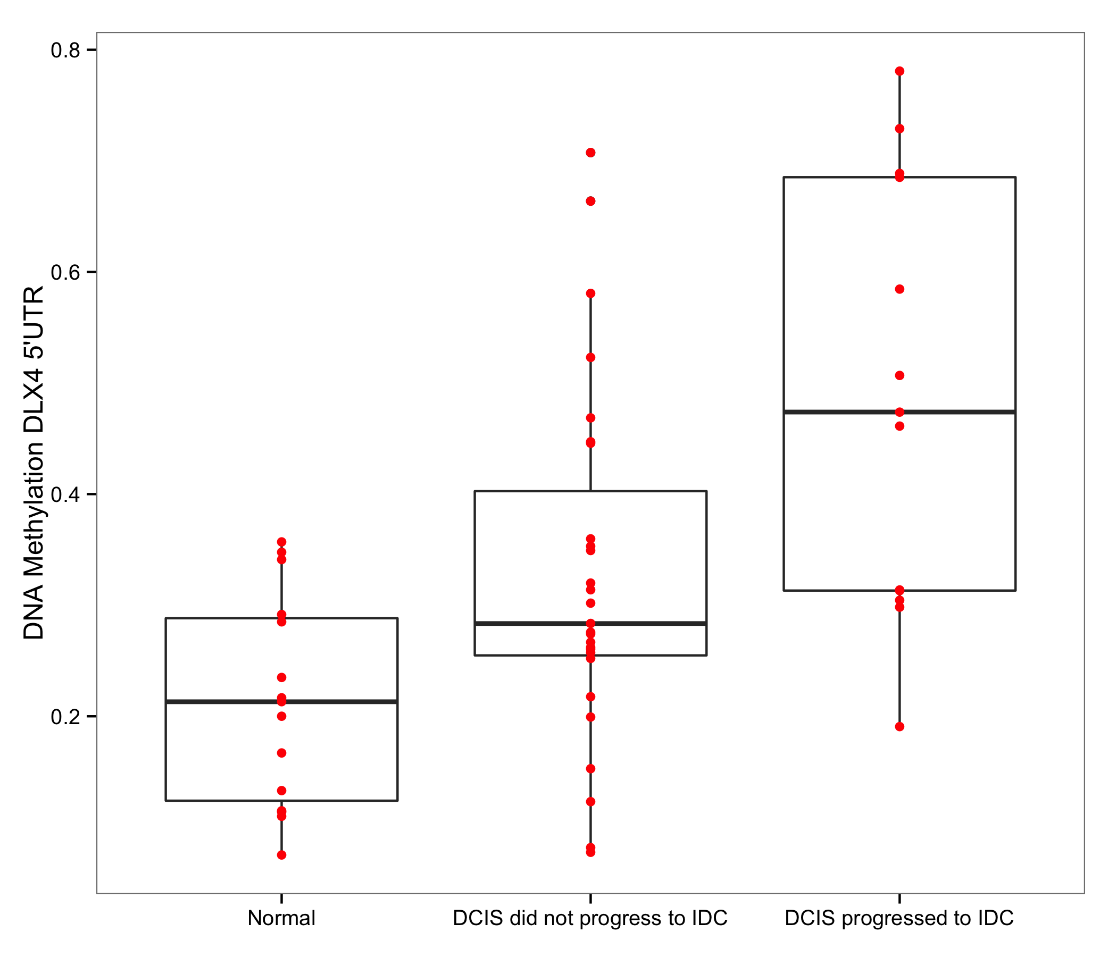
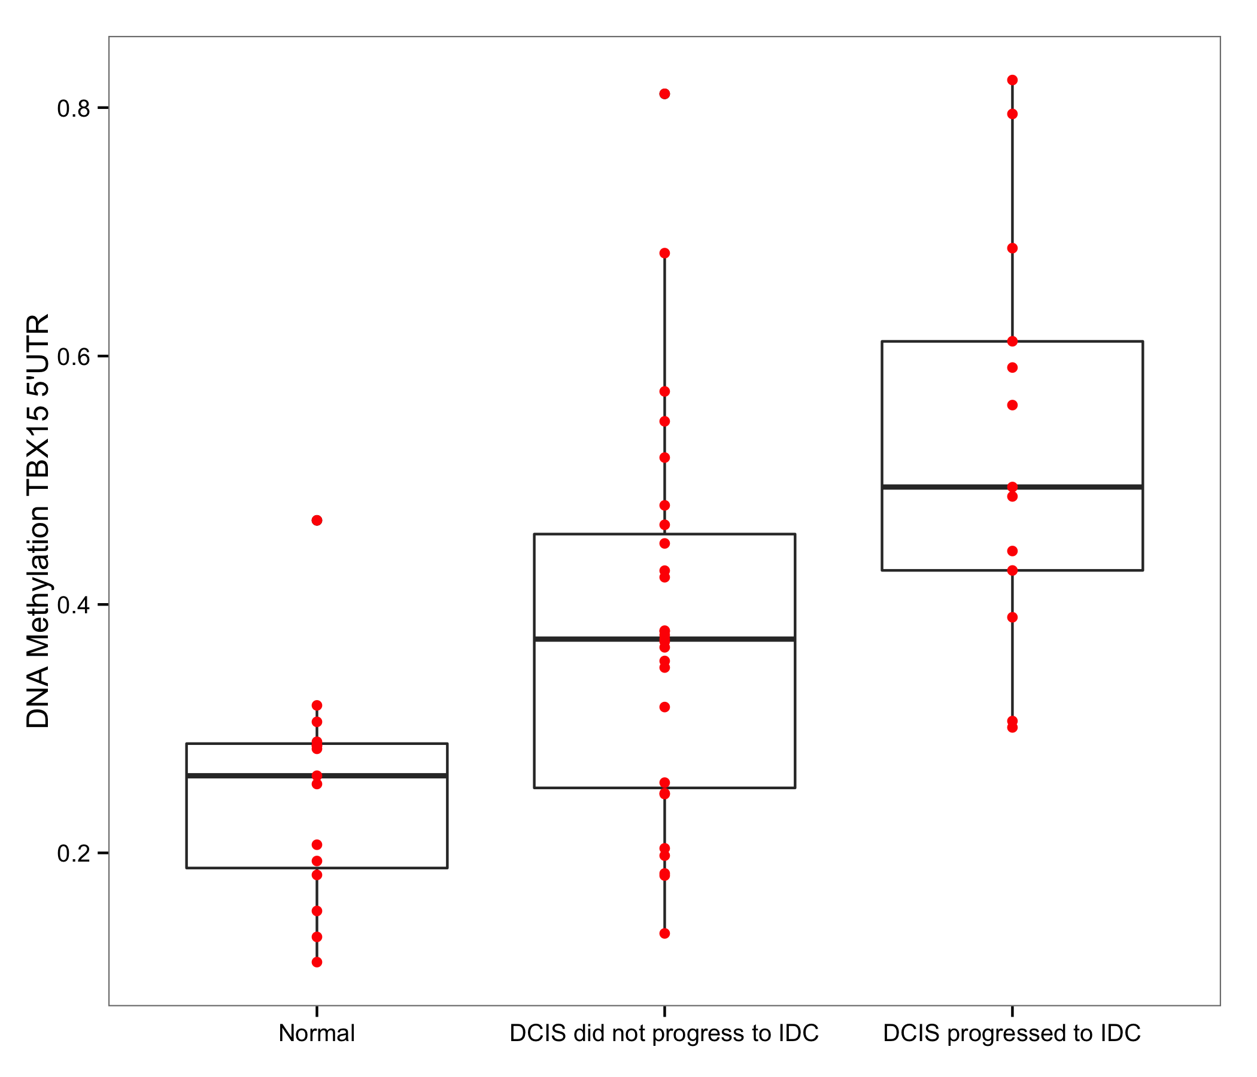
DNA Methylation DLX4
DNA Methylation TBX15
n=55
n=55
Notes:
Supplemental Figure 4. A total of 276 CpGs among the 641 progression-related loci experienced additional DNA methylation deregulation in the same direction that differentiated DCIS from normal-adjacent tissue. Representative plots for 5’UTR region of DLX4 and TBX15 genes across normal adjacent tissues, DCIS tissues from subjects that did not progress to a diagnosis of invasive ductal carcinoma (IDC), and DCIS tissues from subjects that progressed to a diagnosis of invasive ductal carcinoma (IDC).

