Slide 1
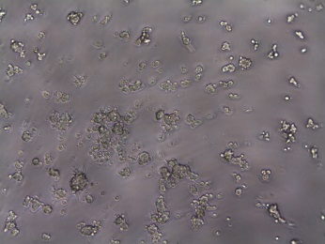
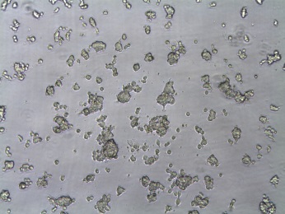
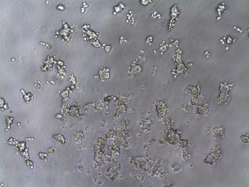
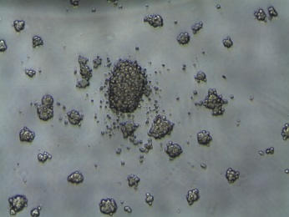
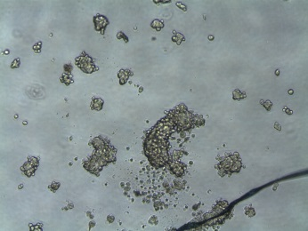
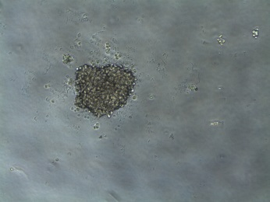
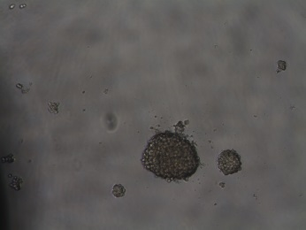
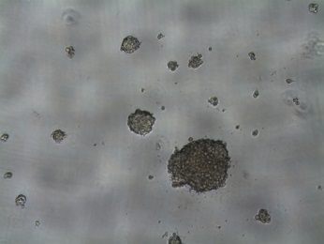
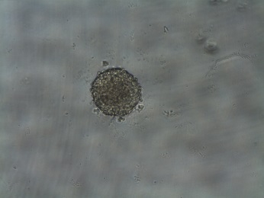
A
untreated
negative control antibody
αCDCP1-Ab3
DU-145
NCI-H358
HCT116
B
Notes:
Experiment D022:
Anoikis setting , CTG; DU145, NCI-H358 and HCT116
PaSt0022 inhibited growth of DU145 + H358, but not HCT116.
Interesting effect observed in images – how to describe?
Conflict with spheroid setting for other PaSt0022 data?

