Slide 1
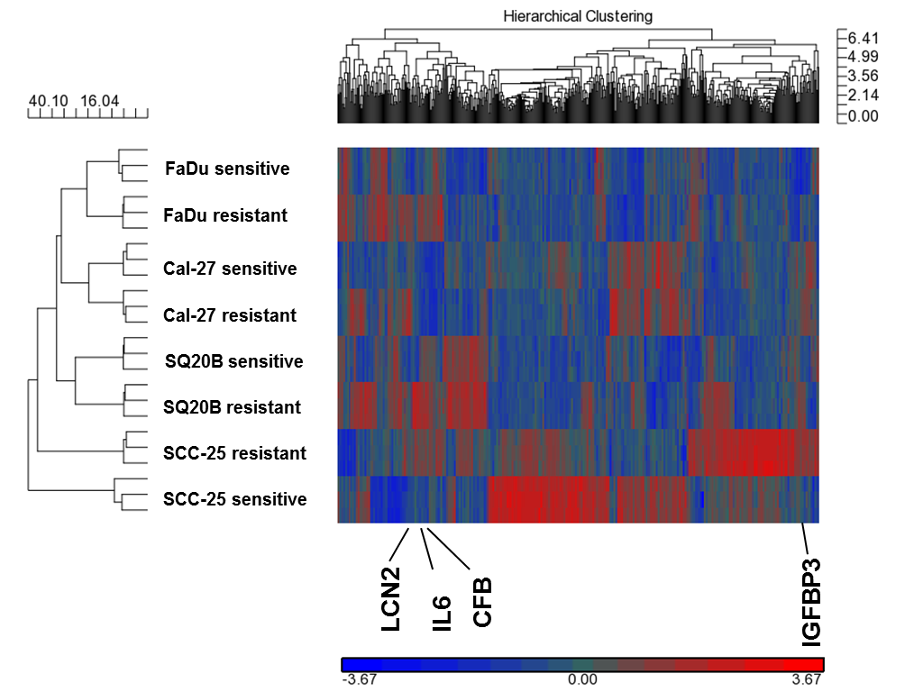
Supplementary Figure 1
Supplementary Figure 1. Heat map of differential gene expression. Heat map displays the results of differential gene expression profiles in erlotinib-resistant FaDu, SQ20B, Cal-27, and SCC-25 HNSCC cells versus their respective sensitive cells. Each row represents each sample tested and each column represents a single probe. Higher, lower relative gene expression are represented as red and blue respectively. Grey indicates no change.

