Slide 1
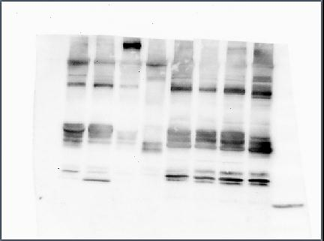
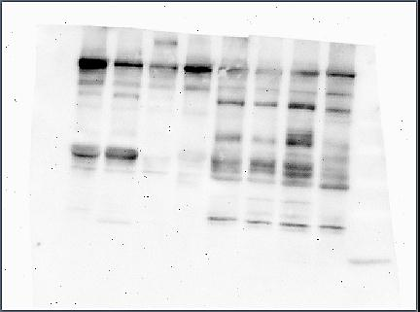
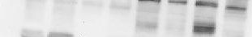
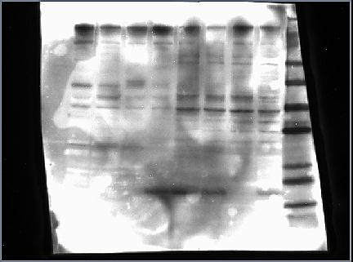
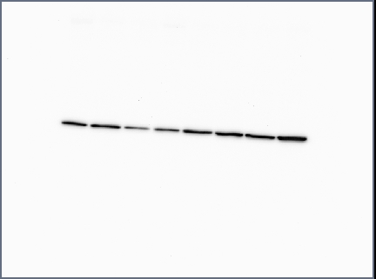
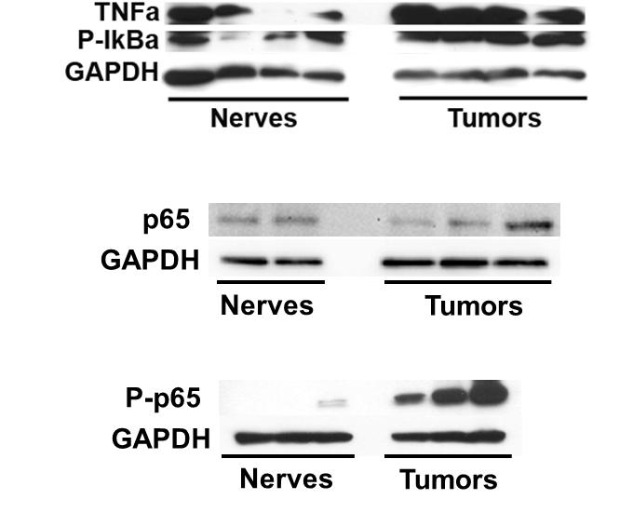
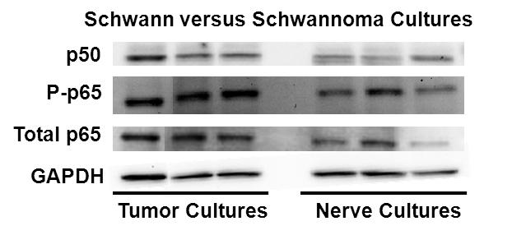
A
p105
p50
RelB
c-Rel
p100
GAPDH
Nerves
Tumors
B
TNFα
P-IκBα
GAPDH
C
VS Cultures
SC Cultures
Notes:
\\apollo\research\ENT\Stankovic\Sonam\V Drive Data 07 2014\NFKB Noncanonical blot 032814

