Slide 1

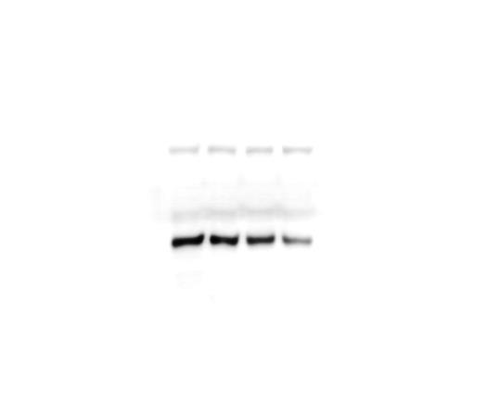


Supplementary Figure 1. Effect of BaP on NR2E3 expression in MCF-10A, HepG2, and Huh7 cells. MCF-10A, HepG2, and Huh7 cells were treated with BaP (1, 2.5 or 5 µM) for 48 h, and the NR2E3 protein level was analyzed on immunoblots of cell lysates probed with an anti-NR2E3 antibody
MCF-10A
HepG2
Huh7
BaP
BaP
BaP
DMSO
μM
DMSO
μM
DMSO
μM
NR2E3
1
2.5
5
NR2E3
1
2.5
5
NR2E3
1
2.5
5
Actin
Actin
Actin

