Slide 1
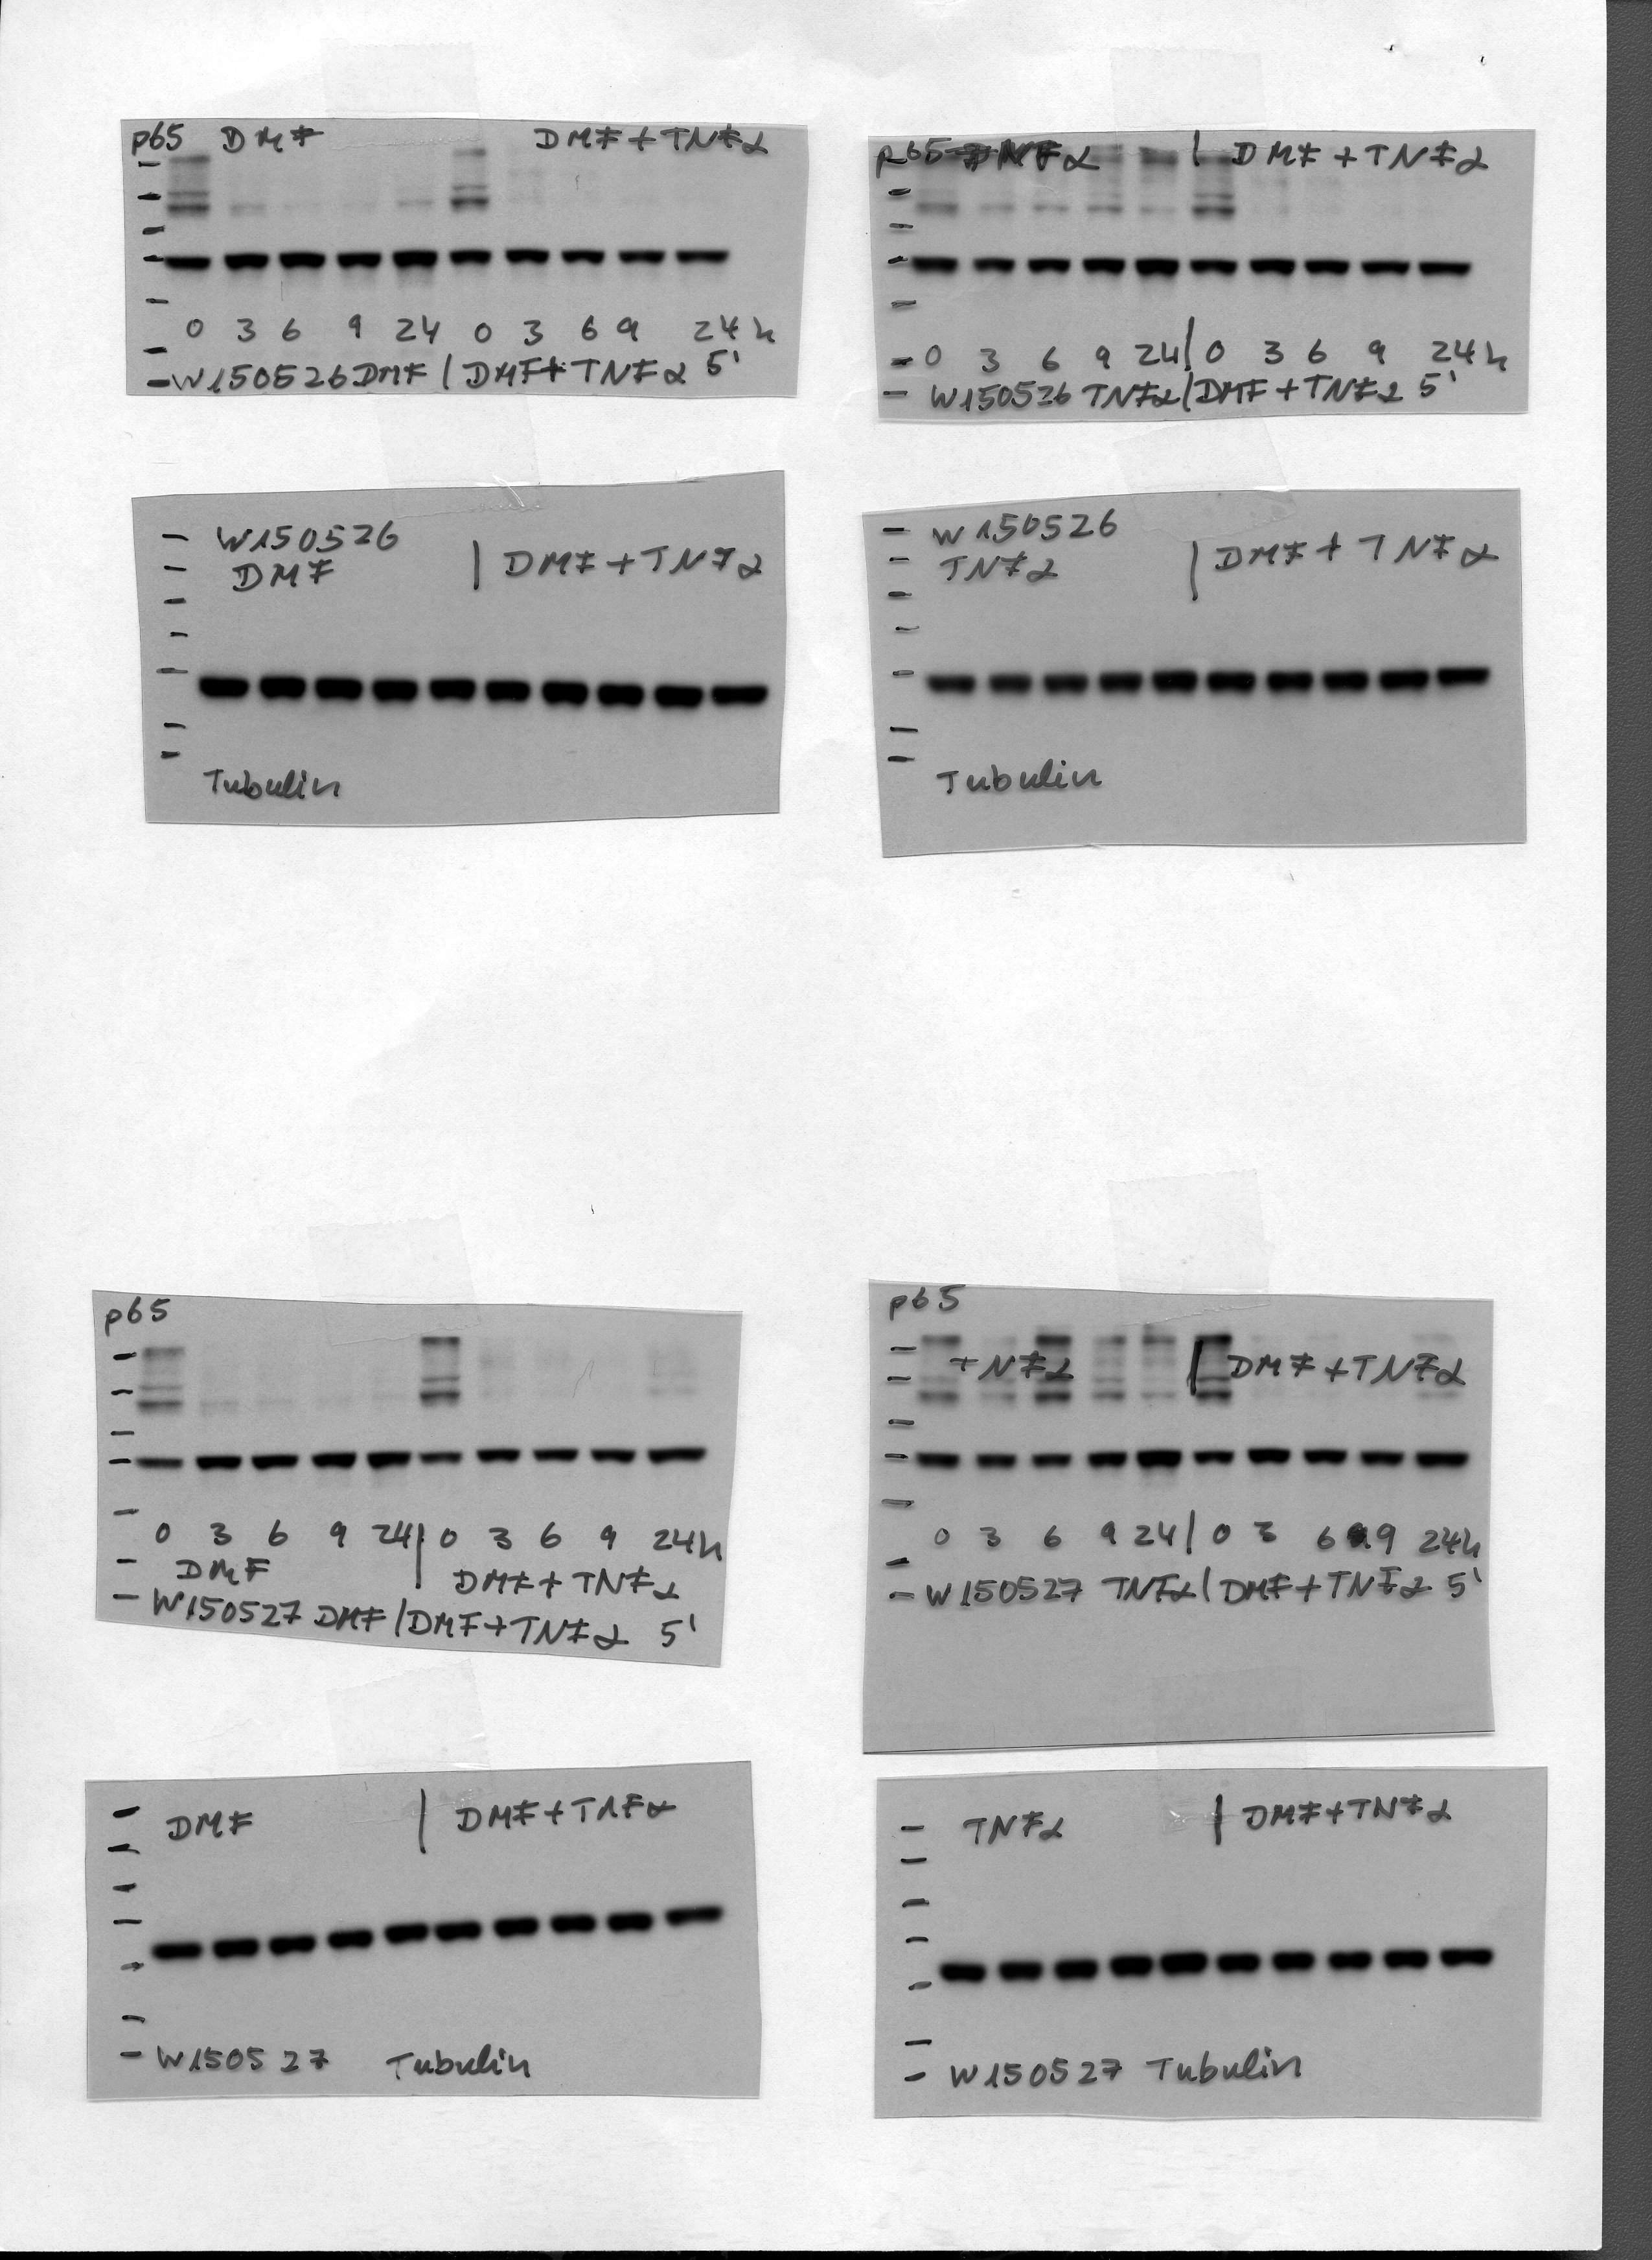
DMF
TNF-α
DMF + TNF-α
p65
Tubulin
0 1 3 9 24
h
h
0 1 3 9 24
0 1 3 9 24
h

