Slide 1
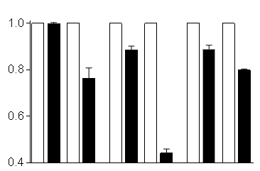
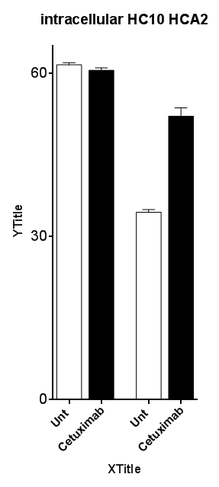
Supplementary Figure S1
A
B
No treatment
Cetuximab
No treatment
EGF
HLA-A
HLA-B/C
HLA-A
HLA-B/C
HLA-A
HLA-B/C
HCA-2
HC-10
P=0.0063
P<0.0001
P=0.0076
P=0.0003
MFI
Fold change
(MFI)
JHU-022
SCC90
93VU

Slide 2
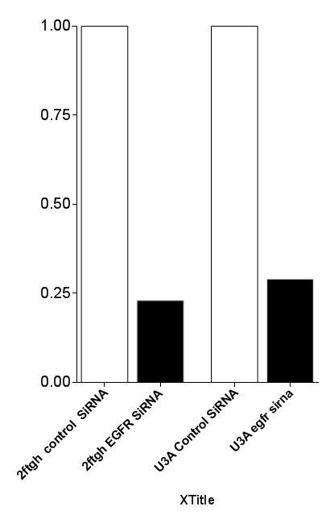
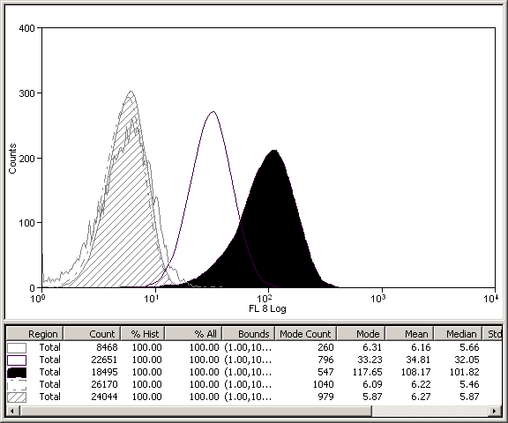
C
Control siRNA
D
EGFR siRNA
Isotype
U3A (STAT1^{-/-}):Control siRNA
U3A (STAT1^{-/-}):EGFR siRNA
2FTGH (STAT1^{+/+}):Control siRNA
76% knockdown
2FTGH (STAT1^{+/+}):EGFR siRNA
70% knockdown
Fold change
(EGFR MFI)
Cell number
2FTGH
(STAT1^{+/+})
U3A
(STAT1^{-/-})
Total STAT 1

Slide 3
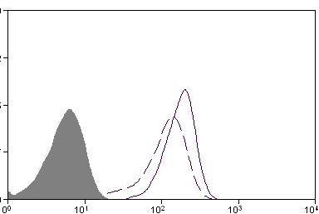
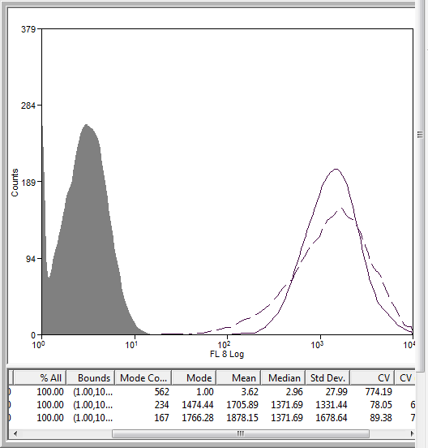
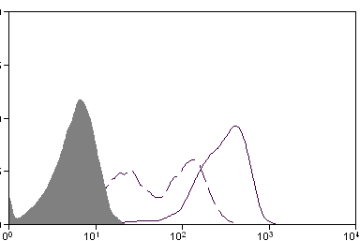
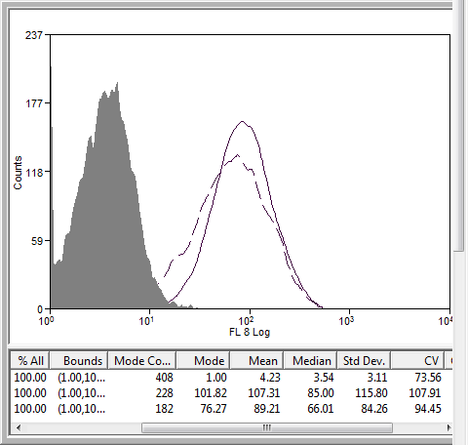
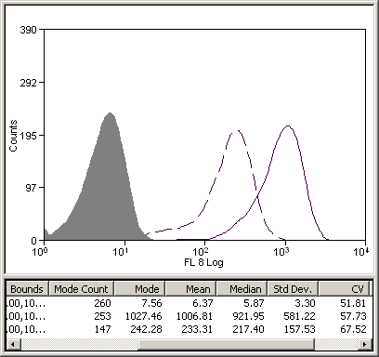
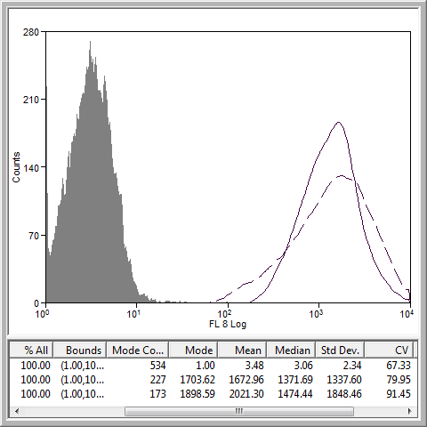
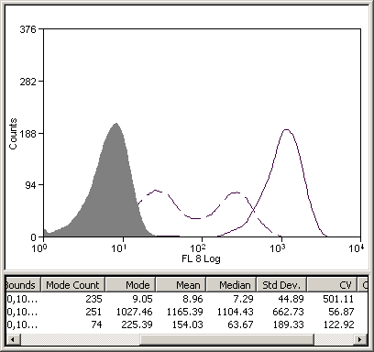
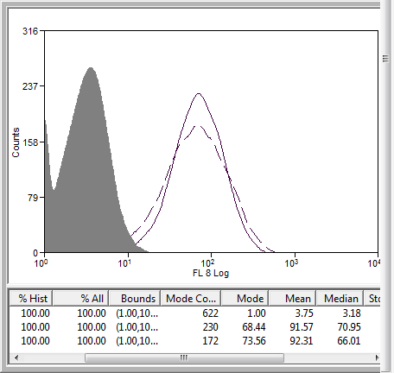
Supplementary Figure S1
E
Isotype
F
Total STAT1
EGFR
Vehicle
1372
Fludarabine
129
188
No treatment
1372
IP: anti-pSTAT1(Tyr 701) Ab
30min
333
89
80
107
Cetuximab
Cell number
Fold change
923
1474
217
1372
IFNγ
92
92
Cetuximab:
-
+
-
+
1104
IFNγ:
-
-
+
+
Cetuximab+IFNγ
64

Slide 4
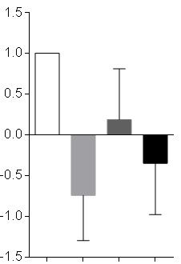


Supplementary Figure S2
A
B
Cetuximab:
-
+
-
+
P=0.005
IFNγ:
-
-
+
+
P=0.0008
P=ns
p-STAT1 (Tyr 701)
Total STAT1
Fold change
(SHP2 transcript)
β−Actin
C
STAT1 transcript
Fold change (log_{e})
Cetuximab:
-
+
-
+
IFNγ:
-
-
+
+
Cetuximab:
-
+
-
+
IFNγ:
-
-
+
+

Slide 5
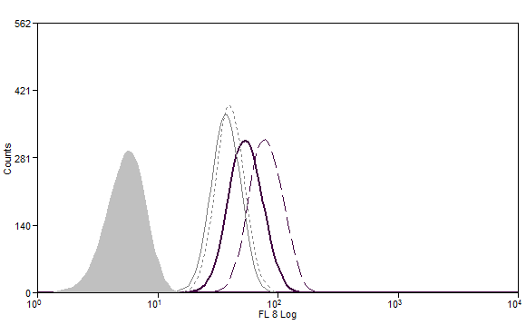
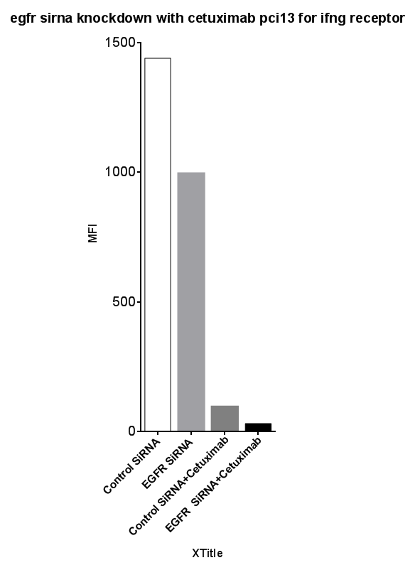
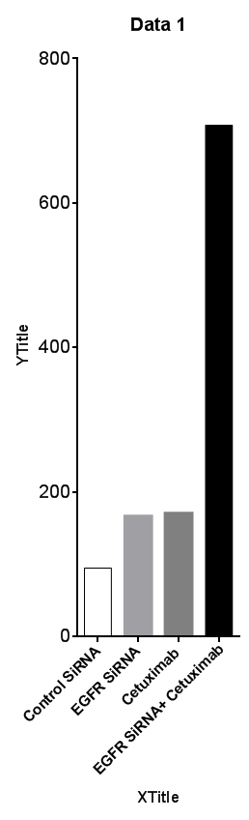
Supplementary Figure S2
D
E
F
Isotype
Control siRNA
Control siRNA
Control siRNA
EGFR siRNA
EGFR siRNA
SHP2 siRNA
Cetuximab
Cetuximab
Control siRNA+Cetuximab
EGFR siRNA + Cetuximab
SHP2 siRNA+Cetuximab
EGFR siRNA +
Cetuximab
44
58
40
81
Cell number
MFI
(IFNγ receptor α chain)
MFI (EGFR)
Total STAT1

Slide 6
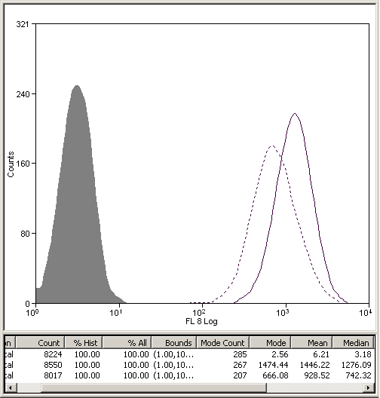
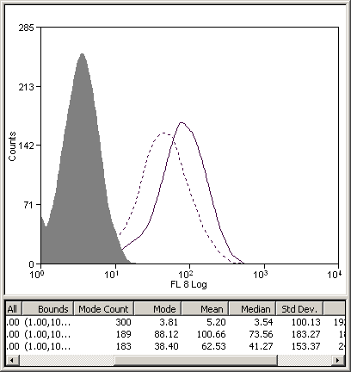
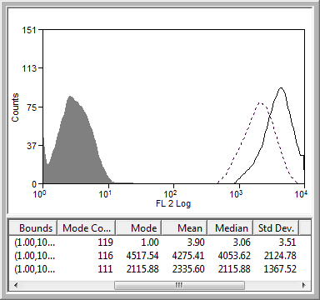
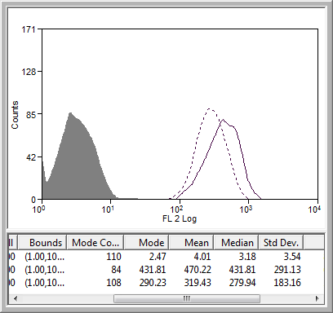
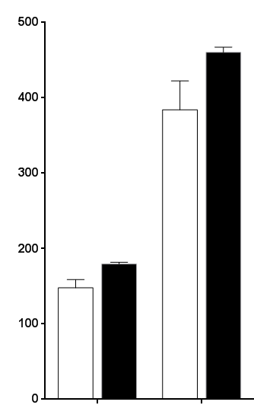
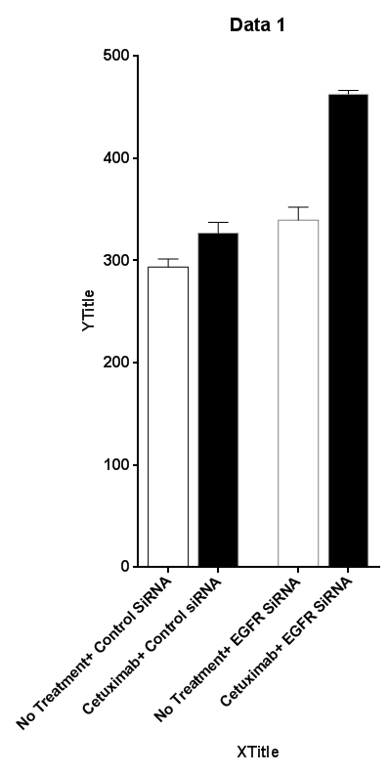
Supplementary Figure S3
A
Control siRNA
EGFR siRNA
C
Control siRNA
EGFR siRNA
Without cetuximab
With cetuximab
Without cetuximab
With cetuximab
1446
101
4257
666
63
2116
470
Cell number
Cell number
319
EGFR
EGFR
B
P<0.0001
D
P<0.0001
P=0.008
P<0.0001
No treatment
P=0.005
No treatment
P<0.0001
Cetuximab
Cetuximab
P=0.01
MFI HLA A/B/C
MFI HLA A/B/C
P=0.0013
Control siRNA:
+
-
Control siRNA:
+
-
EGFR siRNA:
-
+
EGFR siRNA:
-
+

Slide 7
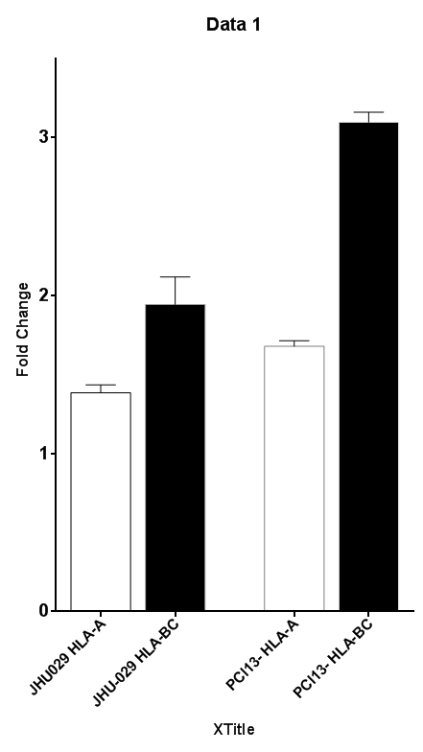
Supplementary Figure S3
E
P<0.0001
HLA-A
HLA-B/C
P=0.006
Fold change (MFI)
JHU-029
PCI-13

Slide 8
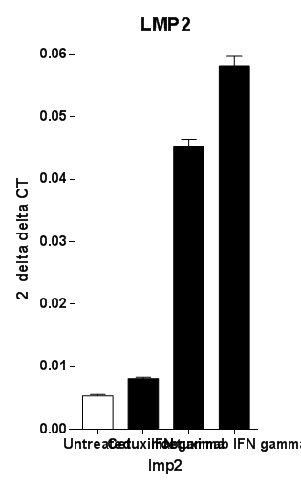
Supplementary Figure S4
A
TAP1 transcript
B
LMP2 transcript
P=0.0029
Fold change (log_{e})
2 delta delta CT
P=0.0008
IFNγ
IFNγ
Cetuximab
Cetuximab+
IFNγ
Cetuximab
Cetuximab+
IFNγ
No treatment
No treatment

Slide 9
Supplementary Figure S5
A
EGFR ₈₅₃₋₈₆₁
MAGE-3 ₂₇₁₋₂₇₉
MFI
Peptide concentration (μg/ml)

Slide 10
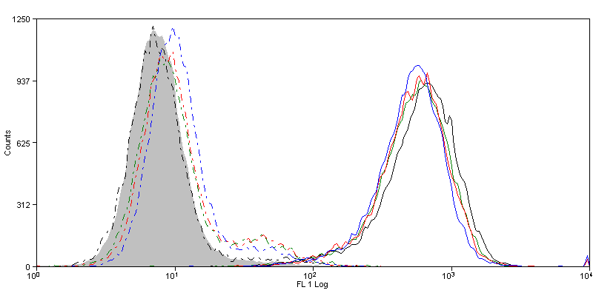
Supplementary Figure S5
mAb 12b6 does not recognize HLA-A2 restricted EGFR ₈₅₃₋₈₆₁ peptide induced assembled pan-HLA class I, whereas mAb W6/32 recognize assembled pan-HLA class I
B
mAb 12B6 binding
mAb W6/32 binding
Cell number
Fl₁(Log)
IgG1 Isotype 10 μg/ml (MFI: 9.58)
EGFR ₈₅₃₋₈₆₁ 10 μg/ml + mAb 12b6 (MFI: 10.5)
EGFR ₈₅₃₋₈₆₁ 10 μg/ml + mAb W6/32 (MFI: 720)
EGFR ₈₅₃₋₈₆₁ 1 μg/ml + mAb 12b6 (MFI: 7.84)
EGFR ₈₅₃₋₈₆₁ 1 μg/ml + Ab W6/32 (MFI: 645)
EGFR ₈₅₃₋₈₆₁ 0.1 μg/ml + mAb 12b6 (MFI: 9.73)
EGFR ₈₅₃₋₈₆₁ 0.1 μg/ml + Ab W6/32 (MFI: 637)
EGFR ₈₅₃₋₈₆₁ 0.01μg/ml + mAb 12b6 (MFI: 9.73)
EGFR ₈₅₃₋₈₆₁ 0.01 μg/ml + Ab W6/32 (MFI: 608)

Slide 11
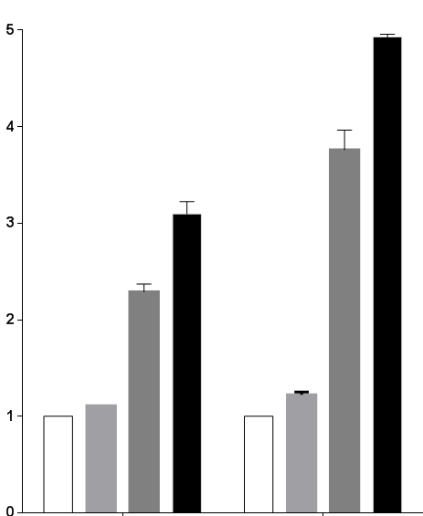
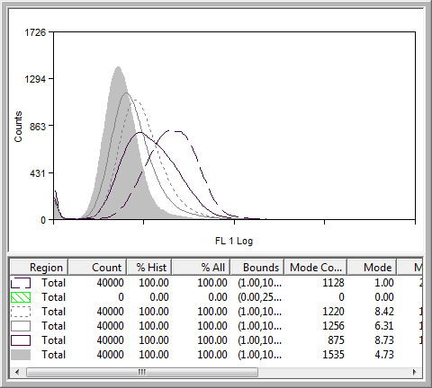
Supplementary Figure S5
C
HLA-A
HLA-B/C
D
P<0.0001
Isotype
Control siRNA
Control siRNA+ Cetuximab
SHP2 siRNA
P<0.0001
SHP2 siRNA+ Cetuximab
Fold Change (MFI)
7
9
11
Cell number
20
Control siRNA:
+
+
-
-
+
+
-
-
HLA-A2:MAGE-3 ₂₇₁₋₂₇₉ complex
Cetuximab:
-
+
-
+
-
+
-
+
-
-
-
-
+
SHP2 siRNA:
+
+
+

Slide 12
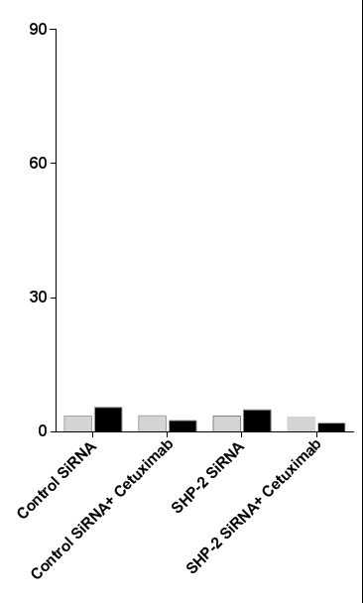
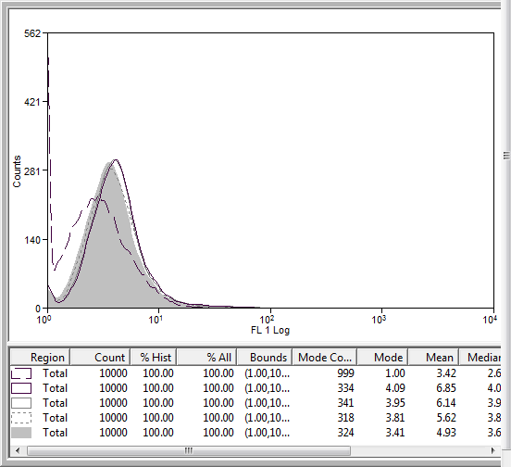
Supplementary Figure S5
E
Isotype binding
F
mAb 12b6 binding
Isotype
Control siRNA
Control siRNA+ Cetuximab
SHP2 siRNA
SHP2 siRNA+ Cetuximab
% positive cells
(HLA-A2:MAGE-3 ₂₇₁₋₂₇₉ complex)
Cell number
4
4
4
3
Control siRNA:
+
+
-
-
HLA-A2-MAGE-3 peptide
complex
Cetuximab:
-
+
-
+
SHP2 siRNA:
-
-
+
+

Slide 13
Supplementary figure legend
Supplementary figure S1
JHU-029 HNC cells were left untreated or were treated for 48h with the EGFR inhibitor mAb cetuximab (10 μg/ml). Levels of surface free HLA-A (HCA-2 Ab) or free HLA-B (HC-10 Ab) was determined by FACS (A). HNC cells were left untreated or were treated for 48h with the rhEGF (10 ng/ml), and inhibition in the levels of HLA-A, and HLA-B/C was determined by FACS (B). Parental 2FTGH (STAT1^{+/+}) and derivative U3A (STAT1^{-/-}) cells were treated with EGFR siRNA and EGFR expression level was determined with FACS (C). After EGFR knockdown, level of STAT1 was evaluated in parental 2FTGH (STAT1^{+/+}) and derivative U3A (STAT1^{-/-}) with FACS (D). In JHU-029 HNC cells were treated with the STAT1 inhibitor fludarabine (20 mM) and levels of STAT1 (left panel), and EGFR (right panel) were determined by FACS (E). Cetuximab induced STAT1 binding to the GAS element (gamma interferon activation site) of the TAP1 promoter was measured using a chromatin immunoprecipitation (ChIP) assay. JHU-029 cells were treated with cetuximab (10 μg/ml for 30 min), IFNγ (10 U/ml) and cetuximab plus IFNγ (10 μg/ml, 10 U/ml) and enhanced binding of p-STAT1(Tyr 701) at TAP1 promoter was determined by chip assay (F).
Supplementary figure S2
JHU-029 were treated (48h), with cetuximab (10 μg/ml), IFNγ (10 U/ml), cetuximab plus IFNγ (10 μg/ml, 10 U/ml) and transcript level of
SHP2 was analyzed with qPCR (A). (B) In JHU-029, levels of p-STAT1 (Tyr 701), total STAT1 was determined with immunoblotting after
treatment (48h), with cetuximab (10 μg/ml), IFNγ (10 U/ml), cetuximab plus IFNγ (10 μg/ml, 10U/ml), and STAT1 transcript level was
examined by qPCR under similar conditions (C). PCI-13 cells were treated with SHP2 siRNA or control siRNA (24h), afterward cells were treated with cetuximab (10 μg/ml, 48h) and levels of total STAT1 was determined with FACS (D). PCI-13 cells were treated with control siRNA, EGFR siRNA, control siRNA plus cetuximab, and EGFR siRNA plus cetuximab and the levels of EGFR (E), IFNγ receptor a chain (F), and were determined by FACS.
Supplementary figure S3
JHU-029 (A-B), and PCI-13(C-D), cells were treated with control siRNA, EGFR siRNA, control siRNA plus cetuximab, and EGFR siRNA plus cetuximab, and levels of EGFR (A and C), and HLA class I (B and D), were determined by FACS. (E) JHU-029 and PCI-13 were treated with EGFR siRNA plus cetuximab to acheive maximum EGFR inhibition and induction in the level of HLA-A and HLA-B/C was determined by FACS.

Slide 14
Supplementary figure S4
JHU-029 were treated (48h), with cetuximab (10 μg/ml), IFNγ (10 U/ml), cetuximab plus IFNγ (10 μg/ml, 10 U/ml) and transcript level of TAP1 (A), and LMP2 (B), were analyzed with qPCR.
Supplementary figure S5
Characterization of HLA-A2:MAGE-3 complex mAb: (A) T2 cells were incubated with MAGE-3₂₇₁₋₂₇₉ or EGFR _{853-861L-} peptides (37ºC, 0.01, 0.1, 1.0, 10.0 μg/ml, 4h), and stained with mAb12b6 or isotype IgG1 (10.0 μg/ml, 1h), followed by FITC-(Fab)². Differences in the binding-intensity of mAb 12b6 and isotype IgG1 was determined by FACS. Ratio of mAb 12b6 vs isotype IgG1 binding is shown . (B) T2 cells were incubated with EGFR₈₅₃₋₈₆₁ peptide (37ºC, 0.01, 0.1, 1.0, 10.0 μg/ml, 4h), and probed with mAb12b6 or W6/32 (10.0 μg/ml, 1h), followed by FITC-(Fab)². Differences in the binding intensity of mAb 12b6 (no binding) and mAb W6/32 (positive binding) was determined by FACS.(C) PCI-13 cells were treated with SHP2 siRNA or control siRNA. After 24 h cells were treated with cetuximab (10 μg/ml, 48h) and levels of HLA-A and HLA-B/C were evaluated by FACS. (D) Levels of HLA-A2:MAGE-3₂₇₁₋₂₇₉–peptide-complex (clone mAb 12b6) presentation were determined by FACS after treatment with control siRNA, control siRNA plus cetuximab (5μg/ml), SHP2 siRNA and SHP2 siRNA plus cetuximab (additional 48h) in MAGE-3₂₇₁₋₂₇₉ TA positive HLA-A2⁺- PCI-13, MFI values are shown in histogram. (E) In MAGE-3₂₇₁₋₂₇₉ TA positive HLA-A2⁻ JHU-029 cells, levels of HLA-A2:MAGE-3₂₇₁₋₂₇₉–peptide-complex (clone mAb 12b6) presentation were determined by FACS after treatment with control siRNA, control siRNA plus cetuximab (5 μg/ml), SHP-2 siRNA and SHP2 siRNA plus cetuximab (additional 48h), a representative histogram is also shown (F).

