Slide 1
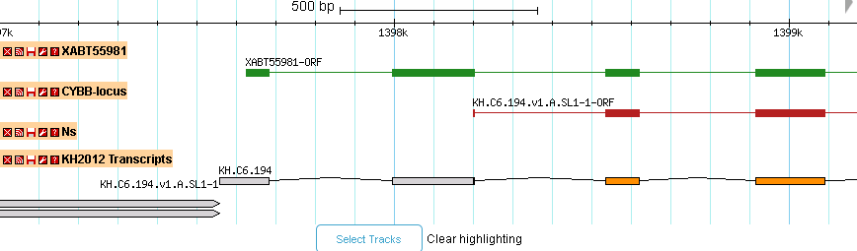
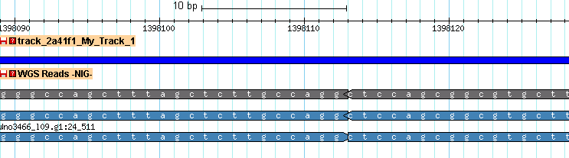
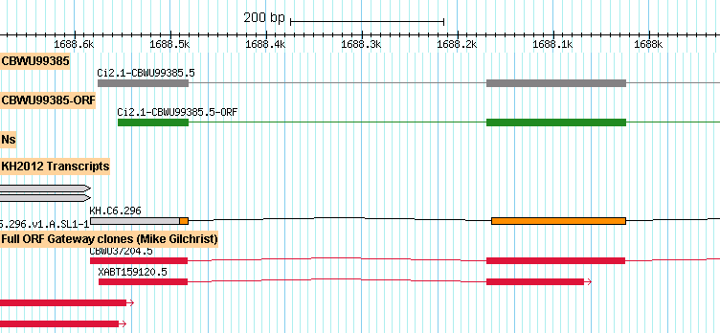
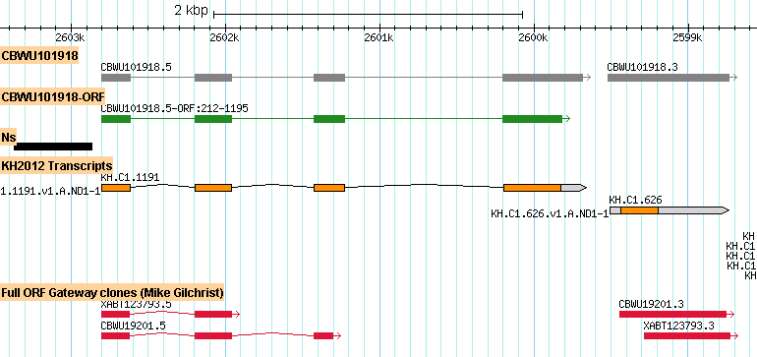
Supplementary
figure 1
A
Query 118 AAAAAGACATTTTTCTACACTCGTGTTTTACTTGGGCCAGCTTTAGCTCTTGCCAGGGCTCCAGCGGCGTGCTTGAACCTCAACTGCTTGCTTGTCTTACTACCAGTCTGTAGGAATCTG 237
||||||||||||||||||||||||||||||||||||||||||||||||||||||||| ||||||||||||||||||||||||||||||||||||||||||||||||||||||||||||||
Sbjct 1398056 AAAAAGACATTTTTCTACACTCGTGTTTTACTTGGGCCAGCTTTAGCTCTTGCCAGG-CTCCAGCGGCGTGCTTGAACCTCAACTGCTTGCTTGTCTTACTACCAGTCTGTAGGAATCTG 1398174
B
...GGTCGTTTACCATGGAGATTGCCgt... ...agCAAAGAGATGAAATATTTTA...
...GGTCGTTTACCATGGAGATTGCCgt... ...agATGAAATATTTTA...
C

