Slide 1
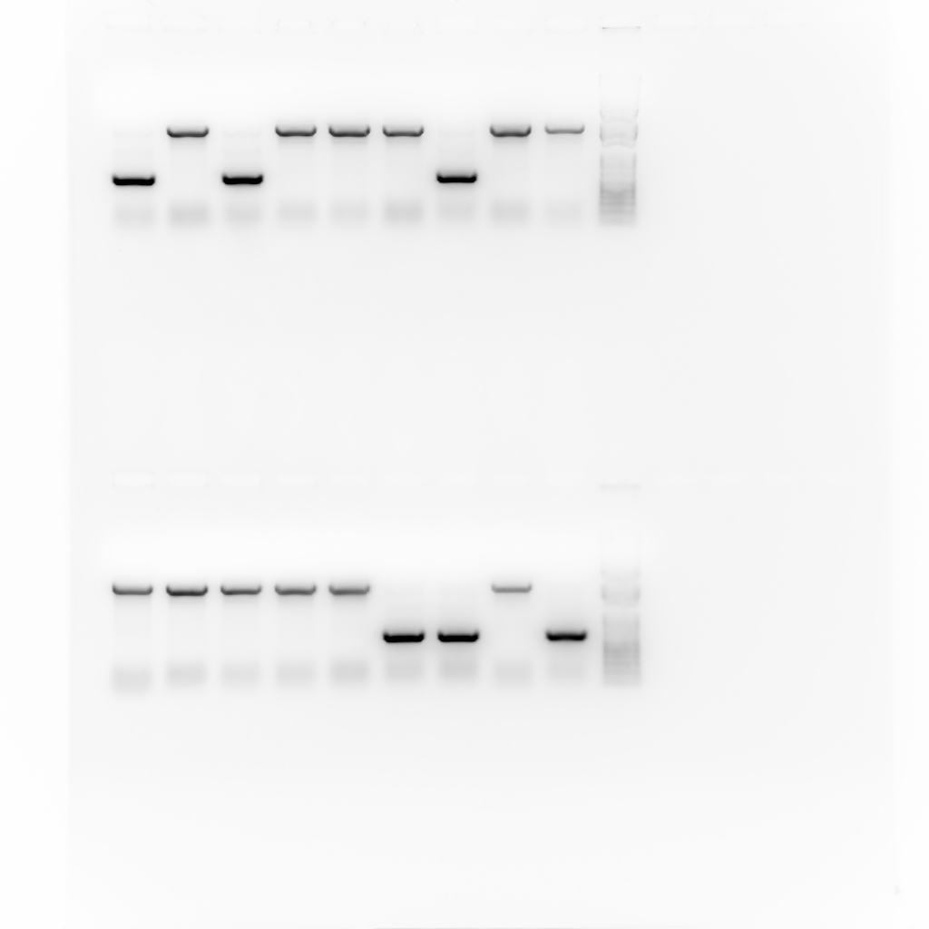
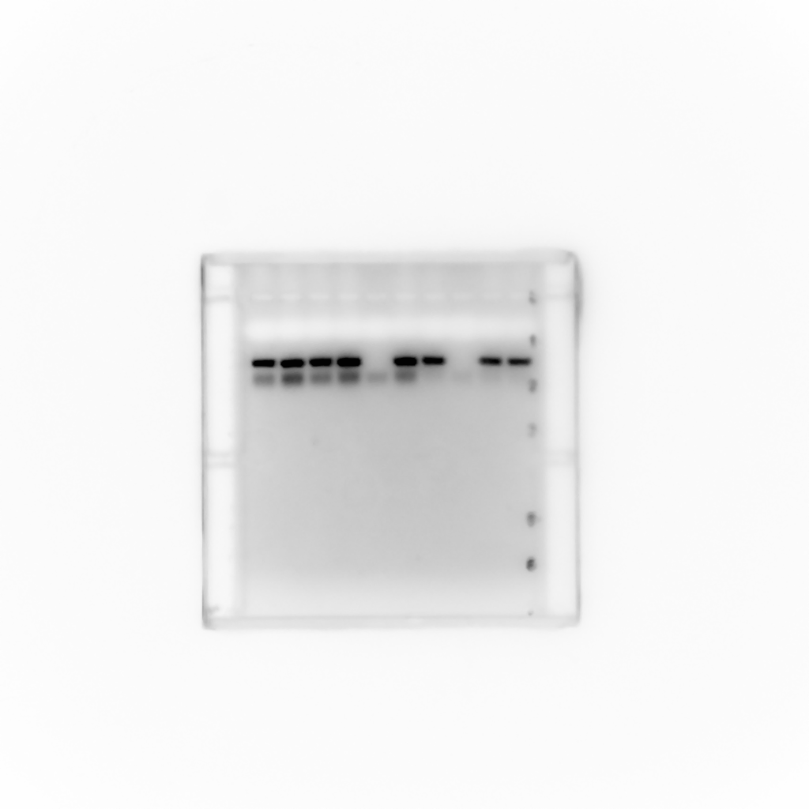
Figure S3. Identification for heterozygous and homozygous Thor mutants by progeny testing with PCR. Using the primer pair P1+P2, Thor mutants (both heterozygous and homozygous) can be identified by a PCR product at 700 bp, while an amplification of 400 bp product using primer pair P3+P4 suggests that one copy of 2nd chromosome is wildtype.
Heterozygous
Homozygous
y¹; Thor² cn¹ / cn¹; ry⁵⁰⁶
y¹; Thor² cn¹ / Thor² cn¹; ry⁵⁰⁶
P1+P2
2300bp
700bp
P3+P4
400bp

