Slide 1
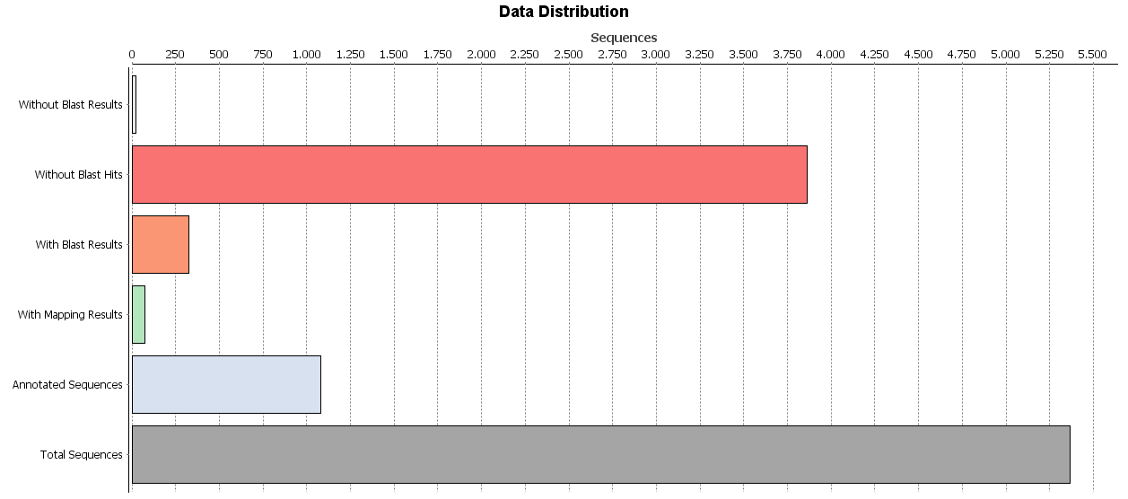
Suppl. Figure 1. Data distribution of the 5,368 unigenes of O. europaea trichomes.

