Slide 1
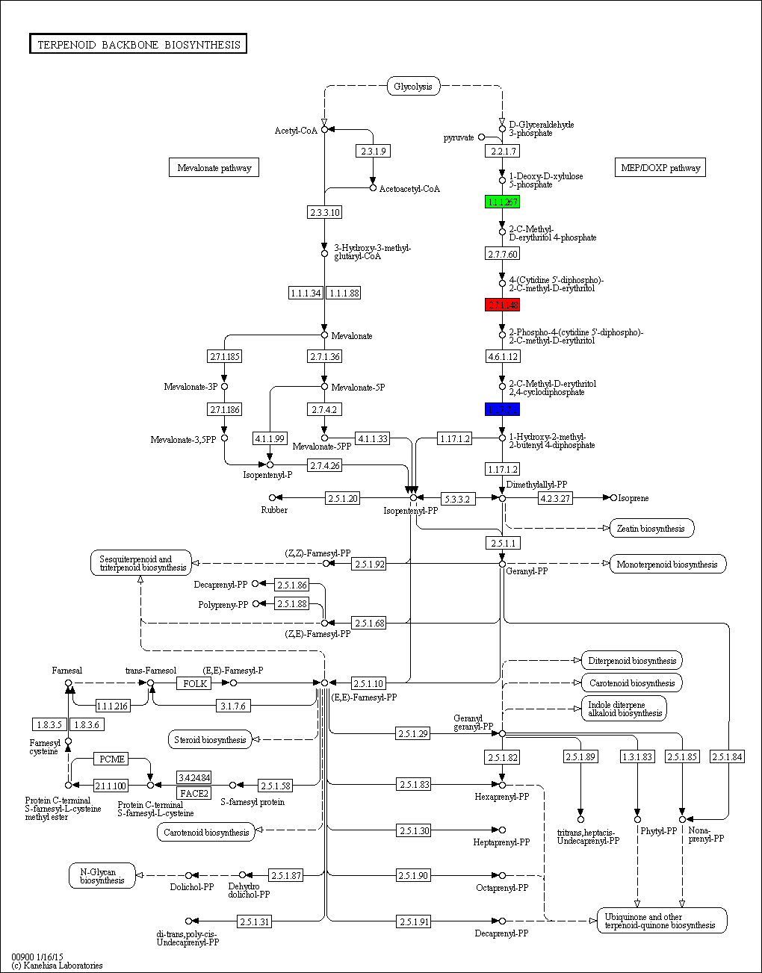
Suppl. Figure 5. Terpenoid backbone biosynthesis pathway as retrieved from KEGG database. The enzymes 1-deoxy-D-xylulose 5-phosphate reductoisomerase (E.C. number 1.1.1.267), 4-(cytidine 5'-diphospho)-2-C-methyl-D-erythritol kinase (E.C. number 2.7.1.148) and 4-hydroxy-3-methylbut-2-en-1-yl diphosphate synthase (E.C. number 1.17.7.1) are highlighted in green, red and blue respectively.

