Slide 1
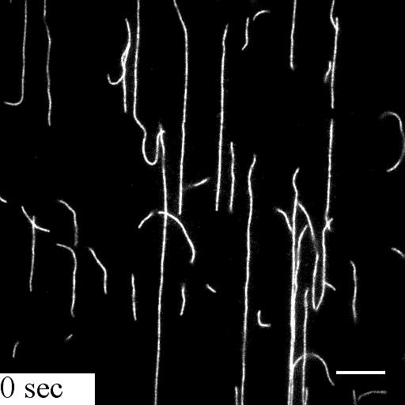
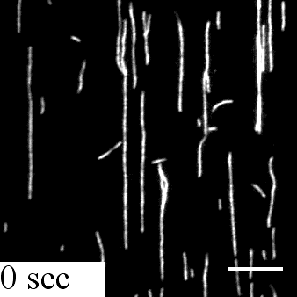
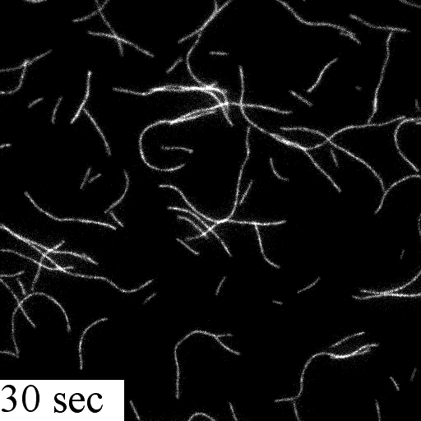
Supplementary Movies 1,2, and 3
Supplementary Movie 1
Supplementary Movie 2
Supplementary Movie 3
Actin+MVT
surface attached filaments
Actin+Cofilin
surface attached filaments
Actin+MVT
non-attached filaments

Slide 2
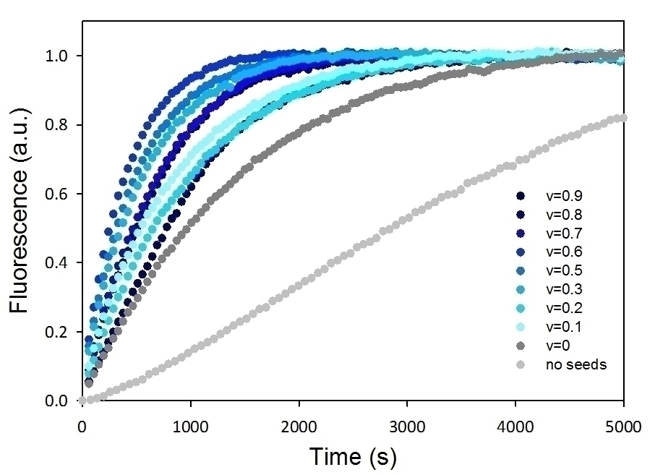
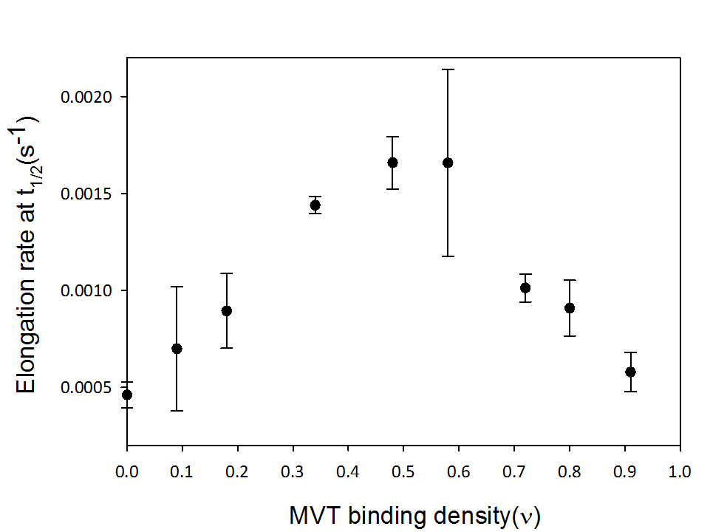
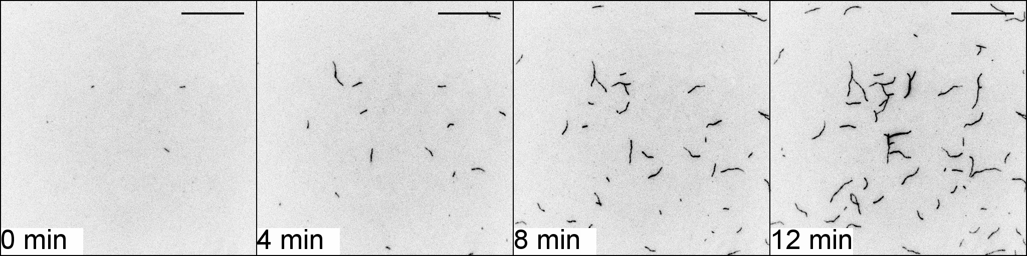
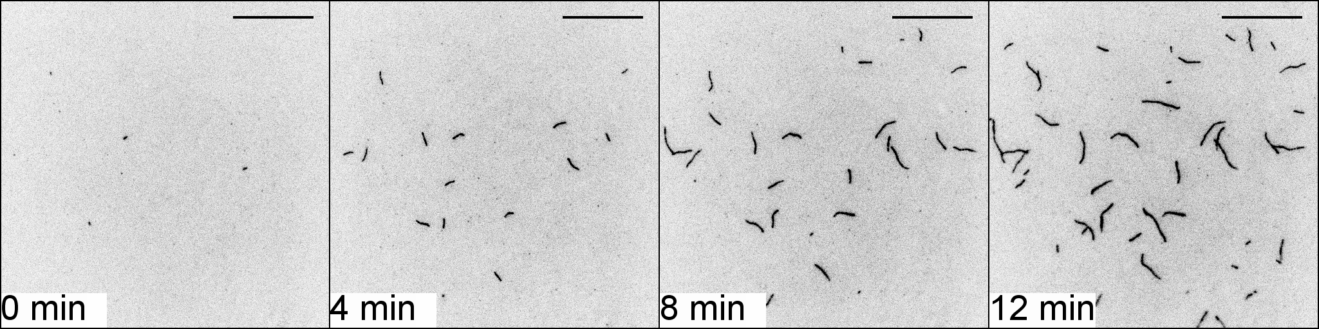
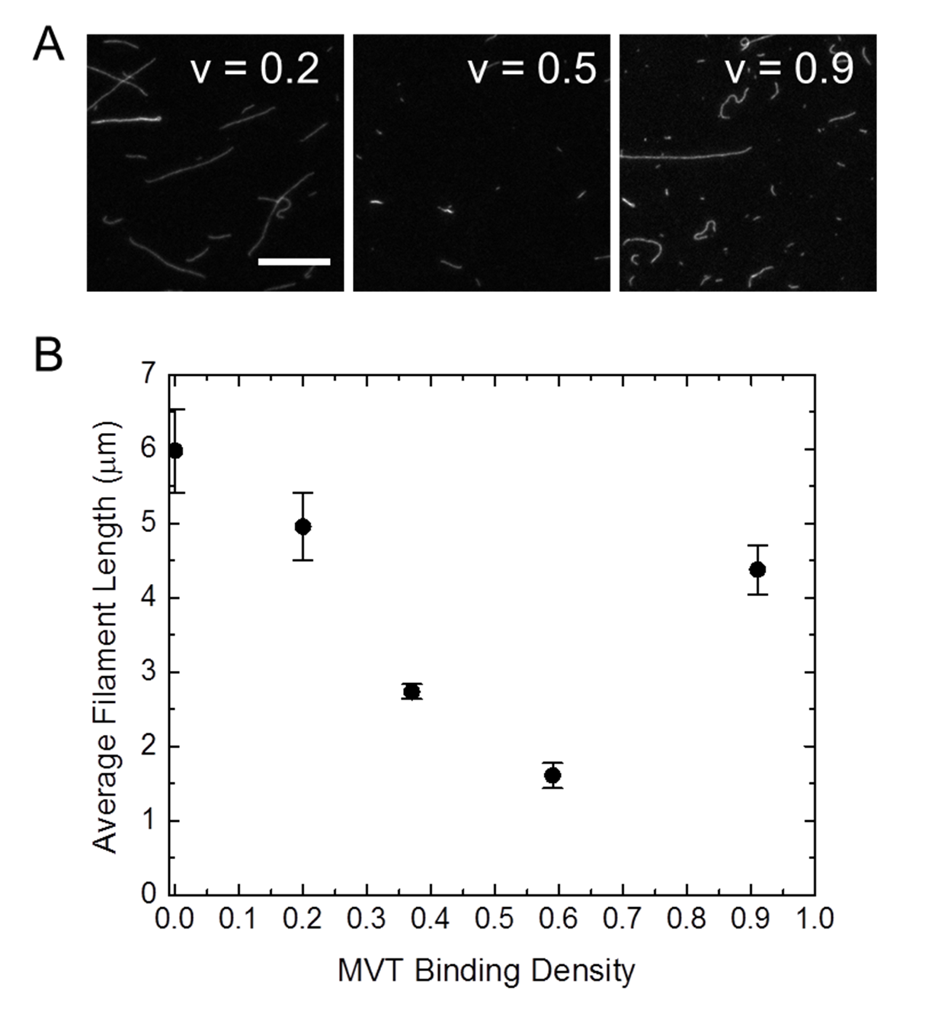
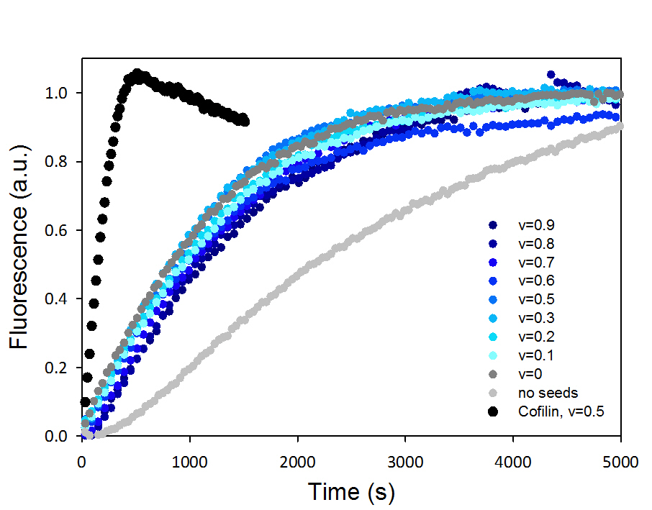
A
B
C
0.6 µM actin
D
+0.6 µM MVT
E
F
G
H
Cof
t_{1/2}=140s

Slide 3
Supplementary Figure 1. Seeded elongation assay reflects apparent severing by MVT. A) Seeds were created by incubating F-actin with increasing concentrations of MVT. (Binding densities of seed preparations are given in the legend.) Polymerization of 2 μM actin (5% pyrene labeled) mixed with 0.4 μM actin seeds. The polymerization curves are colored with increasing shades of blue to reflect increasing binding densities. B) Elongation rates at half-maximal polymerization determined from (A) as a function of the MVT binding density. The elongation rate reaches a maximum with binding density ~0.5-0.6. C-D) MVT does not effect nucleation or elongation of actin filaments. Direct observation of individual actin filament (0.6 µM, 10% Cy3b and 0.5% biotin labeled) elongation in the presence of 0.6 µM MVT by TIRF microscopy. (C) TIRF images are shown for 0, 4, 8, and 12 min, and (D) elongation rates from two different slides for each condition are plotted. Scale bar =10 µm. E and F) Representative fluorescence microscopy images of MVT bound filaments at different binding densities (E) and average filament length as a function of MVT binding density. MVT severing activity is maximal at ν~0.5 (1:1 molar ratio; [actin] = 2µM). G and H) Identical to the experiment and analysis shown in (A-B), except that monomeric actin (2 μM) was added to the actin seeds (0.4 μM) by gentle stirring instead of pipetting. Yeast cofilin (binding density = 0.5) was used as a positive control to demonstrate that the mixing was sufficient. These data support the idea that MVT does not sever but does destabilize filaments leaving them prone to fragmentation such as when pipetted (A).

Slide 4
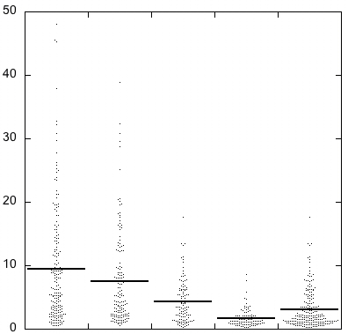
Filament length (µm)
F-actin
F-actin-MVT_{phalloidin}
F-actin-MVT_{intact}
F-actin-MVT_{shattered}
F-actin-MVT_{sum}
Supplementary Figure 2. MVT-decorated F-actin length distributions. F-actin and F-actin-MVT samples were prepared as described in Figure 3D-G. Individual filament lengths were analyzed using the J Filament plugin in Fiji as described in methods. Briefly, the length distribution of F-actin and F-actin-MVT samples diluted into buffers containing MVT or phalloidin (50 nM) were analyzed. F-actin-MVT diluted into MVT containing buffers had two populations which appeared either shattered or intact. The two groups were analyzed independently. The average filament lengths were as follows: F-actin (9.4+/-0.7, n=188), F-actin-MVT_{phalloidin}(7.5+/-0.6, n=152, F-actin-MVT_{intact}(4.3+/-0.3, n=110), F-actin-MVT_{shattered}(1.7+/-0.1, n=105) and F-actin-MVT_{sum}(3.1+/-0.2, n=215). Filaments with partial MVT decoration were observed to fragment during sample handling and spotting for fluorescent imaging. This fragmentation was greatly reduced when samples were diluted into phalloidin containing buffers suggesting that fragmentation occurs after sample incubation and during handling for microscopy.

Slide 5
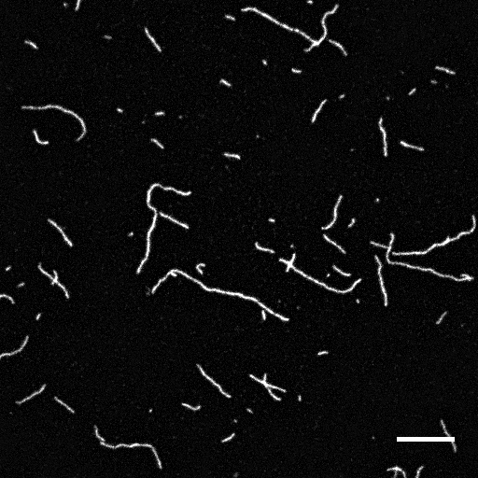
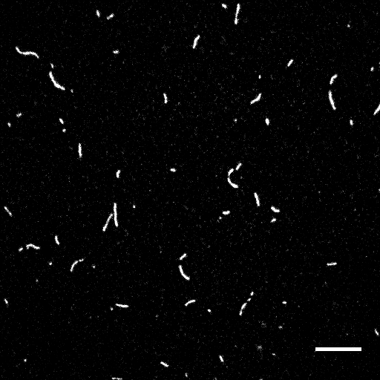

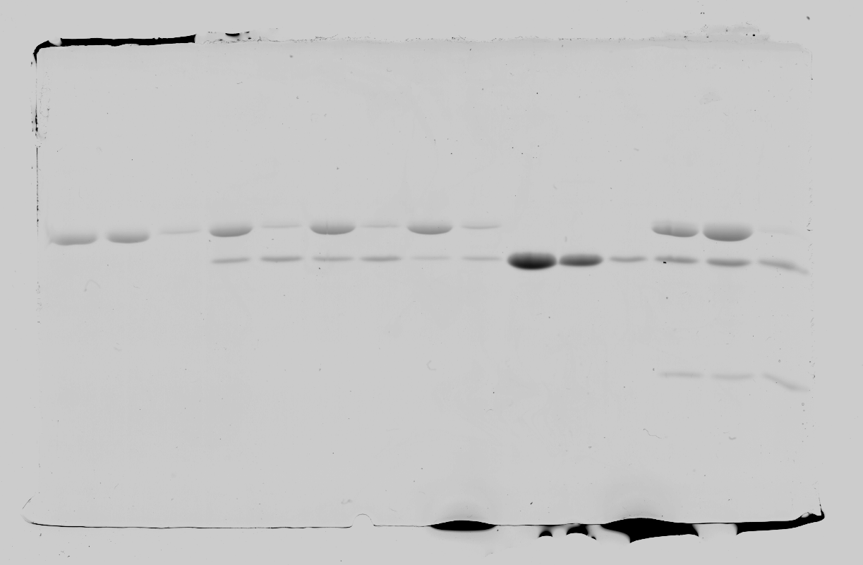
A
B
B’
C
C
Pel
Sup
Pel
Sup
C
D
Filament length (µm)
actin –
MVT –
F-actin
+ MVT (1:1)
H
F-actin
F-actin
+ MVT
Supplementary Figure 3. Partial decoration of yeast F-actin with MVT leads to filament fragmentation in a manner similar to alpha skeletal actin. A-C) Yeast F-actin (2 µM, 20% Cy3b-labeled) was incubated for 2 hours with equimolar MVT (binding density = 0.5) or MVT storage buffer. Actin samples were diluted to 5 nM in F-buffer supplemented with 100 mM BME containing 1 µM MVT in order to maintain a binding density of ~0.5. The diluted solutions were spotted onto a glass slide and a poly-L-lysine coated coverslip was placed on top. Scale bars are on the lower right corner and correspond to 10 µm in A and B. The scale bar in B’ correspond to 5 µm. Representative images are shown for control (A) and MVT decorated actin filaments (B and B’). C) Yeast F-actin (2 µM, 20% Cy3b-labeled) was incubated alone or with 2 µM MVT for 2 hours as in (A). Samples were centrifuged at 300,000g for 30 minutes. The resulting supernatant and pellet fractions were analyzed by SDS-PAGE to determine the amount of MVT bound to F-actin. Under the conditions used for the fragmentation assay, v~0.5. D) Individual filament lengths were analyzed using the J Filament plugin in Fiji as described in methods. The average filament lengths were as follows: F-actin (4.3+/-0.5, n=107), F-actin-MVT (2.1+/-0.2, n=204). Fluorescent images showed fragmentation in MVT decorated yeast F-actin at partial binding density similar to that observed for alpha skeletal muscle actin (Figure 3).

Slide 6
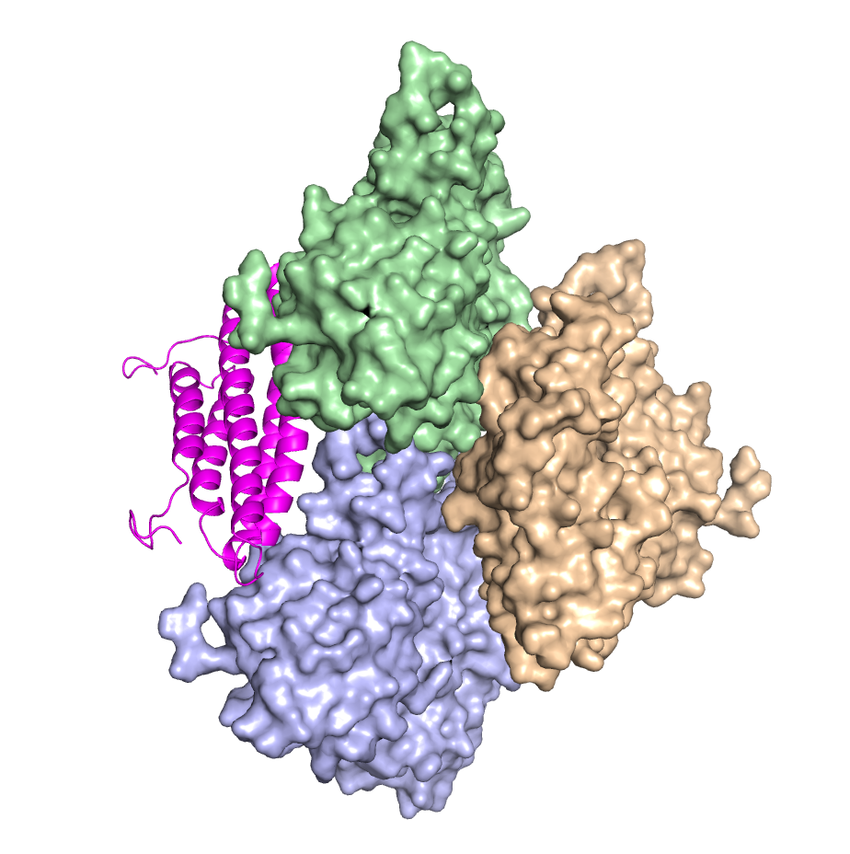
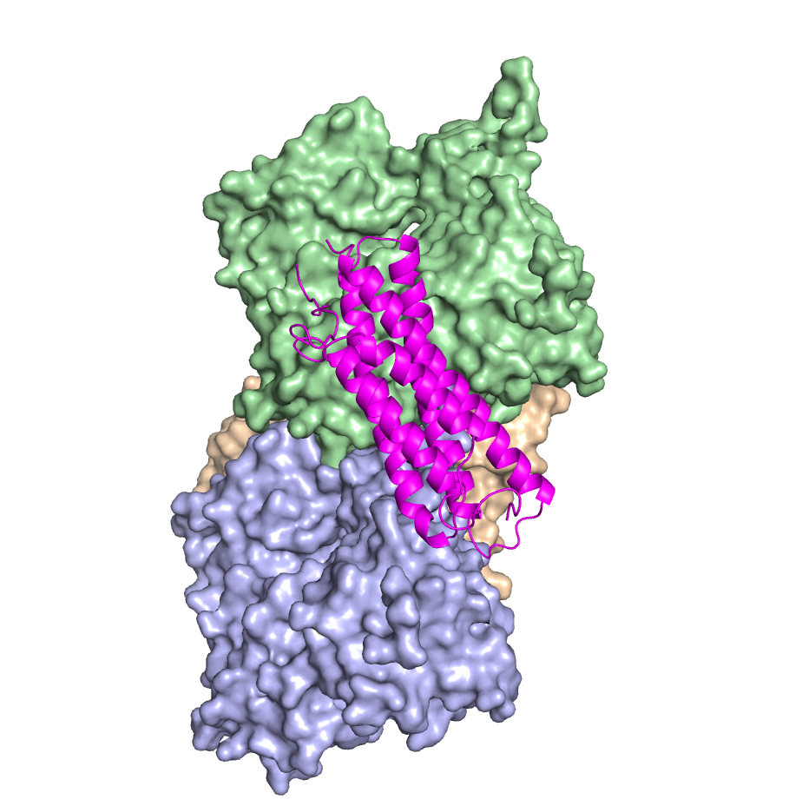
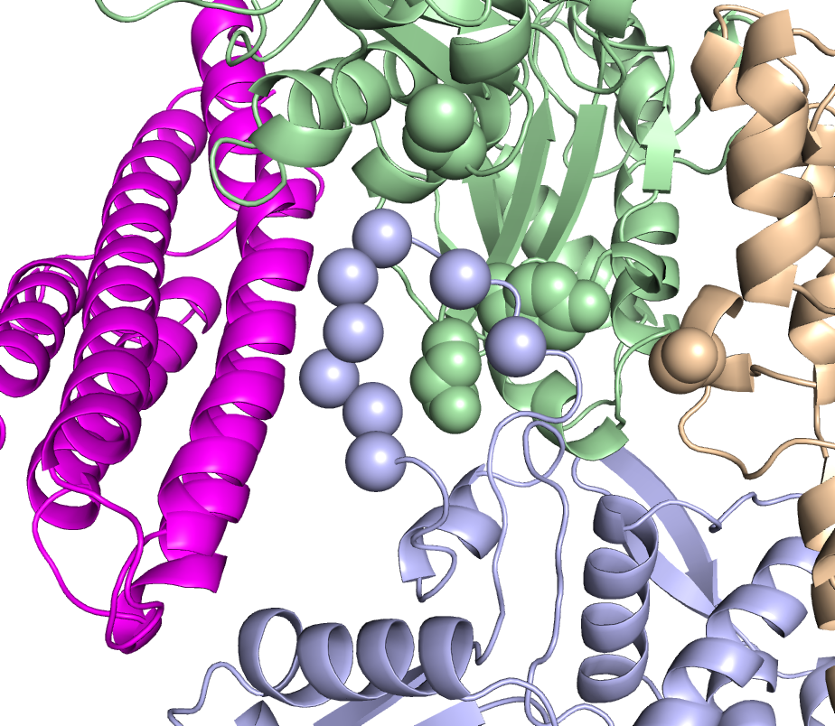
A
90 °
B
Supplementary Figure 4. MVT is predicted to bind near the D-loop and W-loop of actin. A) A three subunit model of the actin filament in complex with VT 37. Modeling of MVT into cryoEM structures predicts that it will bind in a manner similar to VT (unpublished data). B) Zoom in of the predicted VT-actin interface and spheres indicating the probe locations described in Figure 5.

Slide 7
Supplementary Figure 5. MVT reduces the number of filaments in VT induced bundles. Networks shown in Figure 7 were analyzed by measuring fluorescent intensity as line scans of individual bundles for samples with equimolar VT/MVT (n=183 bundles) and VT alone (n=160 bundles). The number of filaments in a given bundle was estimated by dividing the intensity by the maximum intensity of individual filaments decorated with MVT under the same conditions. The average number of filaments in VT bundles is 5 and decreases to 3 when equimolar MVT is present. The maximum number of filaments decreases from 11 to 6. (Box-and-Whisker plot indicates the upper and lower 25th percentile and median of all values and the error bars indicate 10th and 90th percentile.)

Slide 8
1X VT
0.5X VT
0.25X VT
No VT or MVT
0.75X VT and
0.25X MVT
0.5X VT and
0.5X MVT
0.25X VT and
0.75X MVT
1X MVT
Supplementary Figure 6. MVT attenuates VT induced yeast F-actin bundle networks. Monomeric actin (1.3 μM = 1X, 15% Cy3b) and MVT and/or VT were mixed at the indicated molar ratios with polymerizing TIRF F-buffer (pH 7.0) and added to the sample chamber. The resulting actin network was visualized in real time or at steady state in flow chambers functionalized with biotin-HMM. Images shown were taken after at least 30 minutes of incubation at 24 ˚C. Scale bars correspond to 10 µm. MVT alone was observed to induce an actin mesh while it reduced the formation of coarse bundles by VT when present at equimolar ratios (0.5X VT and 0.5X MVT).

Slide 9
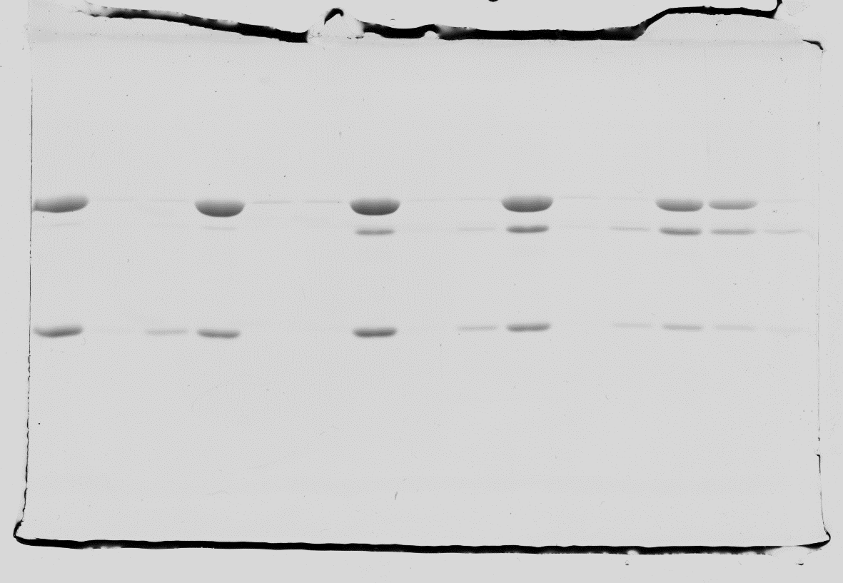
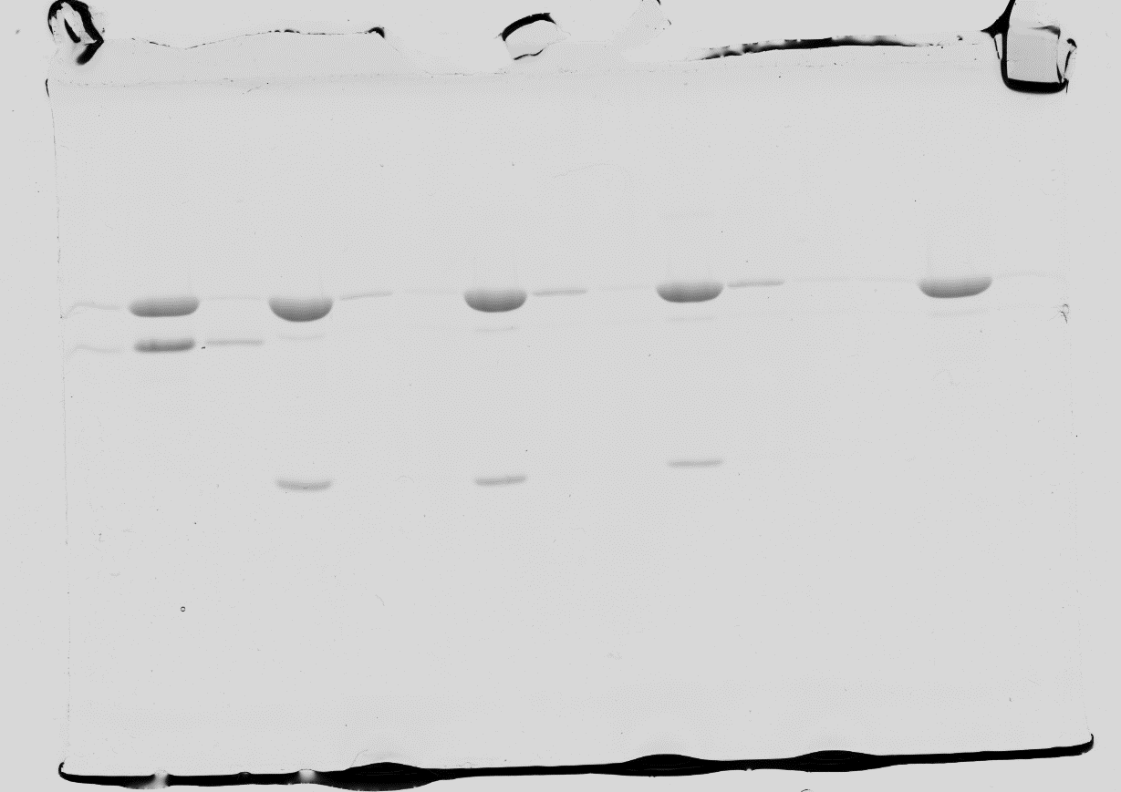
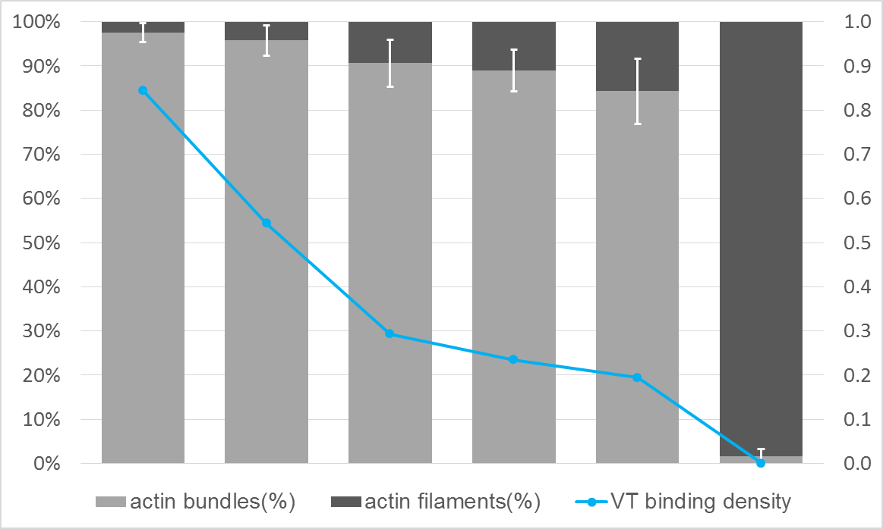
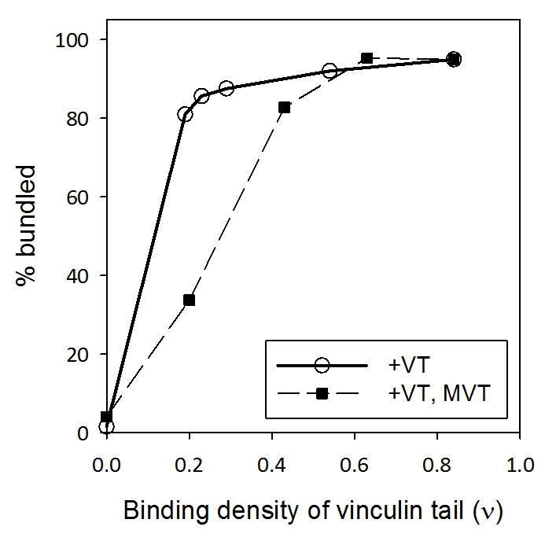
A
LP HP HS
LP HP HS
LP HP HS
LP HP HS
LP HP HS
LP HP HS
Actin—
VT—
Actin | 5 | 5 | 5 | 5 | 5 | 5 | uM
VT | 6 | 3 | 1.5 | 1.2 | 1.0 | - | uM
B
F-actin distribution
Binding density (ν)
C

Slide 10
Supplementary Figure 7. VT induces actin bundles over a wide range of binding densities and MVT inhibits this activity. F-actin and vinculins were mixed at the indicated amounts and incubated for 1 hour at 24 ˚C. Samples were subjected to differential centrifugation as described for Figure 8. A) Actin bundles (LP, low speed pellet), filaments (HP, high speed pellet) and the high speed supernatant (HS) fractions were analyzed by SDS-PAGE and B) subjected to densitometry analysis to determine the percentage of actin filaments in bundles and the binding densities of VT on F-actin (sum of LP+HP). C) Occupation of remaining vinculin tail sites on the filaments by MVT results in a greater loss of bundling that would be predicted by simple competition for binding sites. For example, VT (v~0.2) alone can bundle 80-90% of filaments while the addition of MVT (v~0.6) to this sample reduces this to ~30% bundles (C).

Slide 11
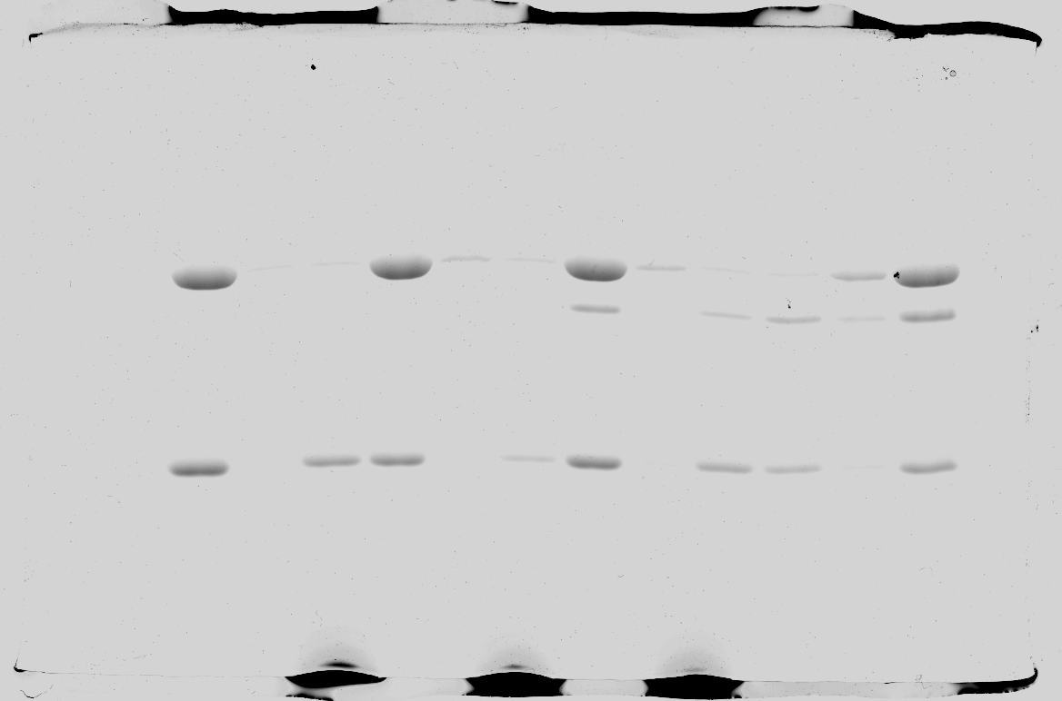
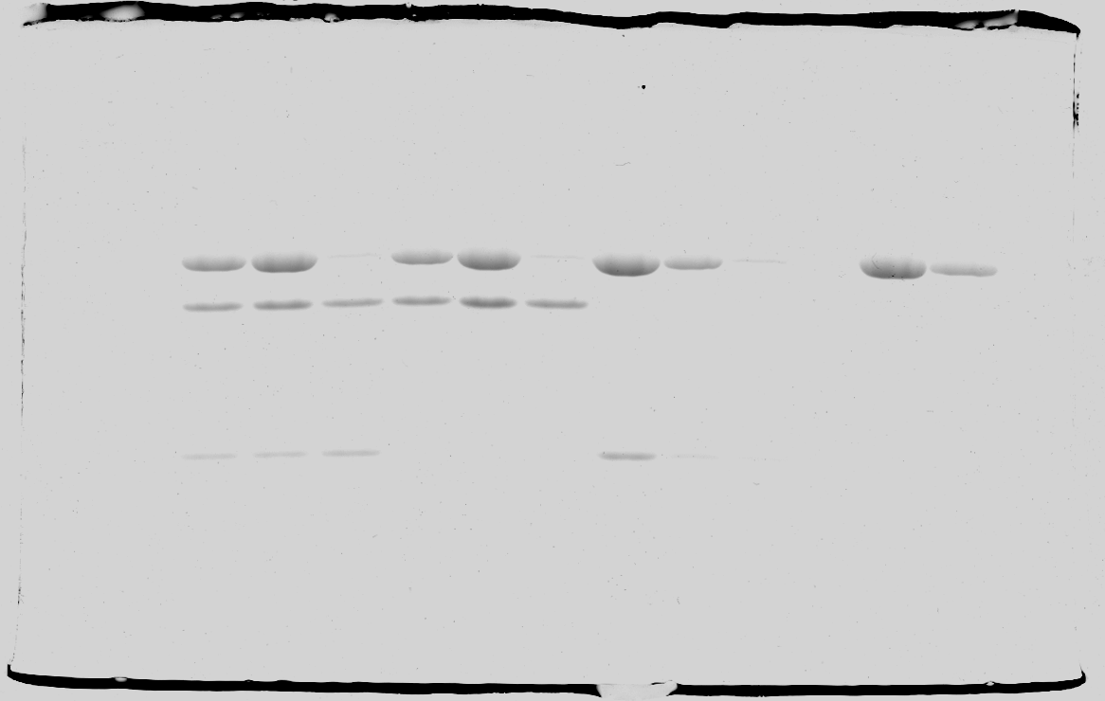
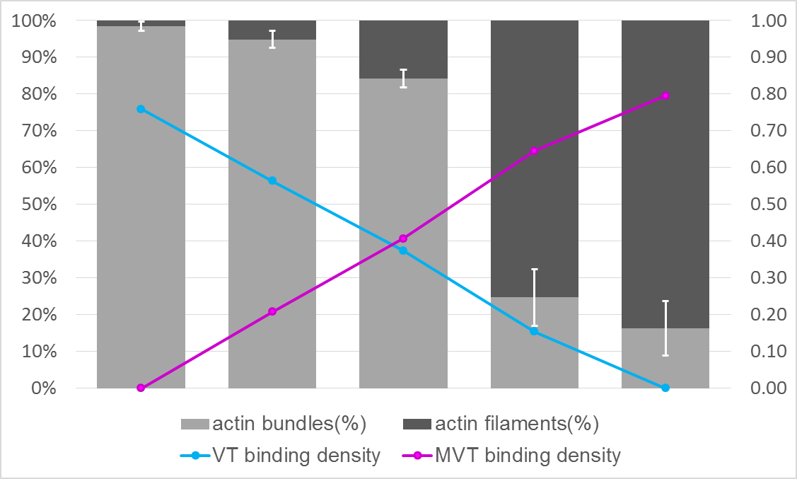
A
LP HP HS
LP HP HS
LP HP HS
LP HP HS
LP HP HS
Actin—
—MVT
VT—
Actin | 5 | 5 | 5 | 5 | 5 | uM
MVT | - | 1.5 | 3 | 4.5 | 6 | uM
VT | 6 | 4.5 | 3 | 1.5 | - | uM
B
F-actin distribution
Binding density (ν)
Supplementary Figure 8. MVT reduces VT’s bundling activity on yeast F-actin. Yeast F-actin (5µM) and vinculins were mixed at the indicated molar ratios and incubated for 1 hour at 24 ˚C. Samples were subjected to differential centrifugation to separate fractions with actin bundles (LP, low speed pellet) or filaments (HP, high speed pellet) as in Figure 8. Unbound vinculins were in the high speed supernatant fraction (HS). A) Fractions were analyzed by SDS-PAGE and B) subjected to densitometry analysis to determine the percentage of actin filaments in bundles and the binding densities of VT and MVT on F-actin (sum of LP+HP). MVT was found to compete with VT and decrease its bundling activity as also observed using alpha skeletal actin (Figure 8).

