Slide 1
Figure S1: Diagram of alleles
A) R26-LsL-SB11
Rosa26 locus
LoxP
Stop/GFP
LoxP
SB11 transposase
pA
B) Spc-Cre
Spc promoter
Cre Recombinase
C) T2/Onc
<<IR/DR
SA
MSCV 5’ LTR
SD
Bi-pA
SA
IR/DR>>
D) p19^{ARF-/-}
X
Exon 1a
Exon 1b
Exon 2
E) p53^{floxed-R270H}
R > H (270)
V
Exon 1
LoxP
Stop
LoxP
Exon 2
Exon 8
F) Pten^{LoxP/LoxP}
Exon 3
LoxP
Exon 4
Exon 5
LoxP
Exon 6
Figure S1: Vectors used to create transgenic and knock-in mice. A) Loxp-GFP/Stop-Loxp SB11 cDNA knocked into the Rosa26 locus. B) Cre Recombinase gene driven by the Surfactant Protein C promoter. C) Oncogenic SB Transposon (T2/Onc). D) Cdkn2a locus showing loss of exon1b, required for Alternative Reading Frame (ARF) expression. E) Trp53 locus showing placement of lox-stop-lox cassette and point mutation in exon 8. F) Pten locus showing placement of LoxP sites surrounding exons 4 and 5. IR/DR = Inverted repeats/Direct Repeats required for SB transposition, SA = Splice acceptors, Bi-pA = bidirectional polyA signal, MSCV 5’ LTR = Murine Stem Cell Virus 5’ Long Terminal Repeat, SD = splice donor. Figures are not drawn to scale.

Slide 2
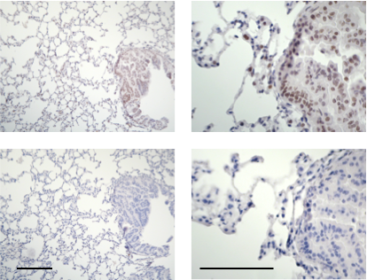
Figure S2: SB expression in lung
SB
No 1º
Figure S2: SB protein expression in lung tissue. IHC for SB in lung tissue of mice harboring the SPC-Cre and Rosa-LsL-SB11 alleles. Top panels showing IHC for SB, bottom panels showing staining with only the secondary antibody. Left panels at 40x bar = 200 µm, right panels at 10x bar = 100 µm.

Slide 3
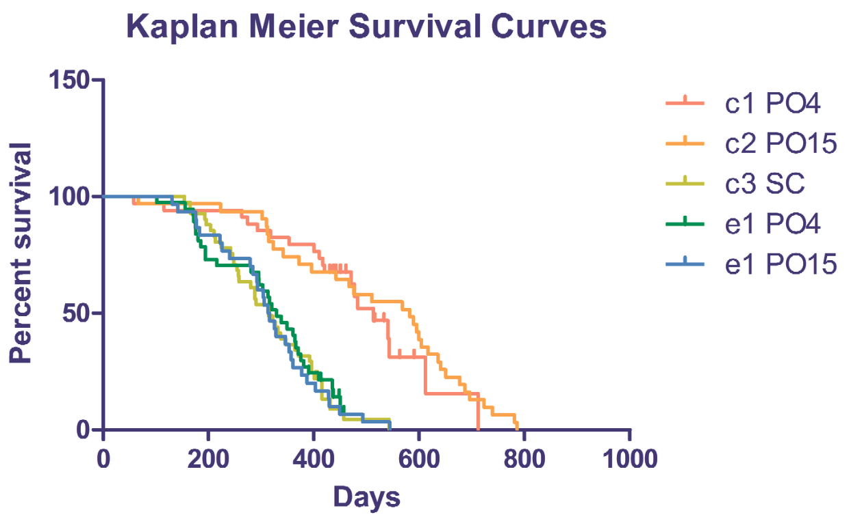
Figure S3: Kaplan Meier all five groups
Figure S3: Kaplan Meier Survival curves for all five genotypes. C1 and C2 = control groups with wild-type Pten (no Spc-Cre) and no SB mutagenesis. C3 = control group with loss of Pten in lungs (Spc-Cre) and no SB mutagenesis. E1 and E2 = experimental groups with both loss of Pten and SB mutagenesis. PO4 = T2/Onc(4), and PO15 = T2/Onc(15).

Slide 4
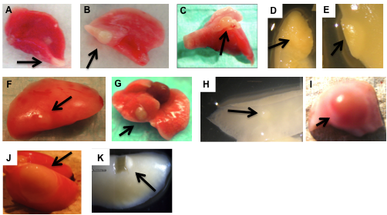
Figure S4: Necropsy Images
Figure S4: Images of lung masses at necropsy (A-J) and after fixation and removal of a portion for molecular analysis (K).

Slide 5
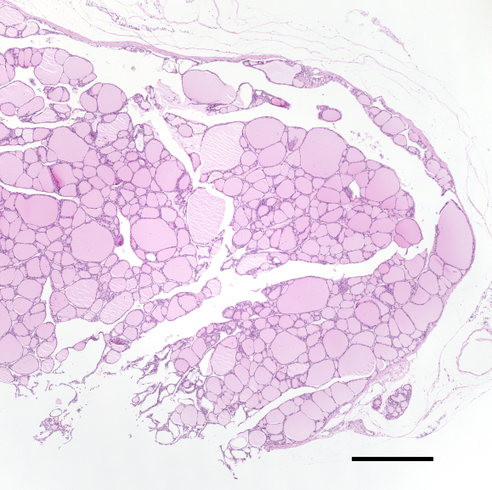
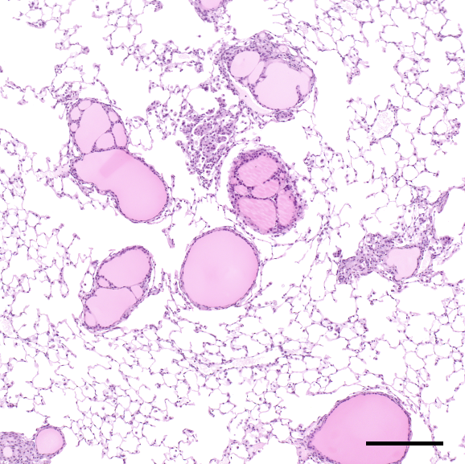
Figure S5: Thyroid AdCa and Mets
A
B
Figure S5: Mouse Photomicrographs of a primary thyroid adenocarcinoma (Panel A) with multiple metastatic lesions in the lung (Panel B). H&E stain. Bar sizes in panels A and B are 500 and 200 microns, respectively.

Slide 6
Figure S6: Transposon insertions in Cul3
Cul3
Figure S6: Location and orientation of transposon insertions in Cul3 from multiple lung tumors. Twelve insertion regions from six independent mice mapped to Cul3 genomic locus. Exons are marked by boxes. Transposon insertion regions and orientation are marked by arrowheads. Cul3 direction of transcription is indicated by arrow.

Slide 7
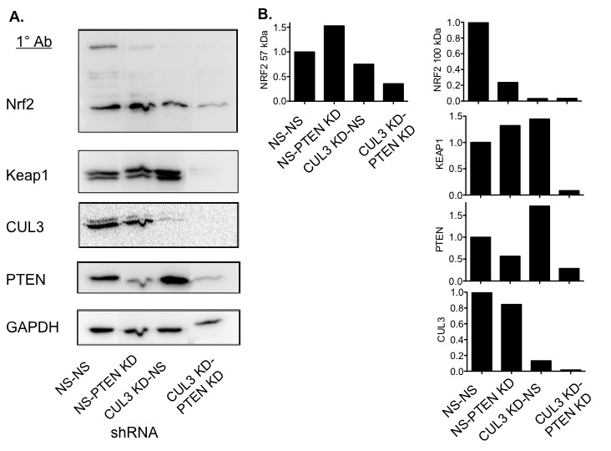
Figure S7: CUL3 and PTEN Protein levels in knockdown and control A549 and H2030 cell lines
Figure S7: CUL3 and PTEN knockdown in A549 cells. A) Western blot of A549 cells treated with shRNA’s that are Non-siliencing (NS), or target PTEN, CUL3, or both PTEN and CUL3. The PTEN plasmid has hygromycin selection and the CUL3 proviral DNA has puromycin selection. Blots were probed and stripped with the following primary antibodies Nrf2, Keap1, CUL3, PTEN, and GAPDH. B) Quantification of western blots indicates that PTEN and Keap1 levels increase when CUL3 is knocked down in A549 cells. However, Keap1 levels decrease when both PTEN and CUL3 are knocked down. The ubiquitinated, 100 kDa version of Nrf2 is reduced when PTEN and/or CUL3 are knocked down.

