Slide 1
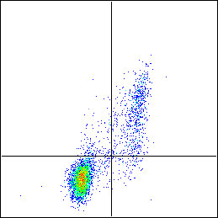
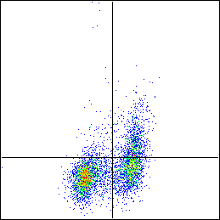
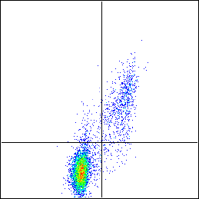
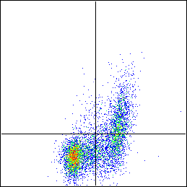
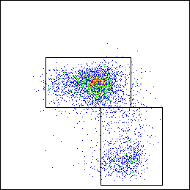
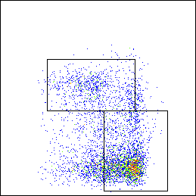
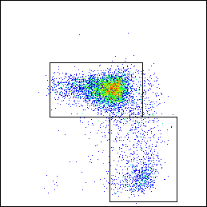
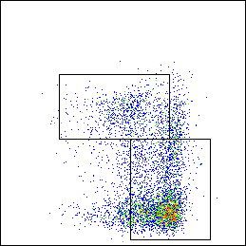
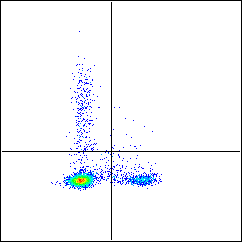
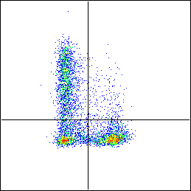
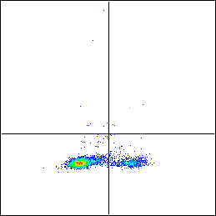
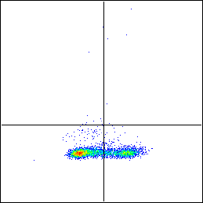
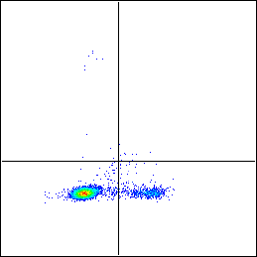
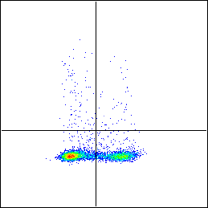
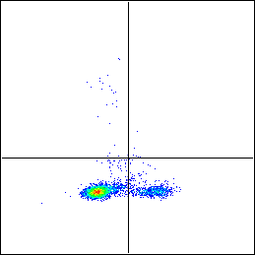
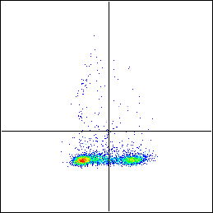
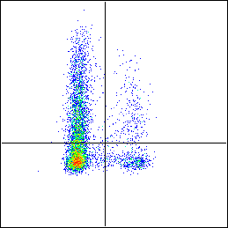
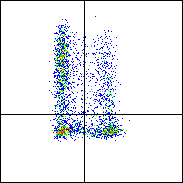
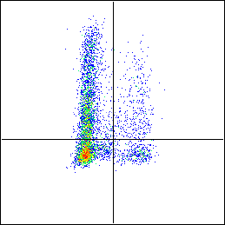
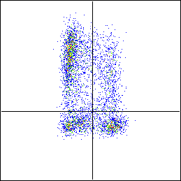
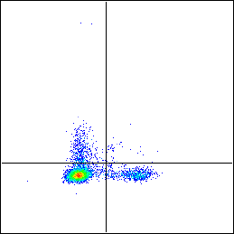
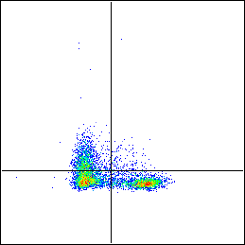
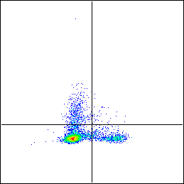
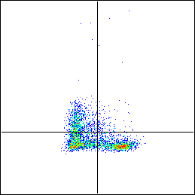
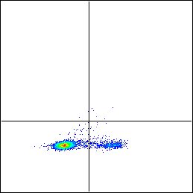
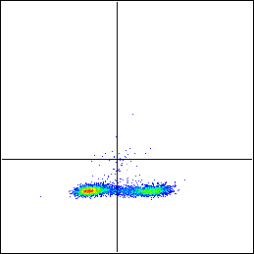
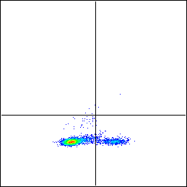
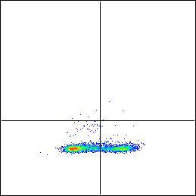
A
WT
HBZ-Tg
IFN-γ KO
HBZ-Tg/IFN-γ KO
2.88
15.4
3.04
16.9
2.13
12.3
1.68
21
CD25
79.8
1.88
50.2
29.9
84.1
1.39
54
23.2
Foxp3
74.5
18.6
81.6
16.8
CD62L
20.7
57.8
14.3
65.3
CD44
B
WT
HBZ-Tg
IFN-γ KO
HBZ-Tg/IFN-γ KO
6.18
0.35
36.9
3.92
0.18
0.082
0.14
0.1
IFN-γ
81.6
11.9
26.4
32.7
84.7
15.1
65.1
34.7
0.2
0.12
1.54
0.8
0.48
0.081
1.73
0.67
IL-17
87.9
11.8
62.3
35.4
84.7
14.7
61.9
35.7
39.1
4.49
43.4
16.2
46
7.28
46.7
17.8
TNF-α
48.5
7.95
20.3
20.2
39.2
7.49
18
17.5
7.22
0.62
20.7
1.97
8.98
0.75
21.2
2.73
IL-2
80.2
12
40.5
36.9
75.1
15.1
39.4
36.7
0.036
0.089
0.13
0.19
0.083
0.062
0.086
0.043
IL-4
88.7
11.2
61.5
38.2
85.9
13.9
64.2
35.7
Foxp3

