Slide 1
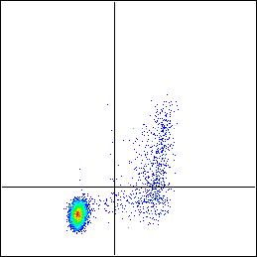
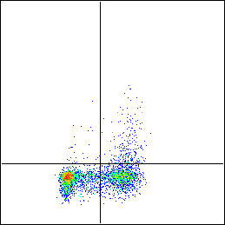
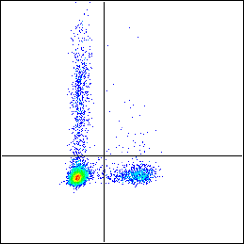
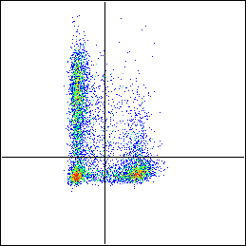
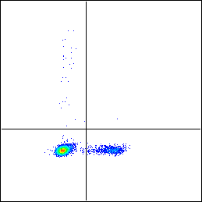
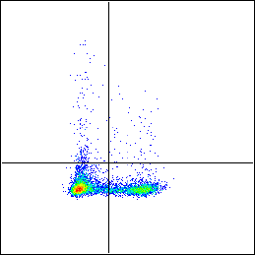
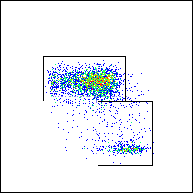
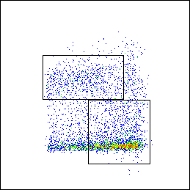
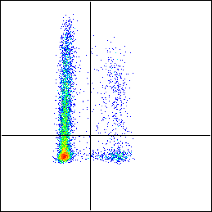
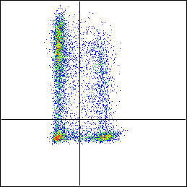
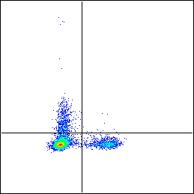
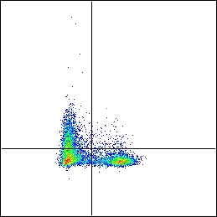
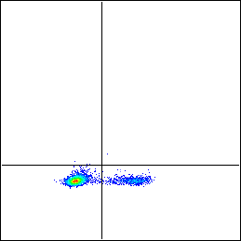
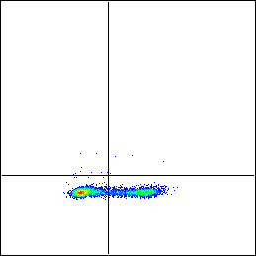
A
B
SPF WT
SPF HBZ-Tg
SPF WT
SPF HBZ-Tg
0.14
7.19
0.69
5.79
9.72
0.66
42.3
8.79
CD25
IFN-γ
12.5
21.9
87.8
4.92
53.5
40
77.1
27.1
Foxp3
0.49
0.016
2.59
1.01
79.4
17.4
IL-17
11.3
15.9
57.8
88.2
63.2
33.2
CD62L
42.9
5.21
47.7
17.5
CD44
CD4⁺
SPF WT
SPF HBZ-Tg
Foxp3⁺ (%)
11.0 ± 1.4
39.4 ± 6.0
TNF-α
T_{N} (%)
79.2 ± 2.1
17.3 ± 7.0
44.9
6.94
17.4
17.3
T_{EM} (%)
16.3 ± 2.2
62.9 ± 7.7
7.7
0.11
22.5
1.9
IL-2
79.6
12.6
41.6
34
0.016
0.016
0.12
0.059
IL-4
87.6
12.4
65.8
34.2
Foxp3
CD4⁺Foxp3⁻
SPF WT
SPF HBZ-Tg
IFN-γ (%)
9.2 ± 0.6
38.6 ± 3.3
IL-17 (%)
0.8 ± 0.3
3.2 ± 1.3
TNF-α (%)
46.0 ± 4.8
44.7 ± 2.9
IL-2 (%)
8.5 ± 0.7
28.6 ± 6.7
IL-4 (%)
0.1 ± 0.1
0.4 ± 0.4
S3 Fig

