Slide 1

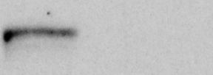


Supplementary Fig. S1
A
B
IP
Input pre-bleed And-1
Gl2 Clapsin
siRNA
Claspin
Claspin
And-1
And-1
47

