Slide 1
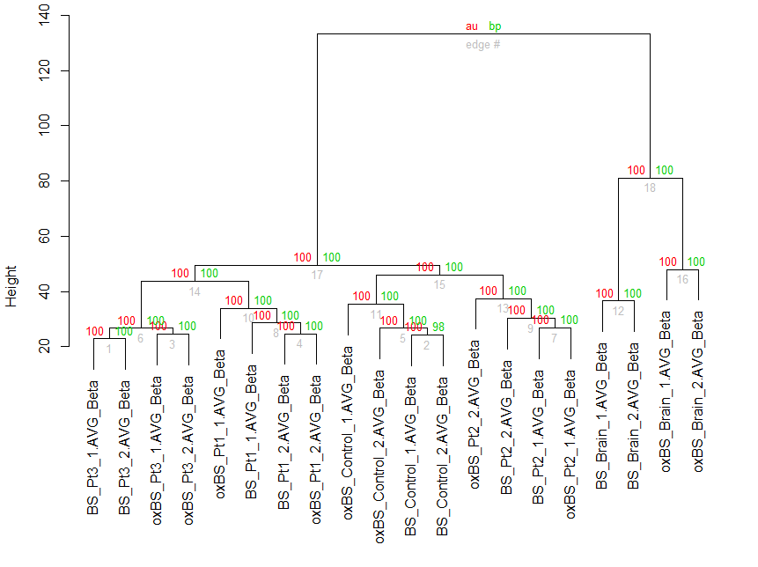
Figure S3. Hierarchical clustering analysis for BS/oxBS-array
Unsupervised hierarchical clustering of all samples shows clear separation between tissue types (brain and blood). Meanwhile, less apparent separation between BS and oxBS conversion in Pt1 and Pt2 indicates a small amount of 5hmC in the blood samples. ‘‘au’’ figures, in red, refer to approximate unbiased p-values (%); ‘‘bp’’ numbers, in green, refer to bootstrap p-values (%).

