Slide 1
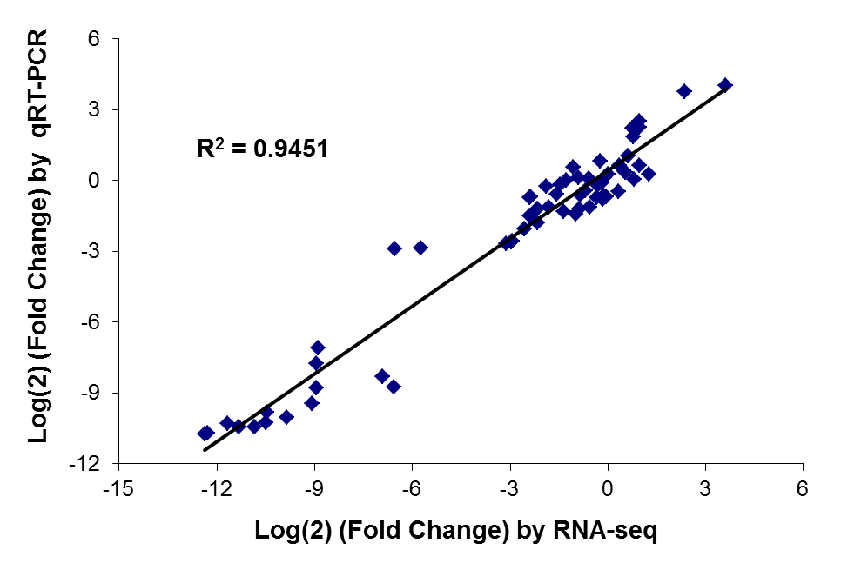
Figure S3: Scatter plot of relative levels of transcript expression as measured by RNA-seq and qRT-PCR. Relative levels of transcript expression are presented as log2 (fold-change). Both RNA-seq and qRT-PCR data were analyzed based on three biological replicates. Pearson coefficient correlation analysis between data from RNA-seq and qRT-PCR shows R² = 0.94 (p-value < 0.00001).

