Slide 1
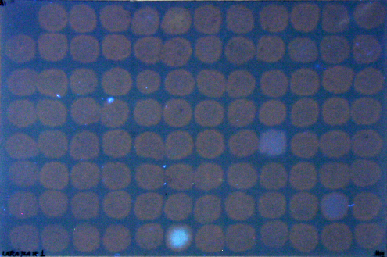
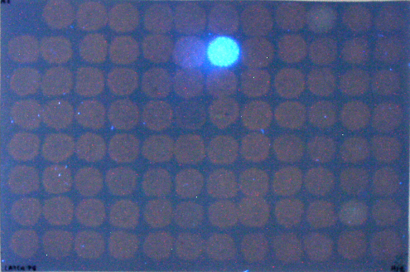
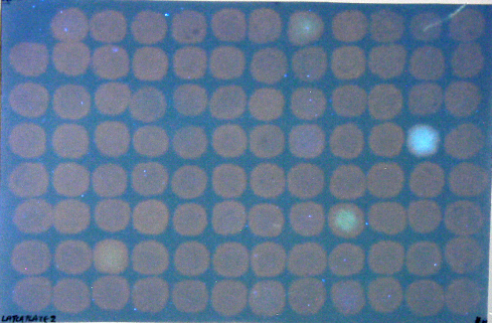
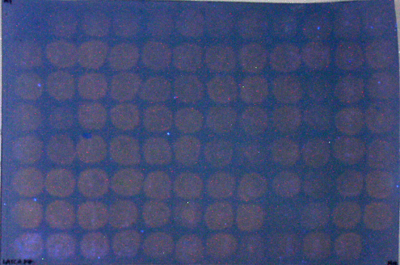
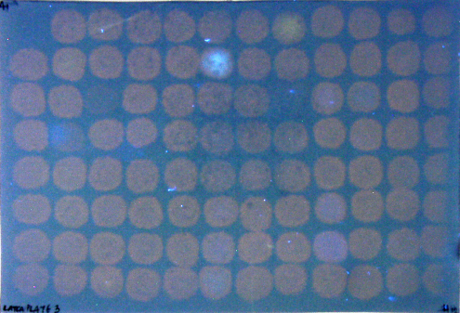
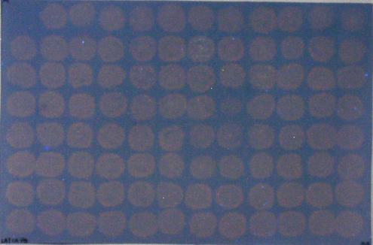
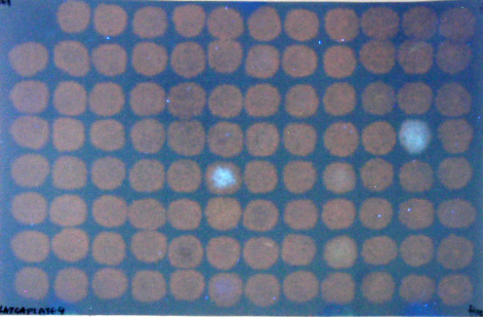
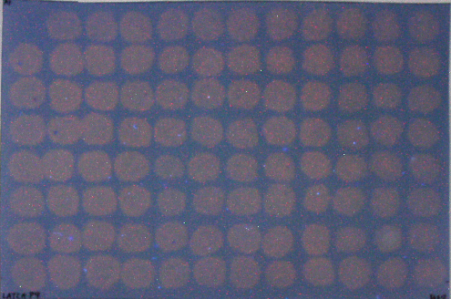
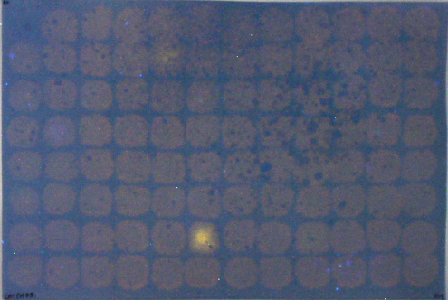
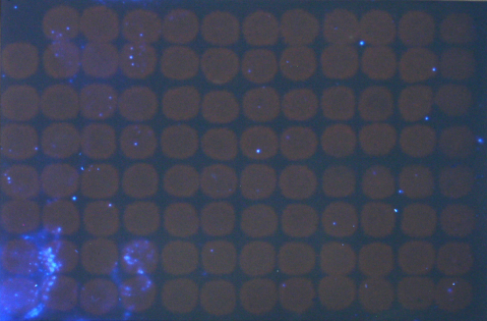
Fig. S1. Dot-blot screens for LATCA inhibitors of parsley XET activity.
Details as in Fig. 2. Results are shown for the 47 plates of LATCA xenobiotics (L1–L47). On each plate, well A1 contained no enzyme; columns 1 and 12 contained no xenobiotic.
Fig. S1
Latca collection of xenobiotics,
plates 1–10.
L1
1
2
3
4
5
6
7
8
9
10
11
12
L6
1
2
3
4
5
6
7
8
9
10
11
12
A
A
B
B
C
C
D
D
E
E
F
F
G
G
H
H
L2
1
2
3
4
5
6
7
8
9
10
11
12
L7
1
2
3
4
5
6
7
8
9
10
11
12
A
A
B
B
C
C
D
D
E
E
F
F
G
G
H
H
L3
1
2
3
4
5
6
7
8
9
10
11
12
L8
1
2
3
4
5
6
7
8
9
10
11
12
A
A
B
B
C
C
D
D
E
E
F
F
G
G
H
H
L4
1
2
3
4
5
6
7
8
9
10
11
12
L9
1
2
3
4
5
6
7
8
9
10
11
12
A
A
B
B
C
C
D
D
E
E
F
F
G
G
H
H
L5
1
2
3
4
5
6
7
8
9
10
11
12
L10
1
2
3
4
5
6
7
8
9
10
11
12
A
A
B
B
C
C
D
D
E
E
F
F
G
G
H
H

Slide 2
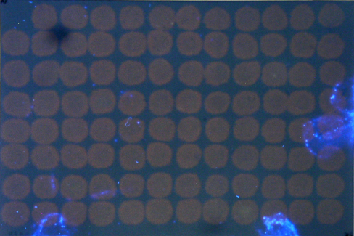
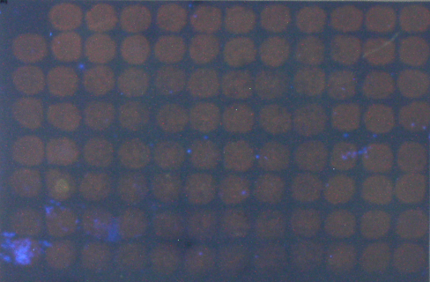
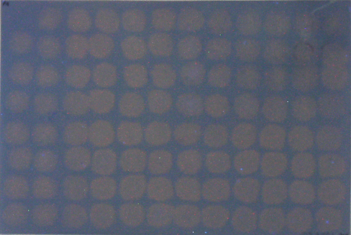
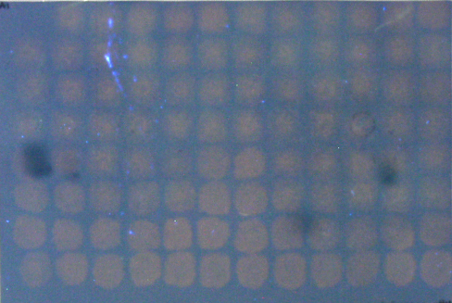
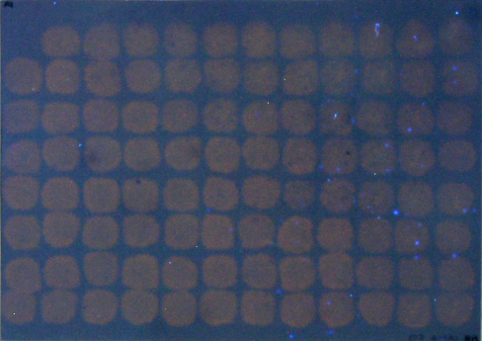
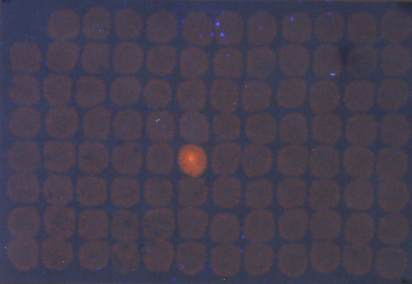
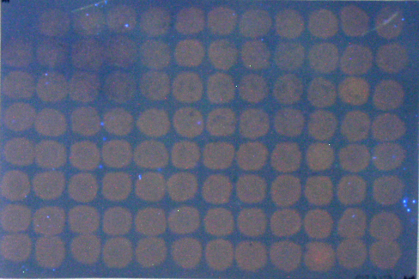
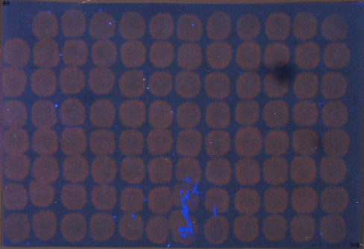
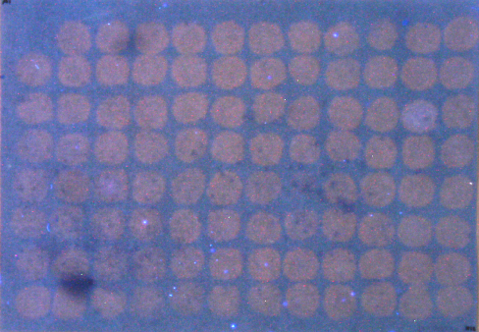
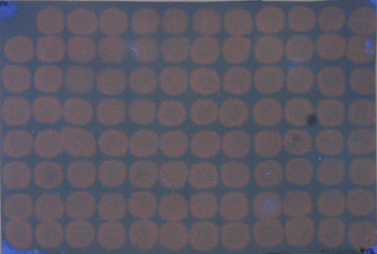
Fig. S1. Dot-blot screens for LATCA inhibitors of parsley XET activity.
Details as in Fig. 2. Results are shown for the 47 plates of LATCA xenobiotics (L1–L47). On each plate, well A1 contained no enzyme; columns 1 and 12 contained no xenobiotic.
Fig. S1
cont’d
Latca collection of xenobiotics,
plates 11–20.
L11
1
2
3
4
5
6
7
8
9
10
11
12
L16
1
2
3
4
5
6
7
8
9
10
11
12
A
A
B
B
C
C
D
D
E
E
F
F
G
G
H
H
L12
1
2
3
4
5
6
7
8
9
10
11
12
L17
1
2
3
4
5
6
7
8
9
10
11
12
A
A
B
B
C
C
D
D
E
E
F
F
G
G
H
H
L13
1
2
3
4
5
6
7
8
9
10
11
12
L18
1
2
3
4
5
6
7
8
9
10
11
12
A
A
B
B
C
C
D
D
E
E
F
F
G
G
H
H
L14
1
2
3
4
5
6
7
8
9
10
11
12
L19
1
2
3
4
5
6
7
8
9
10
11
12
A
A
B
B
C
C
D
D
E
E
F
F
G
G
H
H
L15
1
2
3
4
5
6
7
8
9
10
11
12
L20
1
2
3
4
5
6
7
8
9
10
11
12
A
A
B
B
C
C
D
D
E
E
F
F
G
G
H
H

Slide 3
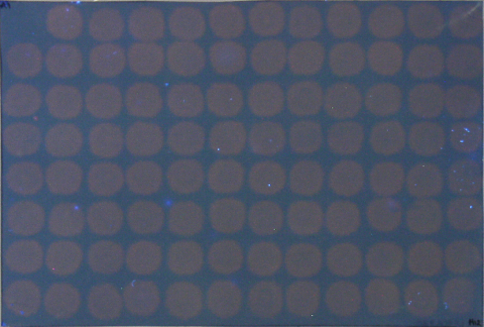
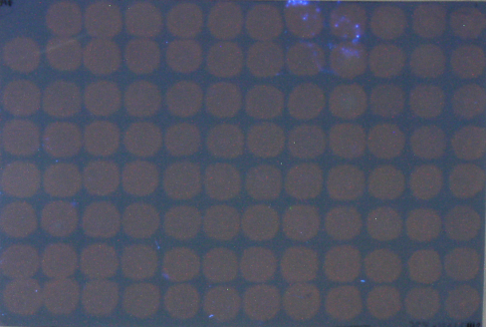
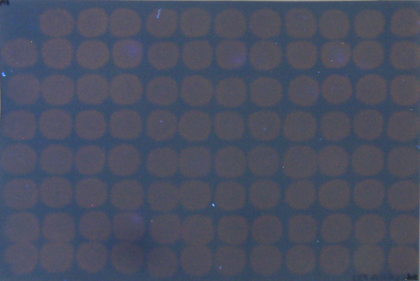
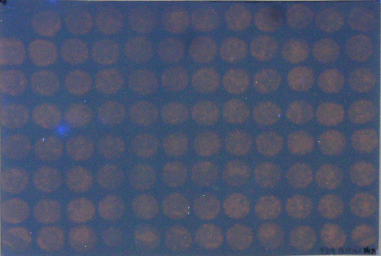
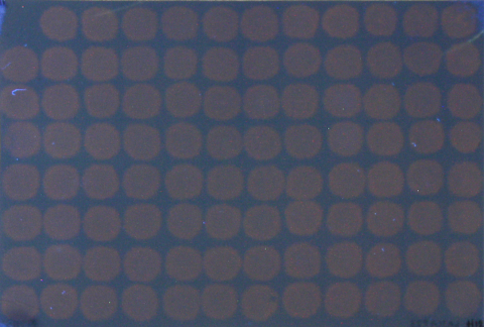
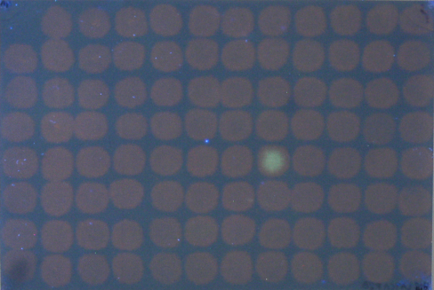
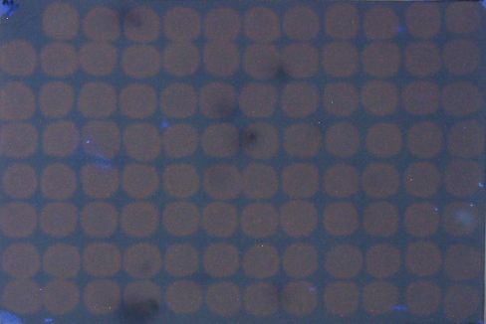
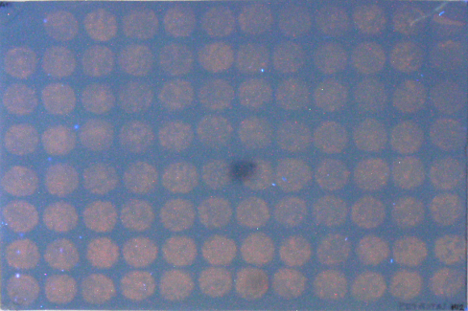
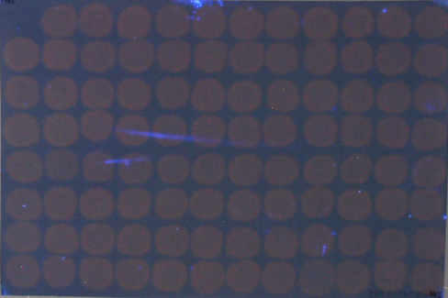
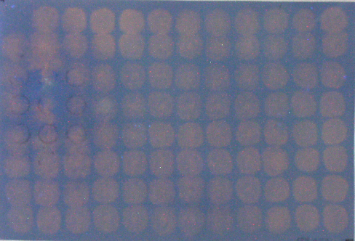
Fig. S1. Dot-blot screens for LATCA inhibitors of parsley XET activity.
Details as in Fig. 2. Results are shown for the 47 plates of LATCA xenobiotics (L1–L47). On each plate, well A1 contained no enzyme; columns 1 and 12 contained no xenobiotic.
Fig. S1
cont’d
Latca collection of xenobiotics,
plates 21–30.
L21
1
2
3
4
5
6
7
8
9
10
11
12
L26
1
2
3
4
5
6
7
8
9
10
11
12
A
A
B
B
C
C
D
D
E
E
F
F
G
G
H
H
L22
1
2
3
4
5
6
7
8
9
10
11
12
L27
1
2
3
4
5
6
7
8
9
10
11
12
A
A
B
B
C
C
D
D
E
E
F
F
G
G
H
H
L23
1
2
3
4
5
6
7
8
9
10
11
12
L28
1
2
3
4
5
6
7
8
9
10
11
12
A
A
B
B
C
C
D
D
E
E
F
F
G
G
H
H
L24
1
2
3
4
5
6
7
8
9
10
11
12
L29
1
2
3
4
5
6
7
8
9
10
11
12
A
A
B
B
C
C
D
D
E
E
F
F
G
G
H
H
L25
1
2
3
4
5
6
7
8
9
10
11
12
L30
1
2
3
4
5
6
7
8
9
10
11
12
A
A
B
B
C
C
D
D
E
E
F
F
G
G
H
H

Slide 4
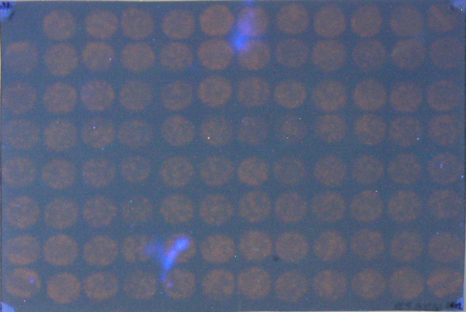
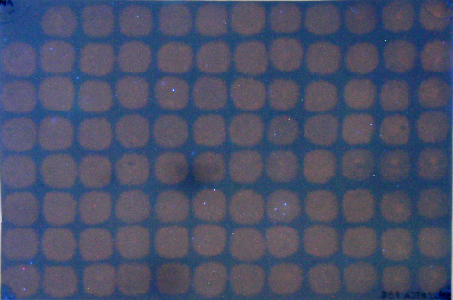
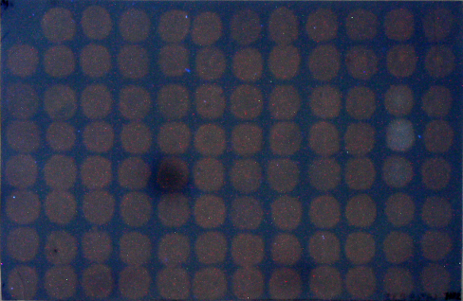
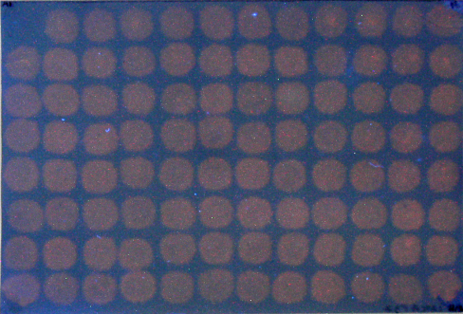
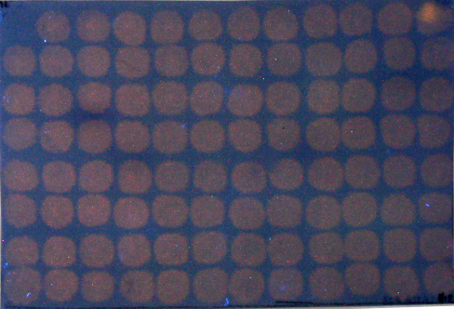
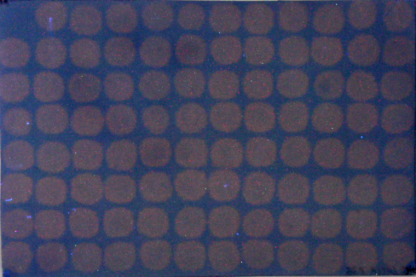
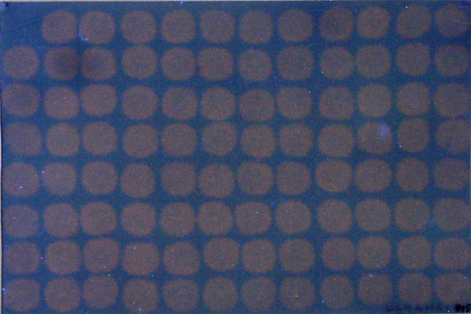
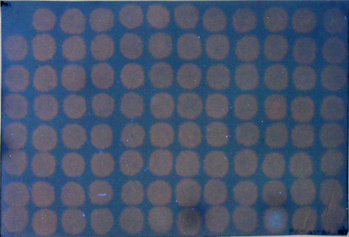
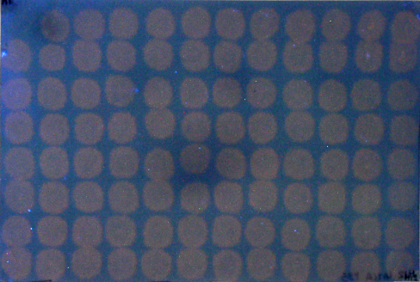
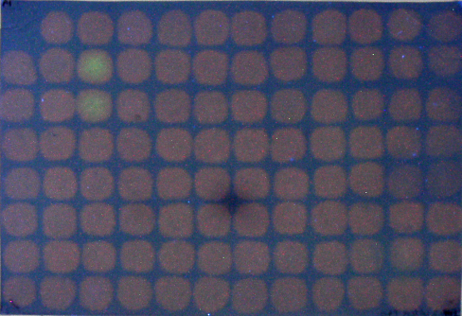
Fig. S1. Dot-blot screens for LATCA inhibitors of parsley XET activity.
Details as in Fig. 2. Results are shown for the 47 plates of LATCA xenobiotics (L1–L47). On each plate, well A1 contained no enzyme; columns 1 and 12 contained no xenobiotic.
Fig. S1
cont’d
Latca collection of xenobiotics,
plates 31–40.
L31
1
2
3
4
5
6
7
8
9
10
11
12
L36
1
2
3
4
5
6
7
8
9
10
11
12
A
A
B
B
C
C
D
D
E
E
F
F
G
G
H
H
L32
1
2
3
4
5
6
7
8
9
10
11
12
L37
1
2
3
4
5
6
7
8
9
10
11
12
A
A
B
B
C
C
D
D
E
E
F
F
G
G
H
H
L33
1
2
3
4
5
6
7
8
9
10
11
12
L38
1
2
3
4
5
6
7
8
9
10
11
12
A
A
B
B
C
C
D
D
E
E
F
F
G
G
H
H
L34
1
2
3
4
5
6
7
8
9
10
11
12
L39
1
2
3
4
5
6
7
8
9
10
11
12
A
A
B
B
C
C
D
D
E
E
F
F
G
G
H
H
L35
1
2
3
4
5
6
7
8
9
10
11
12
L40
1
2
3
4
5
6
7
8
9
10
11
12
A
A
B
B
C
C
D
D
E
E
F
F
G
G
H
H

Slide 5
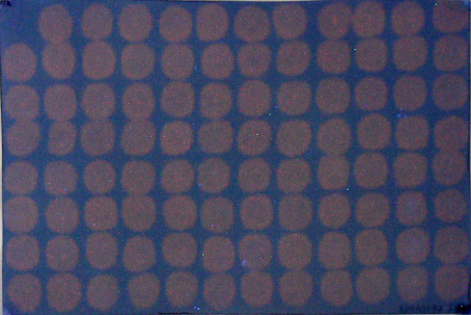
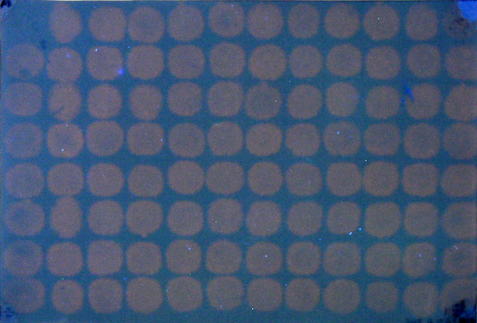
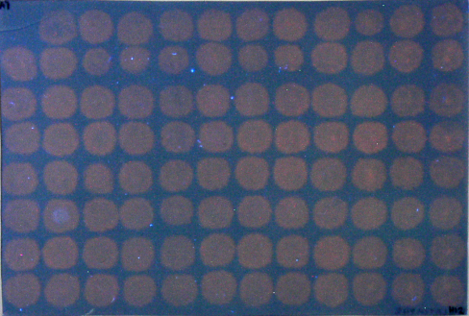
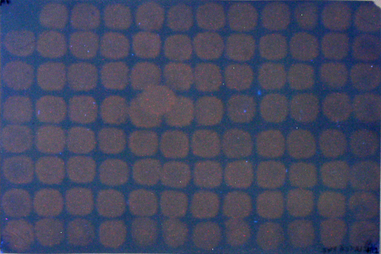
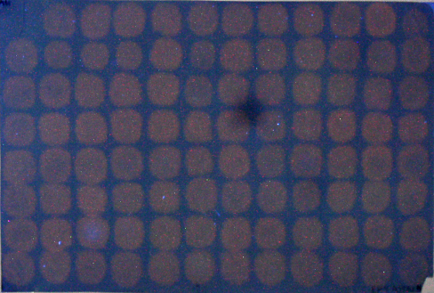
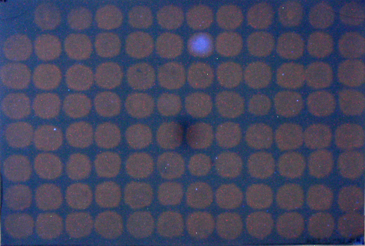
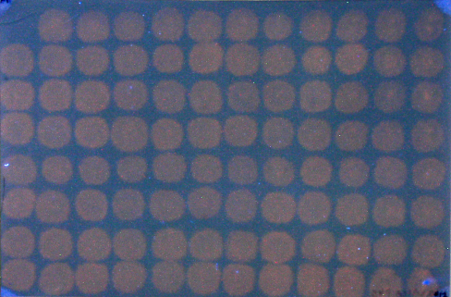
Fig. S1. Dot-blot screens for LATCA inhibitors of parsley XET activity.
Details as in Fig. 2. Results are shown for the 47 plates of LATCA xenobiotics (L1–L47). On each plate, well A1 contained no enzyme; columns 1 and 12 contained no xenobiotic.
Fig. S1
cont’d
Latca collection of xenobiotics,
plates 41–47.
L41
1
2
3
4
5
6
7
8
9
10
11
12
L46
1
2
3
4
5
6
7
8
9
10
11
12
A
A
B
B
C
C
D
D
E
E
F
F
G
G
H
H
L42
1
2
3
4
5
6
7
8
9
10
11
12
L47
1
2
3
4
5
6
7
8
9
10
11
12
A
A
B
B
C
C
D
D
E
E
F
F
G
G
H
H
L43
1
2
3
4
5
6
7
8
9
10
11
12
A
B
C
D
E
F
G
H
L44
1
2
3
4
5
6
7
8
9
10
11
12
A
B
C
D
E
F
G
H
L45
1
2
3
4
5
6
7
8
9
10
11
12
A
B
C
D
E
F
G
H

Slide 6
Fig. S2
Fig. S2. Quantitative re-testing of additional selected LATCA xenobiotics for inhibition of XET activity.
A selection of seven LATCA compounds, which had appeared to show inhibitory or promotory activity against XET in dot-blots screens (Fig. S1), were re-screened for effects in the radiochemical XET assay. Samples are listed according to the LATCA plate number (L7 etc.) and well number (C10 etc.) (see Fig. S1). Dashed line = mean of xenobiotic free controls.
Xenobiotic-free control
Inhibitory in dot-blots
Promotory in dot-blots
←L7 C10
N'-(1-E)-(5-bromofuran-2-yl)-methylidene-2-(3-methyl-phenoxy)-acetohydrazide
L14 C11→
1,4-dihydroxy-2-nitroanthracene-9,10-dione
← L7 G9
epibrassinolide
L14 H10→
4-methoxyphenylamine salt of 1-[(4-hydroxy-9,10-dioxo-9,10-dihydro-1-anthra-cenyl)amino]-1-oxo-2-propanesulphonic acid (ionised)
← L15 E8
3-{[3-(4-hydroxyphenyl)-3-oxopropanoyl]amino}-4-[methyl-(octadecyl)amino]-benzoic acid
L18 E6→
← L27 H4
1-amino-4-hydroxy-2-methoxyanthracene-9,10-dione
2-(4-nitro-2-thienyl)-2,3-dihydro-1H-benzo[d]imidazole

