Slide 1
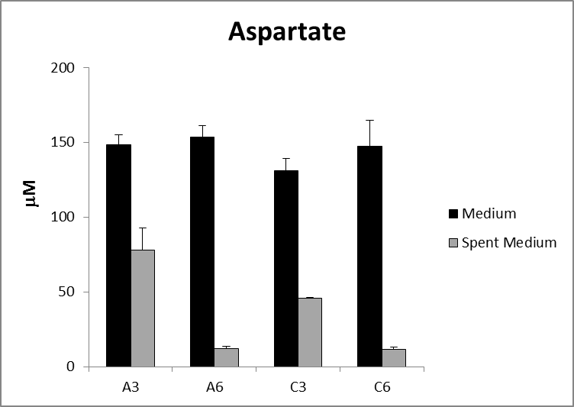
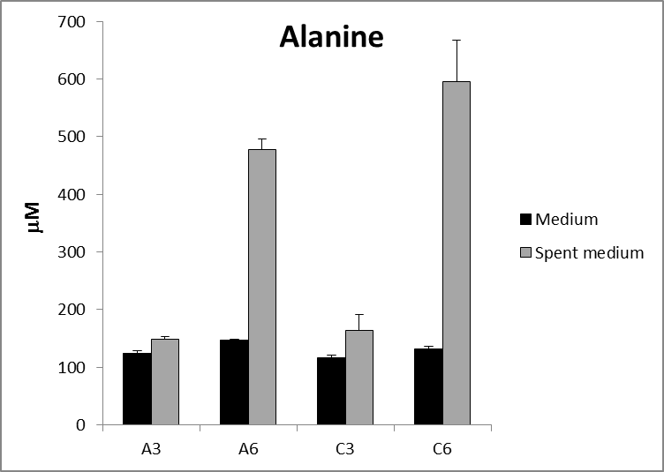
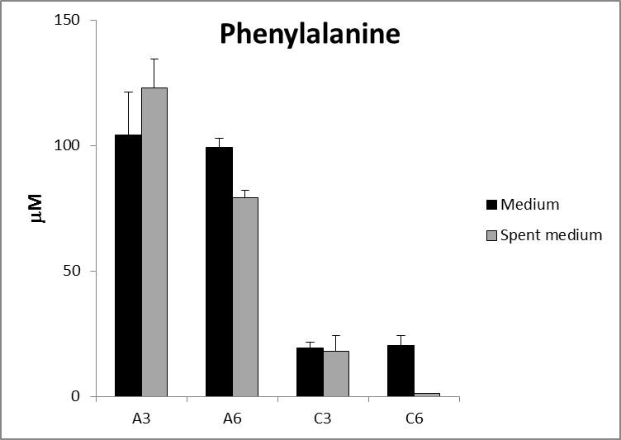
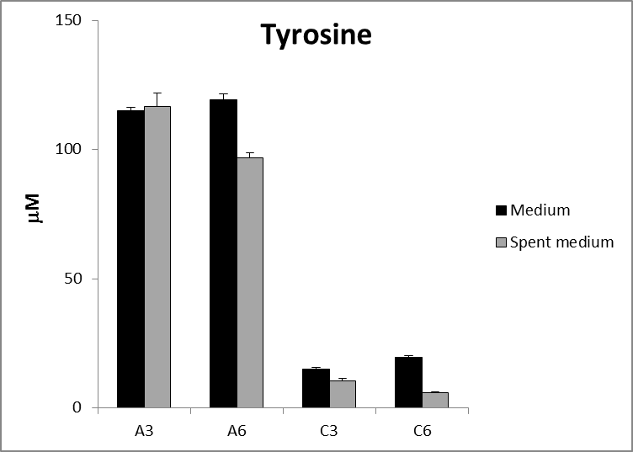
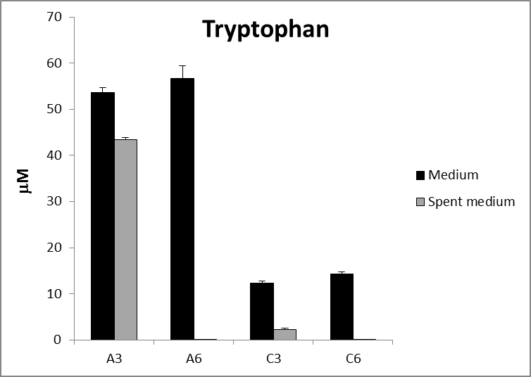
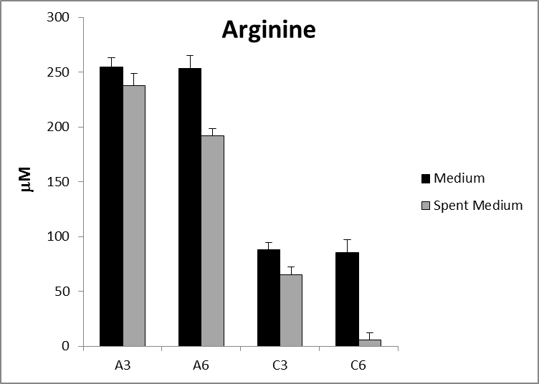
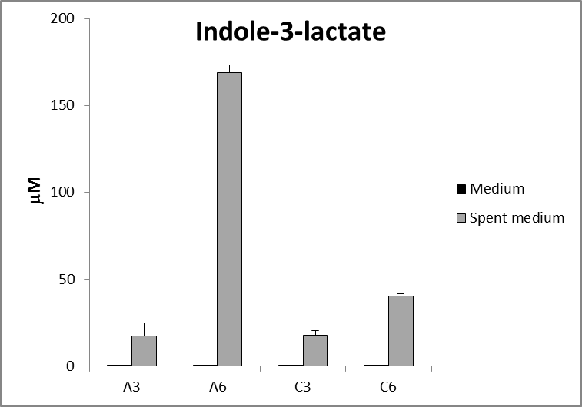
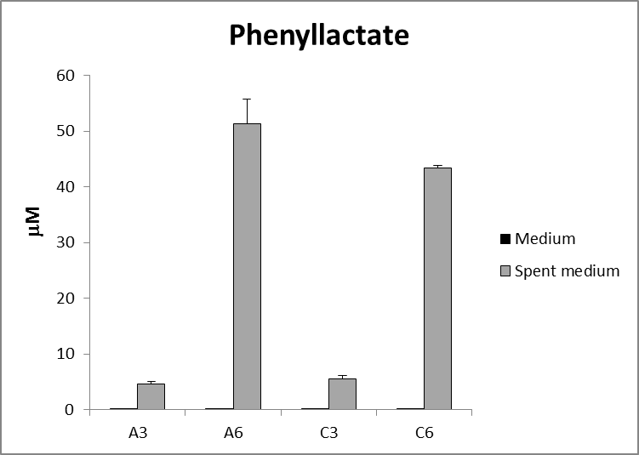
S10 Fig. Metabolomic analysis of spent media.
Key: Medium, uninfected control; Spent medium, supernatent from cultures.
A3 and A6, day 3 and day 6 samples from cultures in medium A (HOMEM + 10% FCS);
C3 and C6, day 3 and day 6 samples from cultures in medium C (mHomem + 10% FCS).

