Slide 1
Manuscript supplementary figures

Slide 2
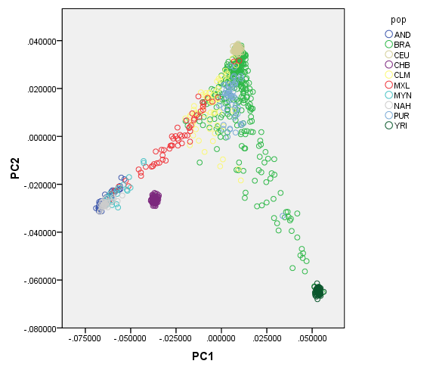
Supplementary figure 1A. PC analysis of the Brazilian individuals analyzed in this study and other relevant samples, including representatives of the parental populations (CEU, YRI and Native American populations) and other admixed groups from the Americas. The plot shows the scores of the first two PC axes. Sample codes: AND (Quechua and Aymara from the Andes), BRA (Brazilian sample analyzed in this study), CEU (Europeans), CHB (Chinese), CLM (Colombians), MXL (Mexican Americans from LA), MYN (Mayans from Mexico), NAH (Nahua from Mexico), PUR (Puerto Ricans), YRI (Yoruba from Nigeria).

Slide 3
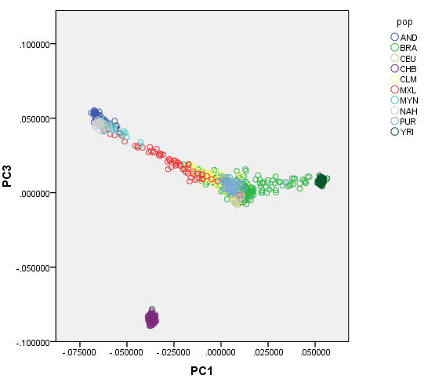
Supplementary figure 1B. PC analysis of the Brazilian individuals analyzed in this study and other relevant samples, including representatives of the parental populations (CEU, YRI and Native American populations) and other admixed groups from the Americas. The plot shows the scores of the first and third PC axes. Sample codes are the same as those shown in Supplementary Figure 1A.
One Brazilian individual
showed strong evidence
of East Asian Ancestry
and was eliminated from
the statistical analysis

Slide 4
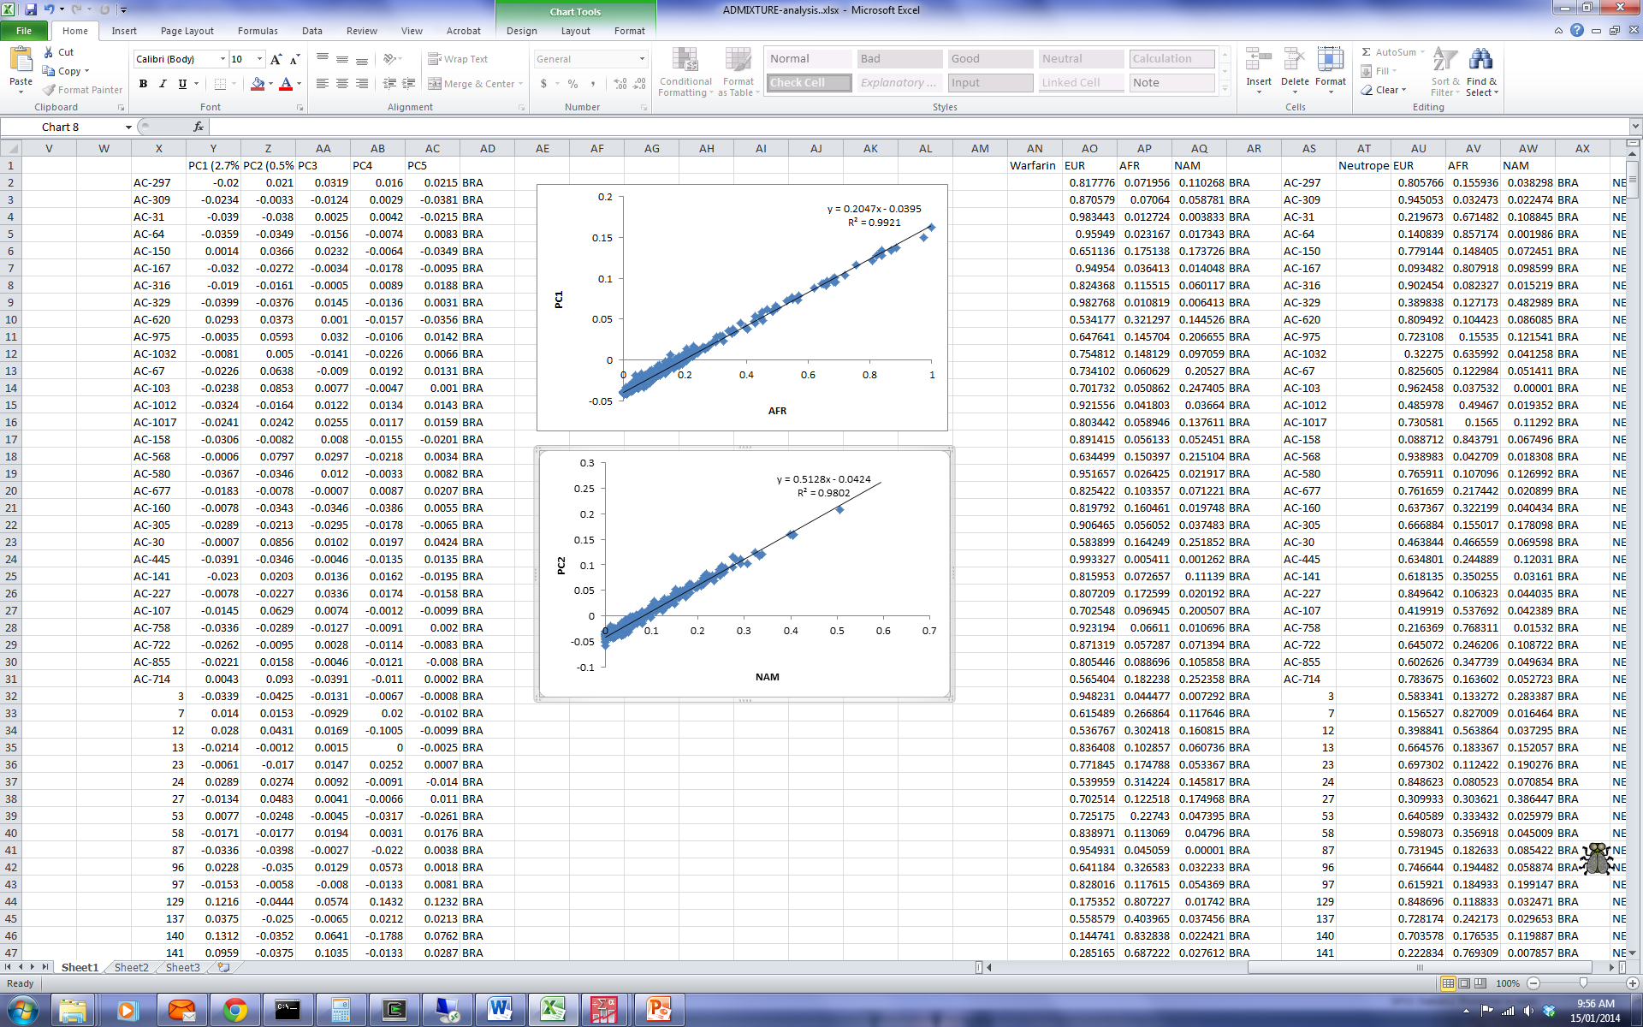
Supplementary Figure 2. Correlation of individual ancestry estimates obtained with the program ADMIXTURE and the scores of the PC analysis. Figure 2A shows the correlation of the estimates of African individual proportions and the scores of the first PC axis. Figure 2B shows the correlation of the estimates of Native American individual proportions and the scores of the second PC axis.
A
B

Slide 5
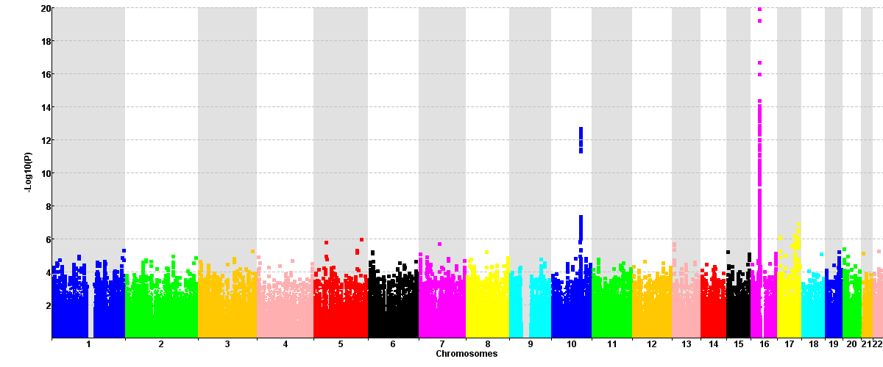
Supplementary Figure 3. Manhattan plot showing the results of the GWA study of warfarin maintenance dose in the Brazilian sample
CYP2C9
VKORC1

Slide 6
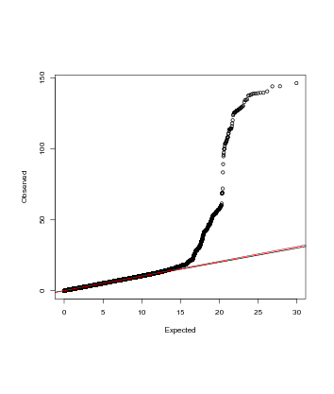
Supplementary Figure 4. QQ plot corresponding to the results of the GWA study of warfarin maintenance dose in the Brazilian sample
Lambda: 1.03

Slide 7
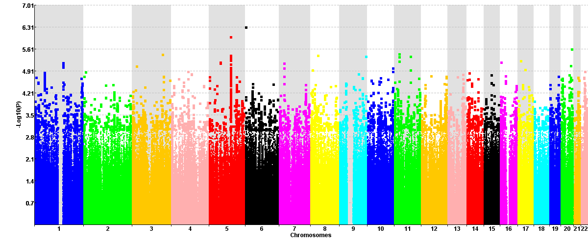
Supplementary Figure 5. Manhattan plot showing the results of the GWA study of warfarin maintenance dose in the Brazilian sample, conditioning on VKORC1 rs749671 and CYP2C9*2 and *3

Slide 8
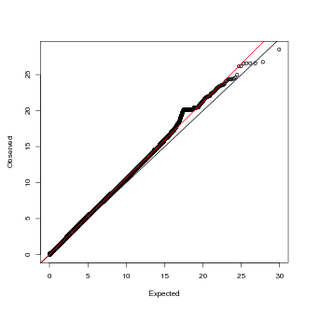
Supplementary Figure 6. QQ plot corresponding to the results of the GWA study of warfarin maintenance dose in the Brazilian sample, conditioning on VKORC1 rs749671 and CYP2C9*2 and *3
Lambda: 1.06

