Slide 1
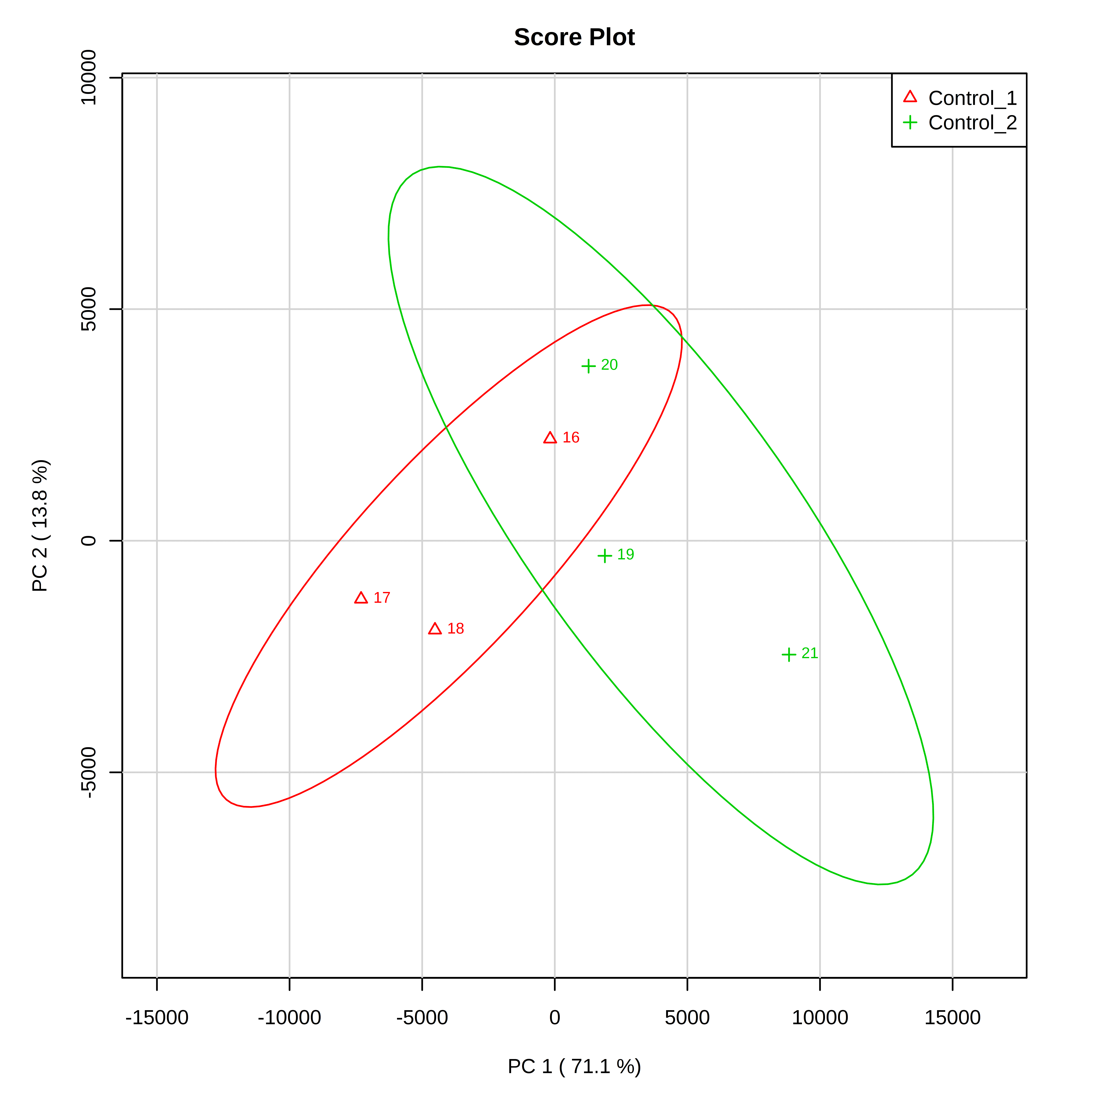
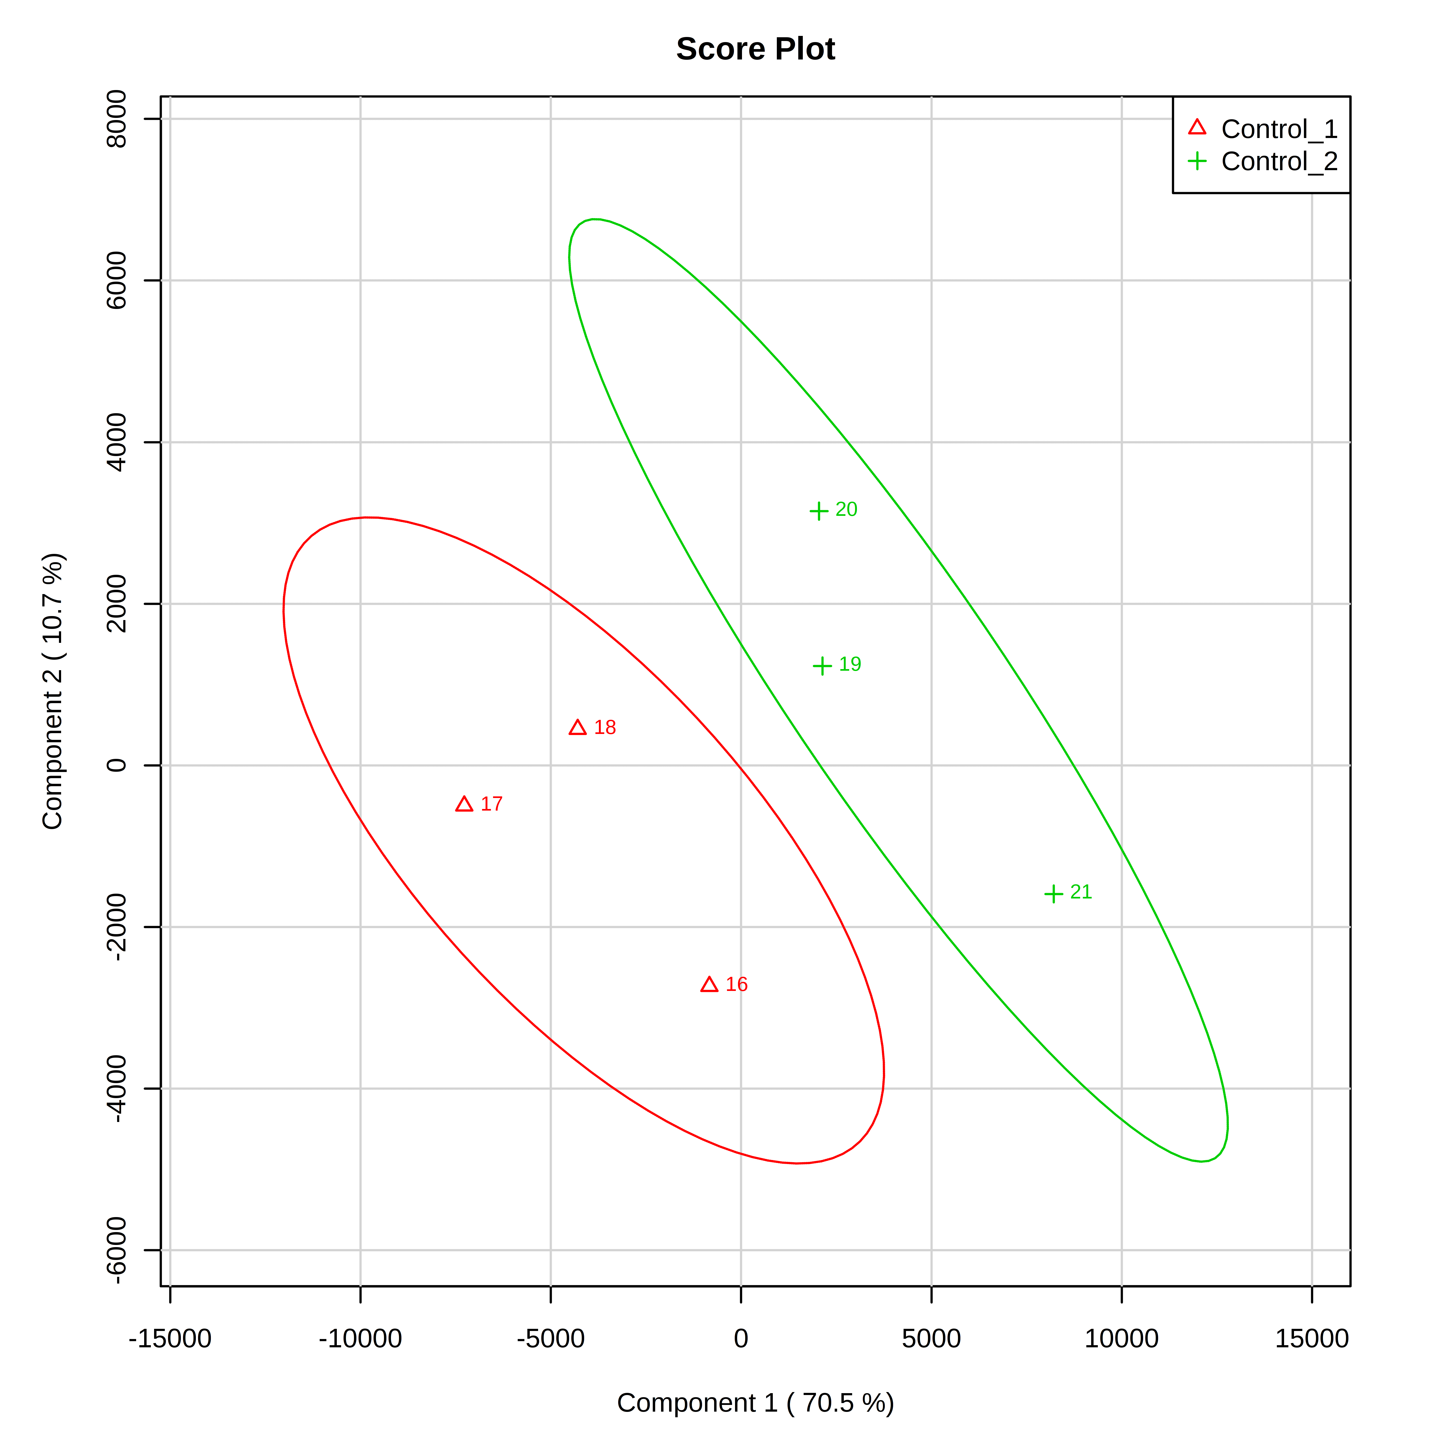
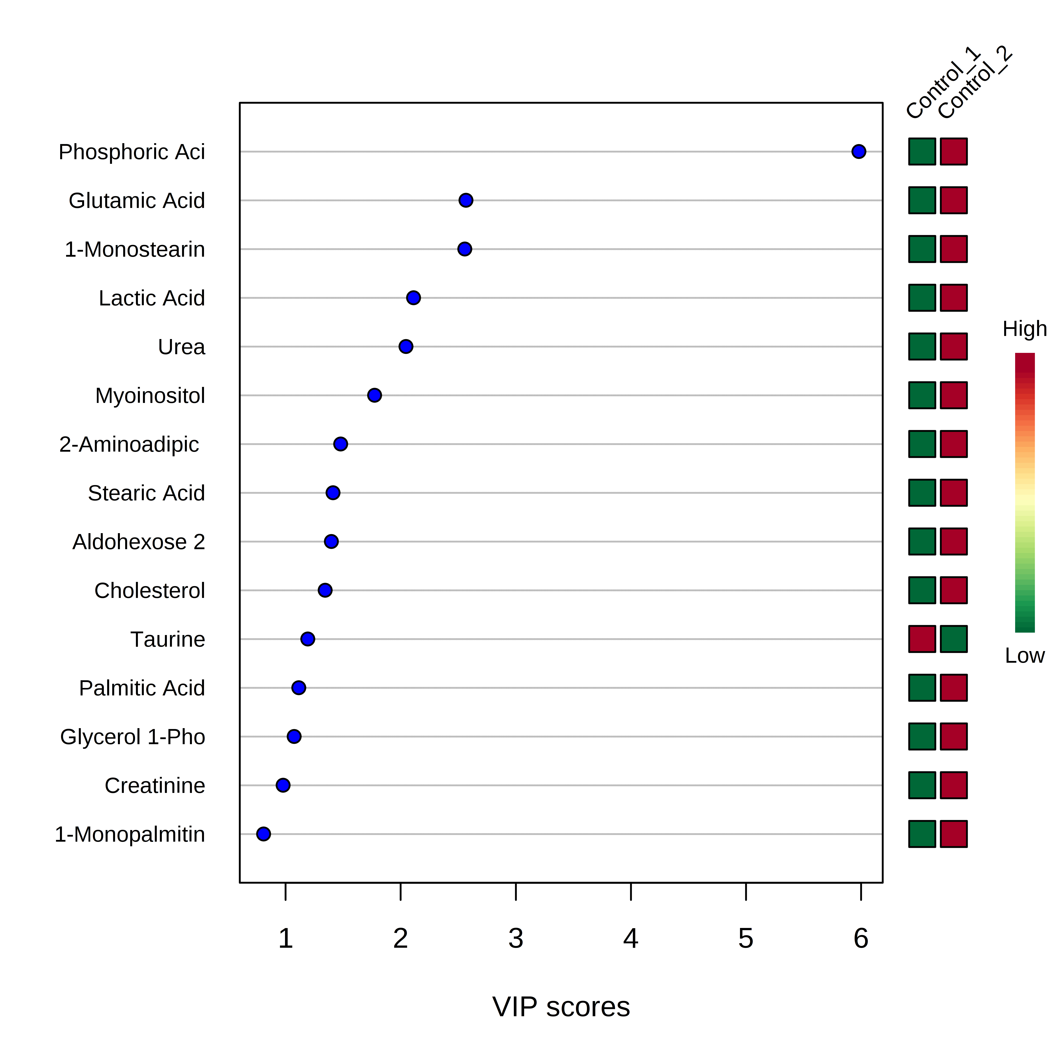
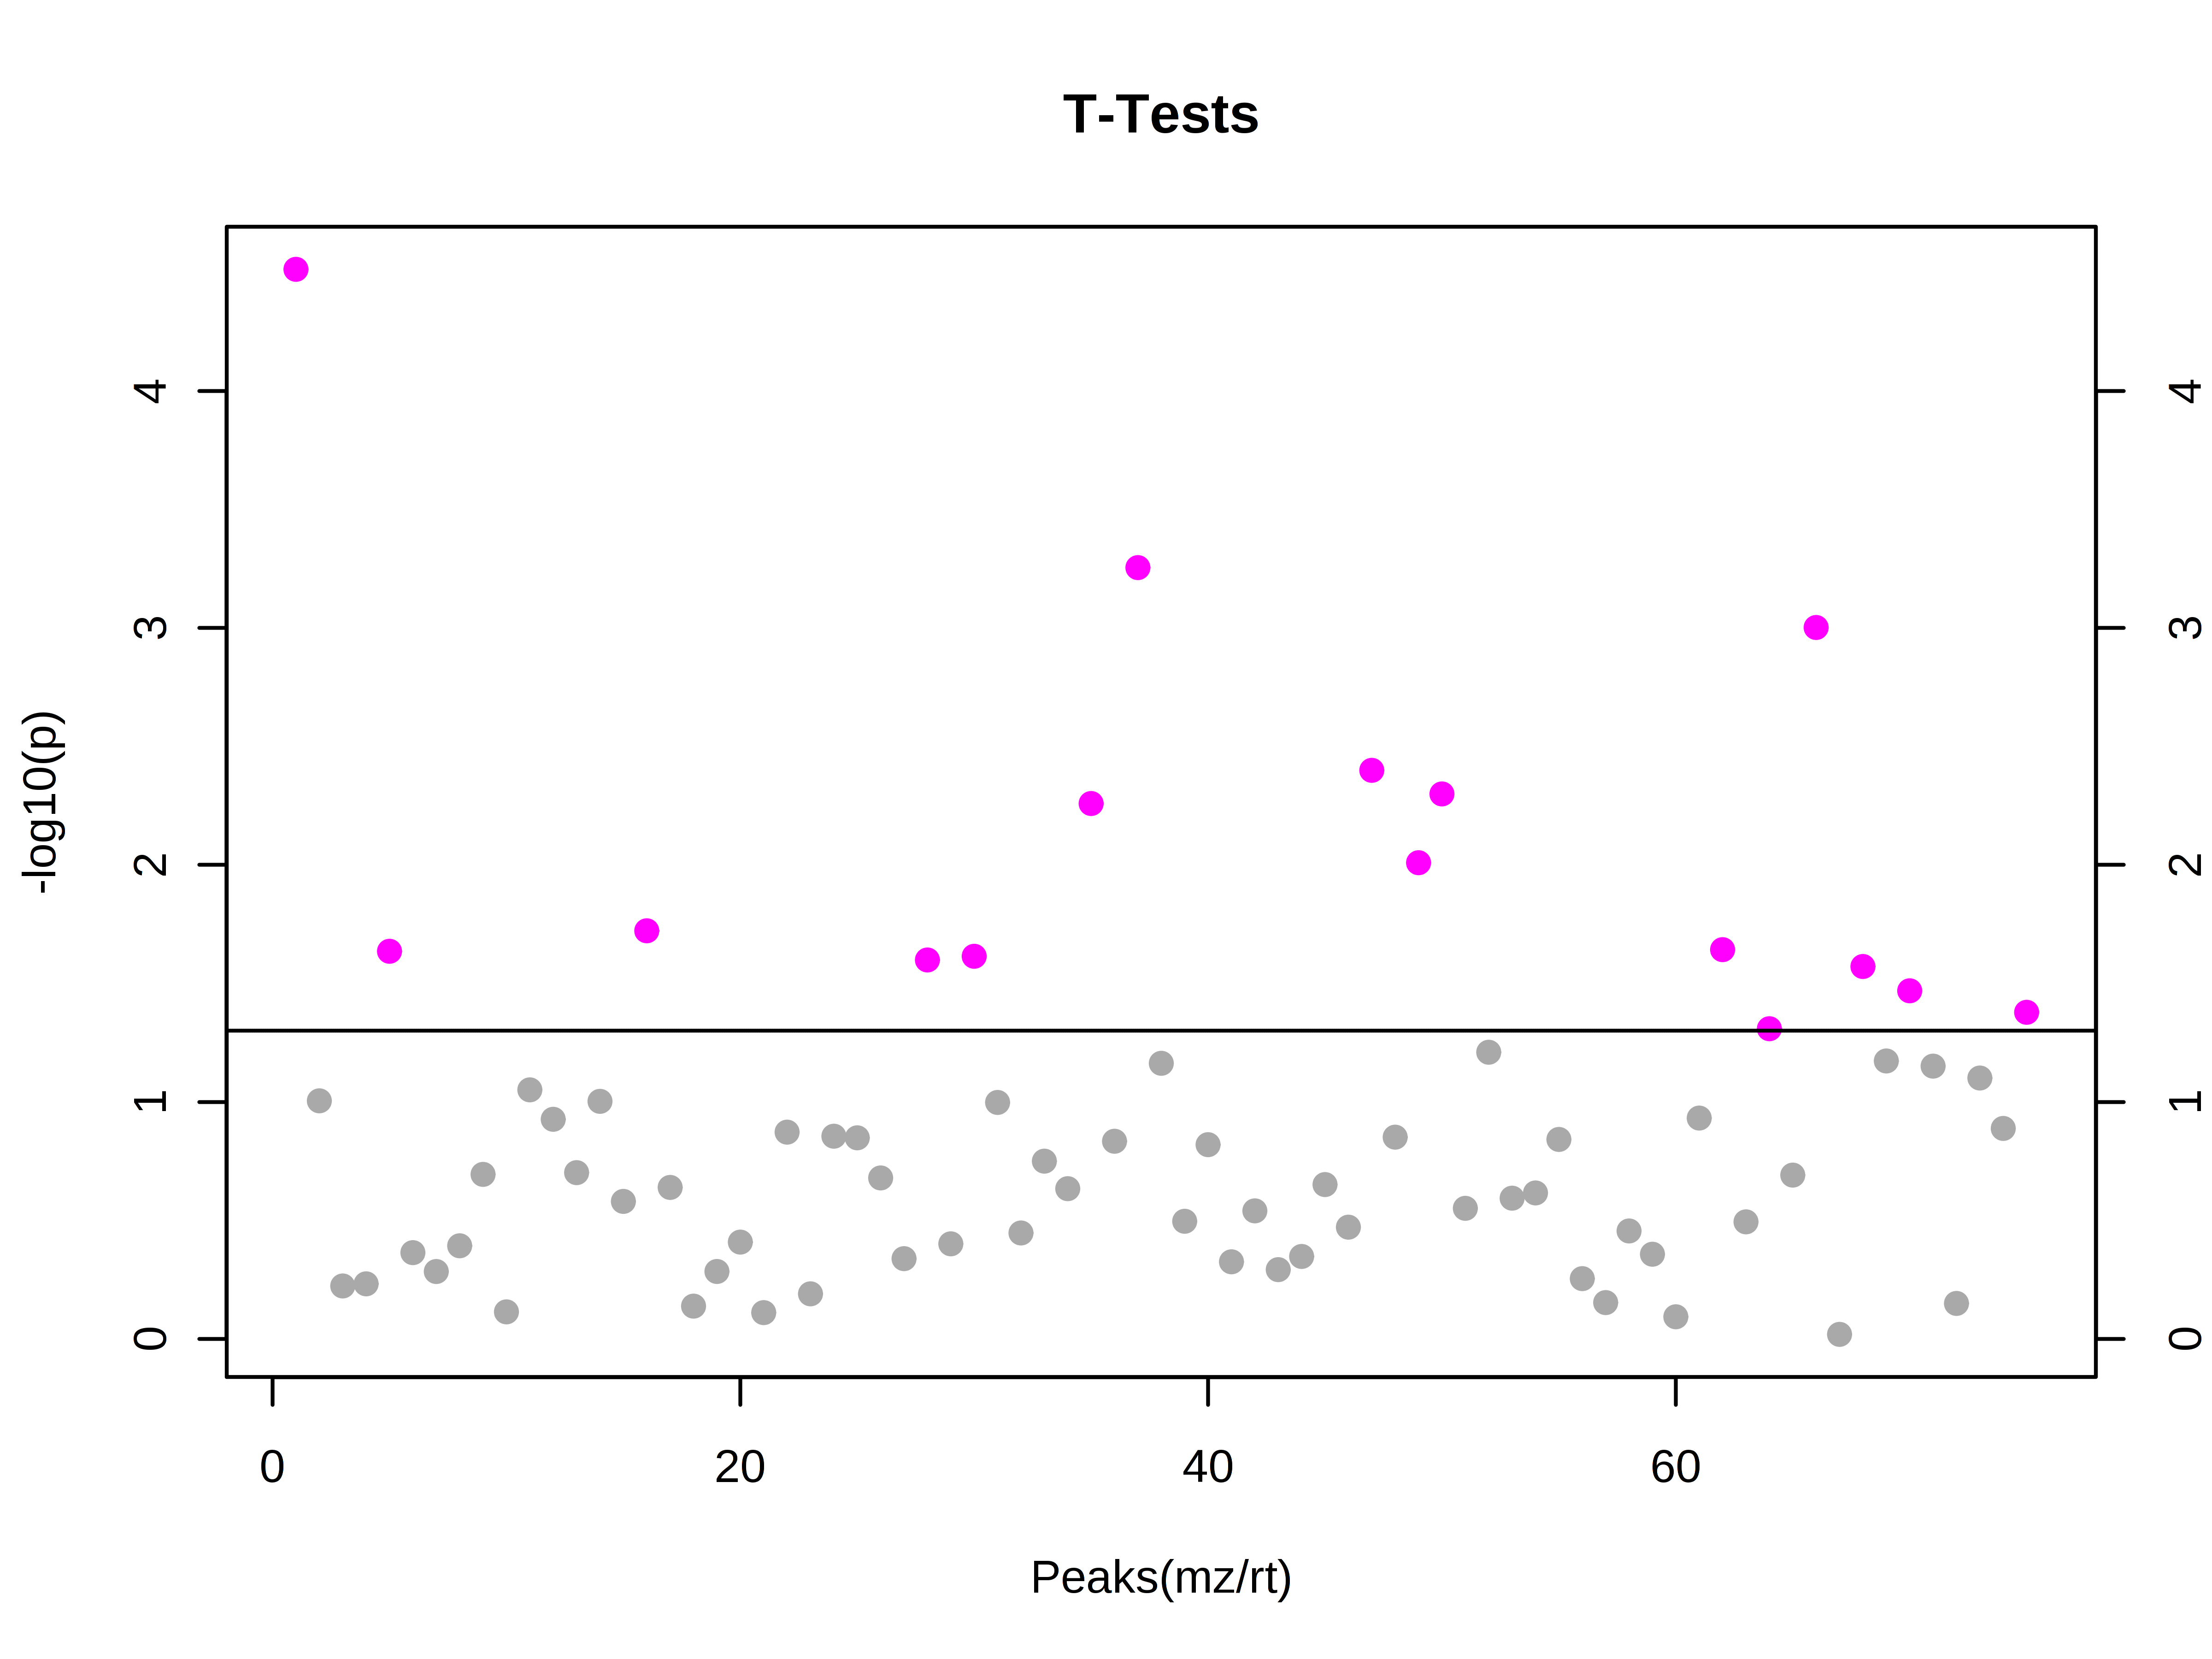
A
B
C
D
E
Grp 1 Grp 2
Fold Change (Group 2 vs. Group 1)
Supplemental Figure 1. Metabolomic comparison of control groups. Analysis (PCA) illustrating the unsupervised relationship between A. Control Group 1 (Brg1^{floxed/floxed};aMHC-Cre-ERT^{+/0};Brm^{-/-} minus tamoxifen treatment) and Control Group 2 (Brg1^{floxed/floxed};aMHC-Cre-ERT^{0/0}(no transgene);Brm^{-/-} mice plus tamoxifen treatment). B. Partial Least Squares Discriminant Analysis (PLS-DA) score visualizes supervised (assigned group) clustering of Control Group 1 and Control Group 2. C. PLS-DA score plots for Control Group 1 heart metabolites (red) compared to metabolites identified in Control Group 2 hearts (green). Each point represents the combined metabolite profile in an individual mouse. Variable Importance in Projection (VIP) plot of VIP statistical analysis identifying the top 15 metabolites. D. T-test significant metabolites between Control Group 1 and Control Group 2. E. Unsupervised heat maps of all identified metabolites and their associated fold changes in Control Group 1 vs. Control Group 2. N=3 (Control Group 1), N=3 (Control Group 2) hearts per group analyzed. Each point represents an individual mouse heart run in parallel with the other samples.

Slide 2
A. Alanine metabolism
Tryptophan
X 4
Reactions
Threonine
Increased ~1.4 fold
Alanine
Increased ~1.3 fold
Serine
Hydroxymethyl
transferase
α-Ketoglutarate
Serine
Hydroxymethyl
transferase
Glycine
Alanine amino-
transferase
Glutamate
Serine
Increased >2 fold
Pyruvate
Acetyl-CoA
Serine
dehydratase
Pyruvate
Dehydrogenase
X 2
Reactions
Cysteine
B. Creatine and creatinine metabolism
Urea
H₂O
L-Arginine
Glycine
L-Ornithine
Guanidino-
Acetate
SAM-GAMT
(N-guanidinoacetate
methyltransferase)
S-Adenosyl-L-Methionine
S-Adenosyl-L-Homocysteine
ATP
ADP
Creatine
Phosphoryl-
Creatine
H₂O
P_{i}
H₂O
Creatinine
Decreased to
~0.6 fold
Phosphoryl-
Creatinine
P_{i}
H₂O
Supplemental Figure 2. Metabolic pathways related to cardiac Brg1/Brm double-mutant activity based on t-test significant metabolites (Figure 2D) not otherwise identified by pathway analysis (Table 2). A. Alanine metabolism, B. Creatine and creatinine metabolism. Figures adapted from: http://www.biocarta.com/pathfiles/alaninepathway.asp and Wyss and Kaddurah-Daouk (2000 Creatine and creatinine metabolism. Physiol Rev 80, 1107-213).

Slide 3
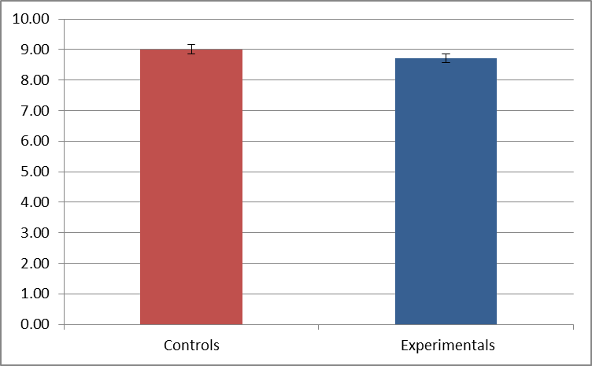
1.1
1.0
0.9
0.8
0.7
0.6
1.00+0.01
0.97+0.05
Pfk1 mRNA Levels /GAPDH (Relative Units)
0.5
0.4
0.3
0.2
0.1
Control Group 2
Brg1/Brm DM (Group 3)
Supplemental Figure 3. RT-qPCR analysis of Pfk1-fb1 mRNA levels normalized to Gapdh levels in hearts from Brg1/Brm double-mutant mice compared to controls. Each histogram shows the relative expression (mean + SE for two independent experiments).

