Slide 1
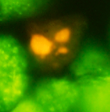
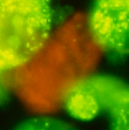
Supplementary Figure 1
A
B
C
hNSCs, +IR, apoptosis
hNSCs, +IR, necrosis
hNSCs, -IR, viable
D
E
F
A172, +IR, apoptosis
A172, +IR, necrosis
A172, -IR, viable
Supplementary Fig. 1. Representative fluorescent microscopic images of apoptosis and necrosis in hNSCs and A172 cells.
Apoptosis (A, D) and necrosis (B, E) determined by the double staining using acridine orange (color: green) and ethidium bromide (color: orange). The images of cell suspension were obtained using a digital camera (DP73, Olympus, Tokyo, Japan) equipped with a fluorescent microscopy (BX51, Olympus). Viable cells are stained in green (C, F). Cells undergoing apoptosis show condensed and fragmented chromatin, cell bodies smaller than viable cells and/or apoptosis bodies that are stained in orange (A, D). Cells undergoing necrosis also show nuclei stained in orange, but they can be distinguished from apoptotic cells since the nuclear morphology resembles that of viable cells (B, E). Bar, 20 μm. IR, X-irradiation.

