Slide 1
Supplementary Figures

Slide 2
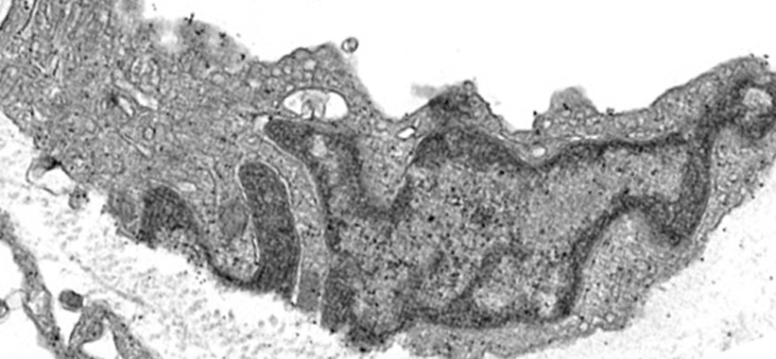
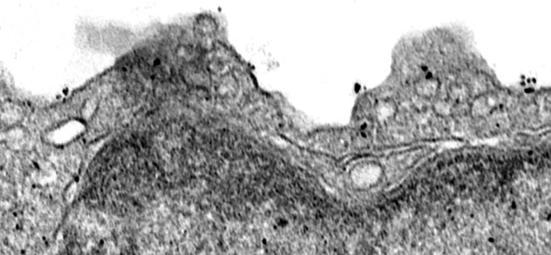
Distant normal vasculature
lumen
i
i
lumen
100 nm
Figure S1. TM4SF1 distribution in normal vascular endothelial cells distant from resected human gastric carcinoma as determined with 8G4 and immuno-nanogold transmission electron microscopy. Low power (and at higher power inset i) immuno-nanogold labeling demonstrate substantially lower membrane label (blue arrows) than that found in the endothelium of vasculature supplying the tumor (compare with Figure 1B). Scale bars, 100 nm.

Slide 3
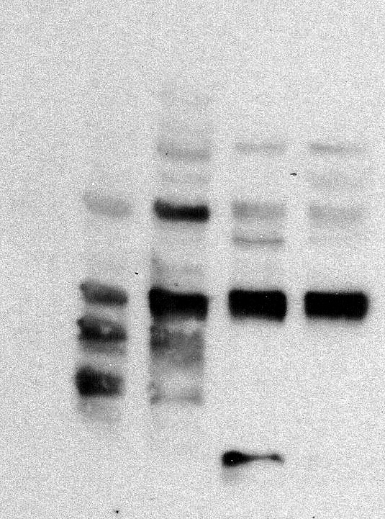
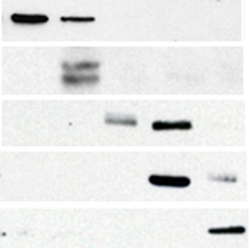
Cell Fractionation
nuclear
Membrane
Cytoskeleton
Chromatin
Cytosol
Soluble
28kD-
25kD-
TM4SF1
22kD-
90kD-
Hsp90
210kD-
VEGFR2
55kD-
HDAC2
18kD-
Histone H3
57kD-
Vimentin
Figure S2. Distribution of TM4SF1 in HUVEC as determined by cell fractionation and immunoblotting with 8G4. Three major TM4SF1 bands (22-, 25-, and 28-kD) were identified in the cell membrane and the soluble nuclear fractions, whereas only the 28kD band was found in the cytoskeletal and nuclear chromatin fractions. TM4SF1 was not detected in the cytosol fraction. Hsp90, VEGFR2, HDAC2, Histone H3 and Vimentin were used as markers for cytosol, cell membrane, nucleus, nuclear chromatin, and cytoskeleton, respectively.

Slide 4
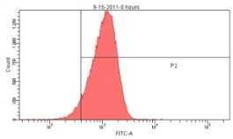
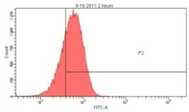
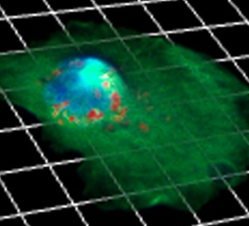
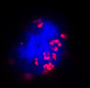
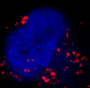
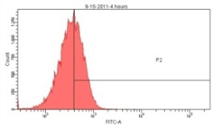
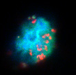
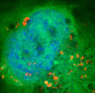
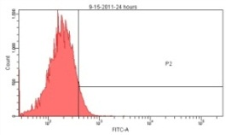
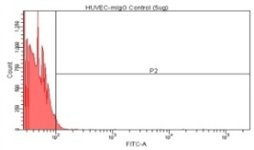
A
Flow Cytometry
B
HUVEC - 4h 8G4 internalization (GFP/DAPI)
0h
95.1%
Frames # (200 nm/frame)
6
15
2h
8G4/DAPI
79.2%
(a) 8G4
4h
Cell Number
47.5%
24h
GFP/8G4/DAPI
4.9%
10 μm
(b) mIgG1
0h
0.1%
Fluorescence Intensity
Figure S3. Internalization of anti-TM4SF1 monoclonal antibody 8G4 in HUVEC. HUVEC were incubated with 8G4 or control mouse-IgG1 (mIgG1) for 1h at 4°C, washed with PBS, and returned to culture to track changes in 8G4 distribution via (A) flow cytometry and (B) confocal 3D Z-stack imaging. (Aa) Cell surface 8G4 staining intensity fell progressively from 95.1 at 0h to 4.9% at 24h. (Ab) HUVEC did not interact with control mIgG1. (B) Confocal 3D Z-stack (22 frames; 220 nm/frame from cell surface to abluminal matrix) definitively localized 8G4 to the nucleoplasm (frame 6, white arrows) of GFP-transduced HUVEC, and also to the perinuclear cytoplasm (frame 15, yellow arrows) at 4h.

Slide 5
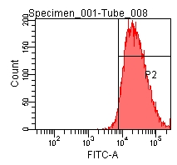
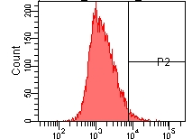
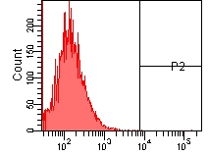
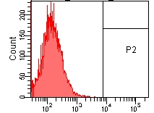
R2
R1
0 h
R2
R1
(a) Anti E-Selectin antibody
0.5 h
Cell Number
R2
R1
1h
R2
R1
0h
(b) mIgG
Fluorescence Intensity
Figure S4. E-selectin internalization in HUVEC as determined by flow cytometry. HUVEC were stimulated with TNF (100 u/ml) for 2h to increase surface expression of E-selectin [13] and then were incubated with (A) anti-E-selectin or (B) control mouse-IgG1 (mIgG) antibody for 1h at 4°C. After washing with cold PBS, HUVEC were returned to culture and cell surface anti-E-selectin antibody was tracked at 0.5h and 1h. Cell surface E-selectin intensity fell to mIgG background levels by 1 hour..

