Slide 1
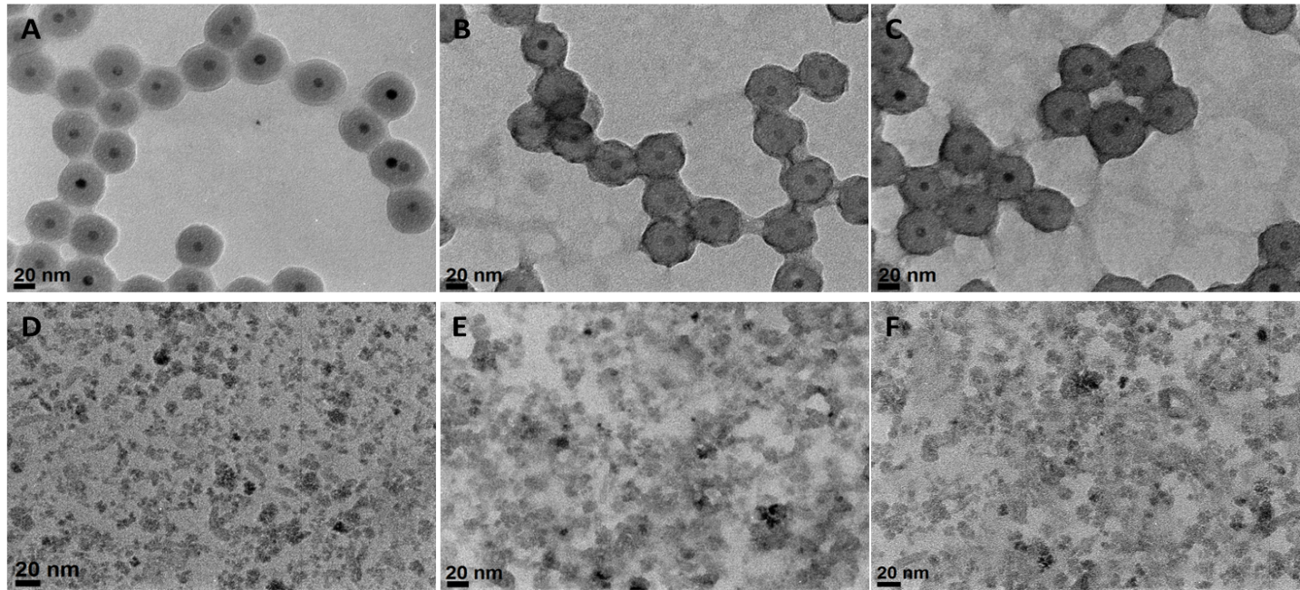
S1_Fig.
Visualizing the protein corona. TEM micrographs of the ‘hard’ protein corona on CSNP and nanomag®-D-spio. CSNP + protein corona without staining (A), CSNP + protein corona with negative staining (B), CSNP + protein corona with fixation and negative staining (C), nanomag®-D-spio + protein corona without staining (D), nanomag®-D-spio + protein corona with negative staining (E), and nanomag®-D-spio + protein corona with fixation and negative staining (F).

