Slide 1
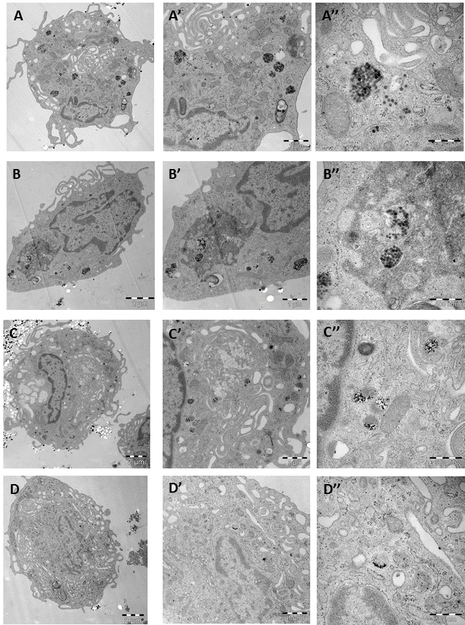
S3_Fig.
Cellular uptake of SPIONs with or without a plasma protein corona. Primary human macrophages cultured without FBS were exposed for 24 h to 50 µg/ml of CSNP (A-A’’), CSNP + protein corona (B-B’’), nanomag®-D-spio (C-C’’), and nanomag®-D-spio + protein corona (D-D’’).

