Slide 1
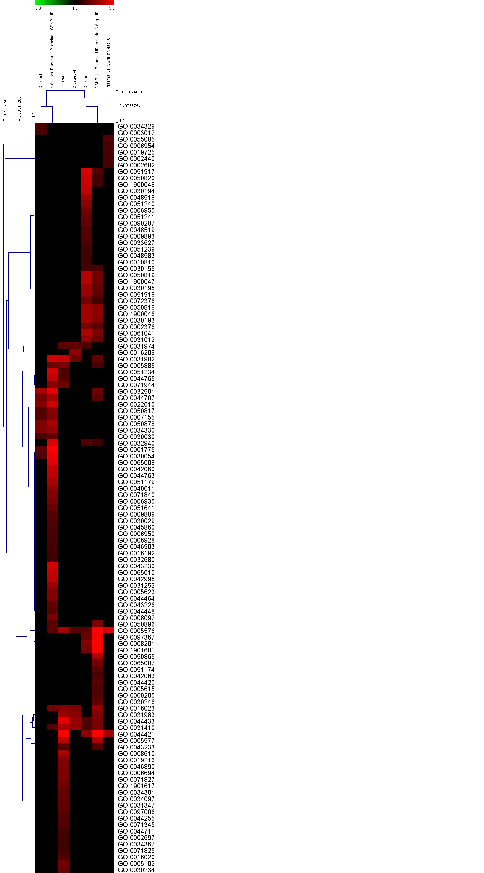
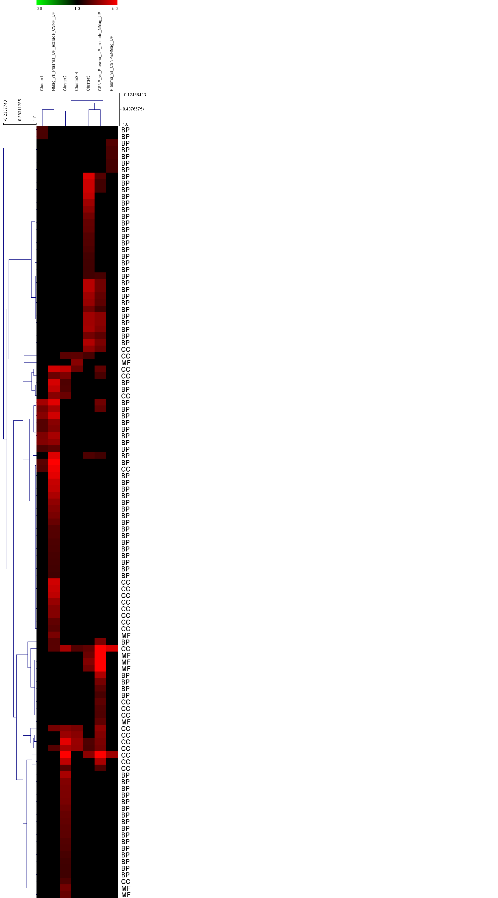
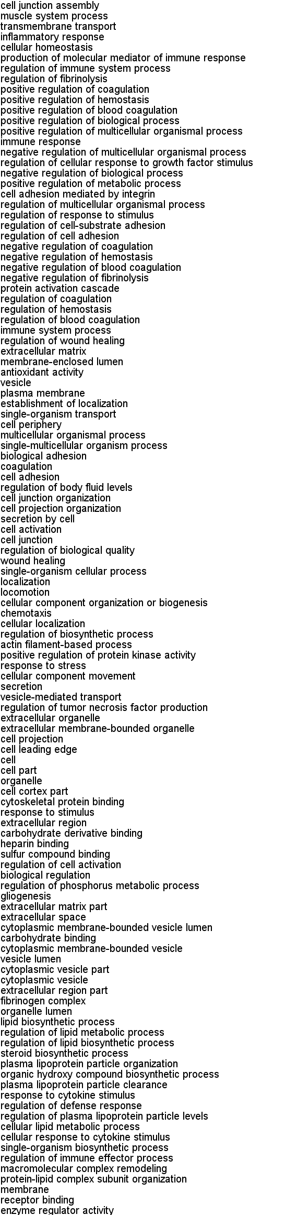
S5_Fig.
Distinct plasma protein corona composition on the two different SPIONs. Gene ontology (GO) enrichment analysis of CSNP corona-specific, nanomag®-D-spio corona-specific and plasma-specific proteins based both on statistical analyses (see Table S2) and on clustering (see Figure 4). Overrepresented GO categories related to each ‘signature’ (cf. Table S5-S6) were hierarchically clustered. GO category branches are indicated as BP (Biological Process), MF (Molecular Function) and CC (Cellular Component). Cluster 1 proteins (nanomag®-D-spio enriched) are specifically enriched for GO ‘cell activation’ and GO ‘coagulation’, Cluster 2 (CSNP enriched) for GO ‘fibrinogen complex’ and GO ‘lipid biosynthetic process’, and Cluster 5 (CSNP) for GO ‘regulation of coagulation’, GO ‘heparin binding’ and GO ‘regulation of fibrinolysis’.

