Slide 1
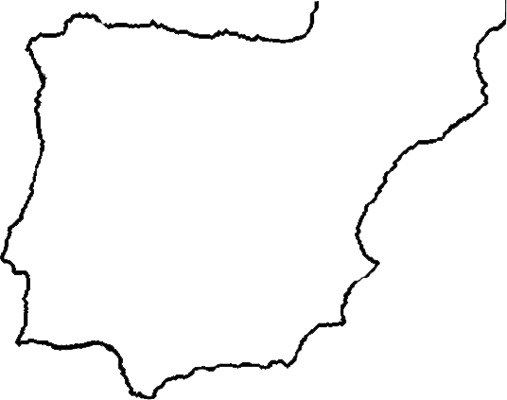
Fig. S1
1
2
3
5
4
6
7
23
8
9
11
10
12
13
15
14
17
16
24
21
19
18
20
22
Notes:
FIG. S1.- Map of the Iberian Peninsula showing the location of the Brachypdoium populations included in the study. Numbers refer to the name of the population given in the table S1.

Slide 2
Fig. S2
Water regime drought tolerance experiment
flowering monitoring
flowering monitoring
vernalization at 4 ºC
LICOR measurements
Collection for 13 δ C
Well watered
% soil moisture
Drought treatment
1
2
3
4
5
6
7
8
9
Weeks
Notes:
Fig. S2. Soil moisture variation during the drought tolerance experiment between the two watering treatments.

Slide 3
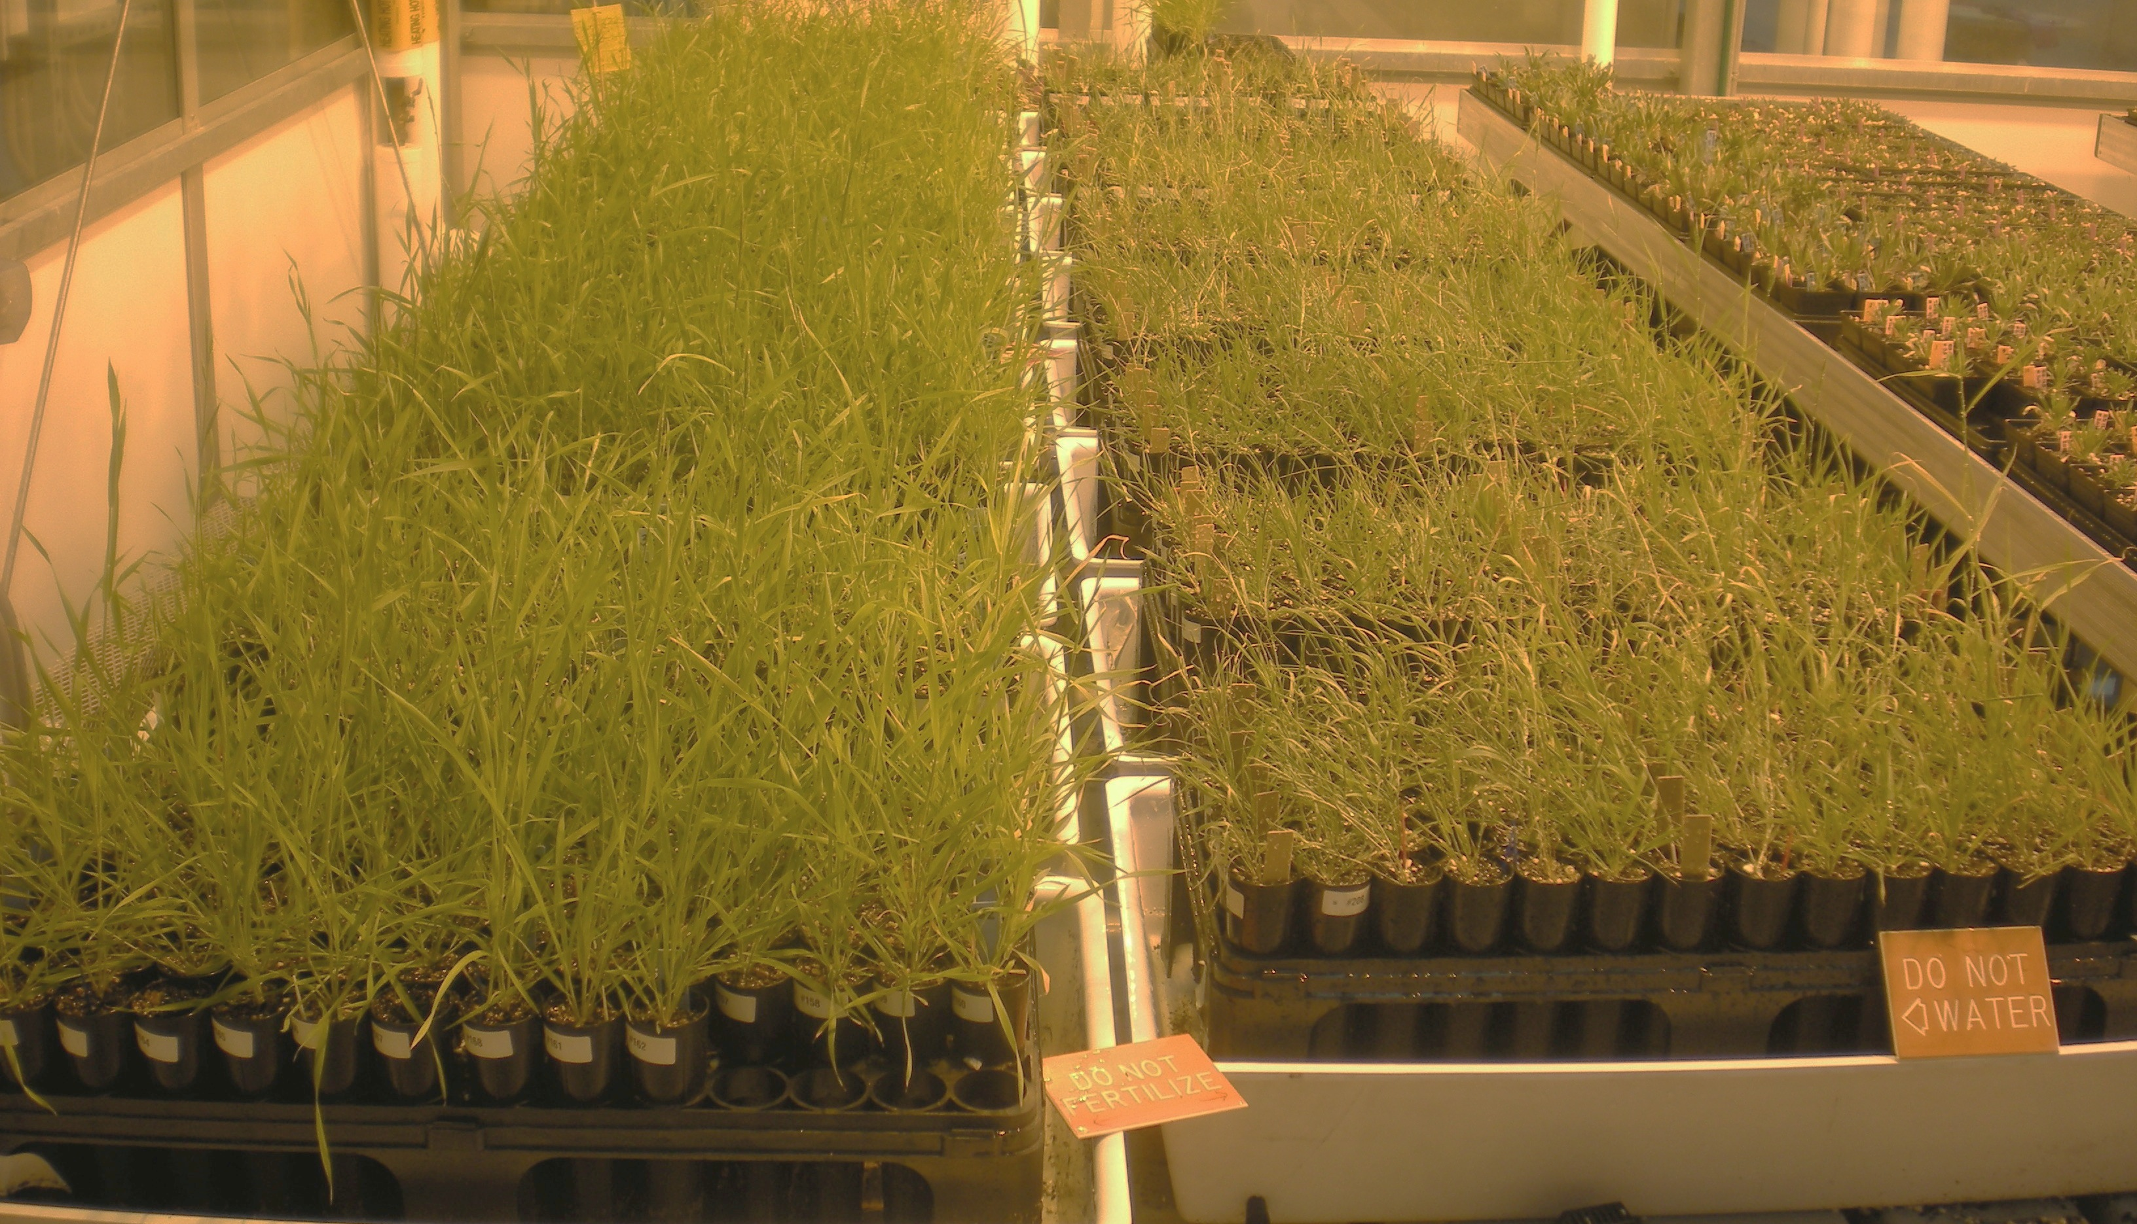
Fig. S3
WELL-WATERED
WATER-RESTRICTED
Notes:
Fig. S3.- A picture of the experiment taken at the 7th week within the Duke Grenhouse. Left, Brachypodium plants subjected to a well-watered treatment. Right, Brachypodium plants subjected to a drought treatment (dry-down).

Slide 4
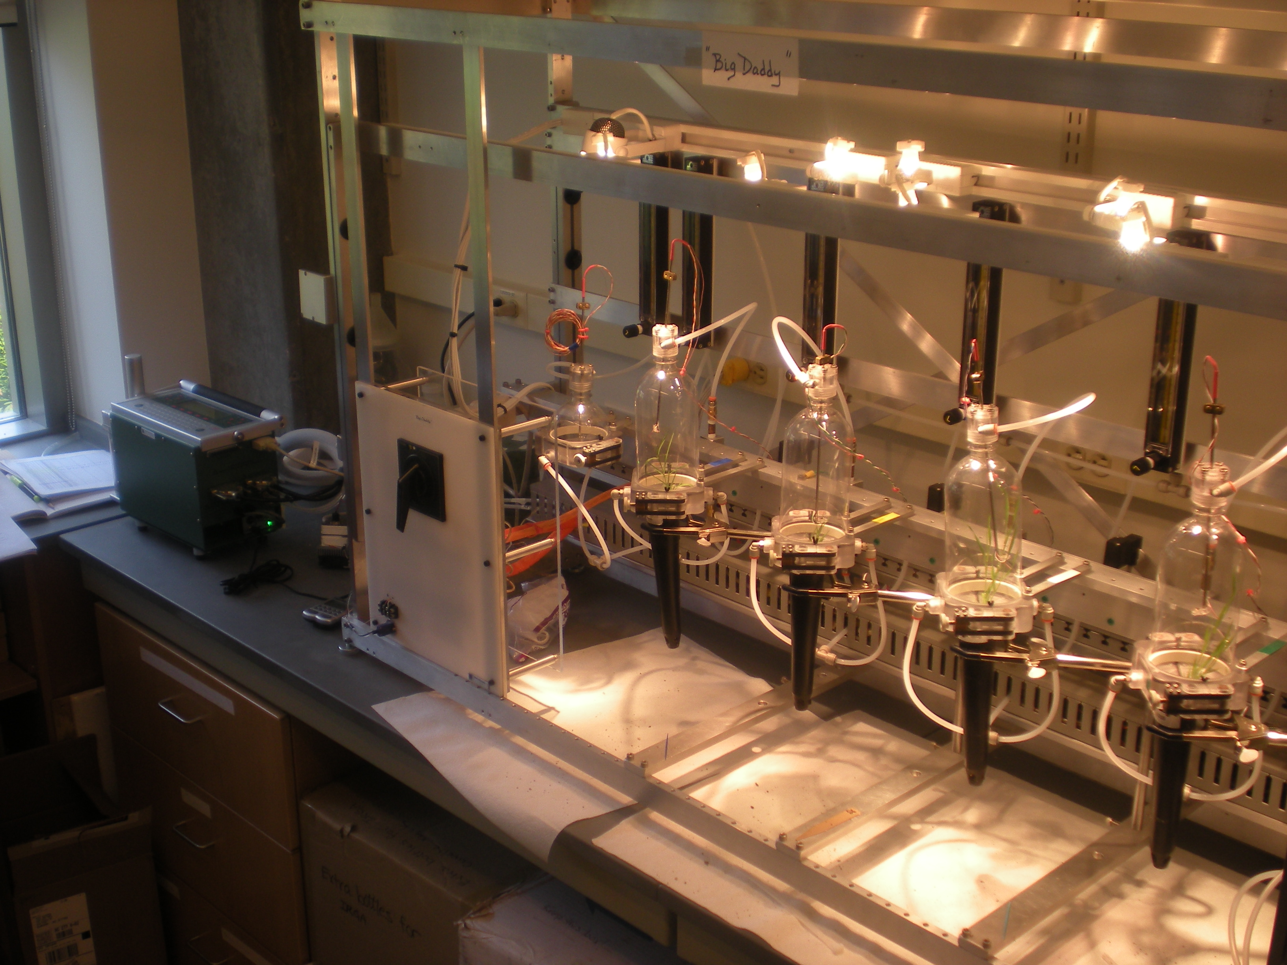
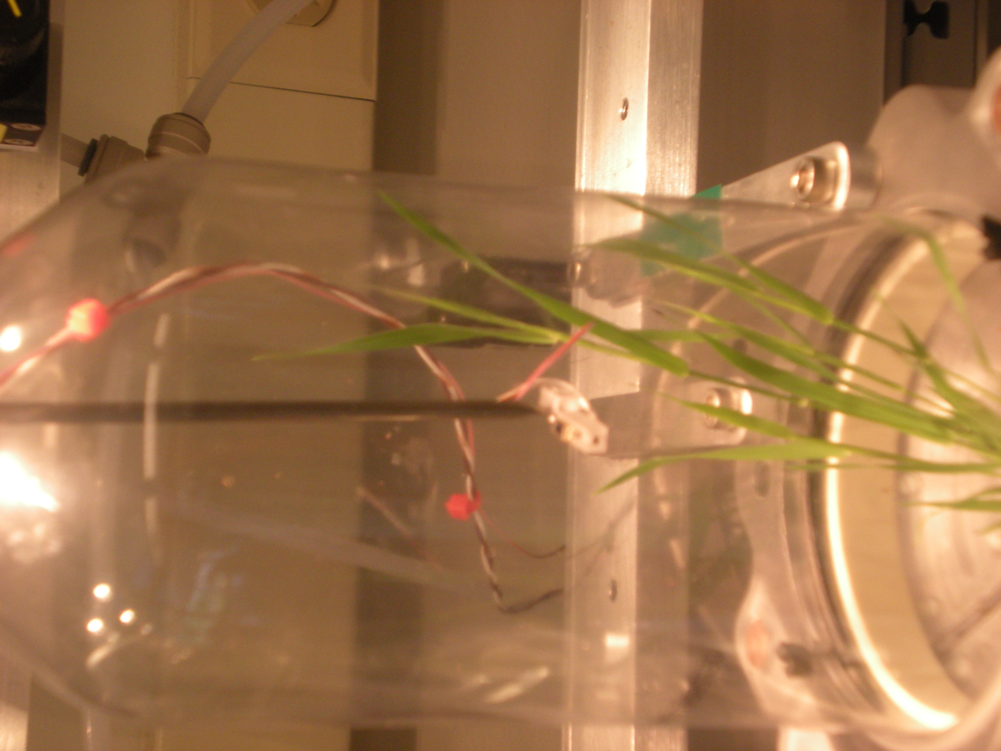
Fig. S4
Notes:
Fig. S4.- LI-COR LI-6400 portable photosynthesis system modified to fit a set of four whole-plant cuvettes in a parallel processing system. This system allows to measure whole gas exchange in several plants simultaneously. This system was designed and built by S. Tonsor (University of Pittbusrg, USA).

Slide 5
Fig. S5
R² = 0.757; P = 0.019
R² = 0.467; P = 0.01
Soil moisture deficit (mm)
Soil moisture deficit (mm)
Latitude
Longitude
R² = 0.314; P = 0.06
R² = 0.329; P = 0.03
Soil moisture deficit (mm)
Soil moisture deficit (mm)
Latitude
Longitude
Notes:
Fig. S5.- Non-linear relationships between annual soil moisture deficit, latitude and longitude across B. distachyon diploid populations (graphs above, green circles), and B. hybridum allotetraploids (graphs below, red traingles).

Slide 6
Fig. S6
WW
WR
WW
WR
11
WW
WR
8
4
3
16
14
17
21
19
2
22
1
5
18
δ¹³C ‰
δ¹³C ‰
A (μmol CO₂ m⁻² s⁻¹)
g_{s} (mmol m⁻²s⁻¹)
Notes:
FIG S6.- Inter-individual natural variation in whole plant photosynthesis (A), stomatal conductance (gs), and carbon isotope ratio among 90 B. distachyon diploid inbred lines which were experimentally exposed to two watering treatments (WW = well watered; WR = water-restricted). Lines come from 14 natural populations across the Iberian Peninsula. Values are adjusted LS-MEANS from the linear mixed models ± 1SE. Numbers in the first graph refer to the name of the population given in the table S1.

Slide 7
Fig. S7
WW
WR
WW
WR
9
WW
WR
12
6
16
7
10
23
14
17
24
13
22
15
δ¹³C ‰
δ¹³C ‰
18
20
A (μmol CO₂ m⁻²s⁻¹)
g_{s} (mmol m⁻²s⁻¹)
Notes:
FIG S7.- Inter-individual natural variation in whole plant photosynthesis (A), stomatal conductance (gs), and carbon isotope ratio among 99 B. hybridum allotetraploid inbred lines which were experimentally exposed to two watering treatments (WW = well watered; WR = water-restricted). Lines come from 15 natural populations across the Iberian Peninsula. Values are adjusted LS-MEANS from the linear mixed models ± 1SE. Numbers in the first graph refer to the name of the population given in the table S1.

Slide 8
Fig. S8
R² = 0.219; P = 0.078
a)
R² = 0.334; P = 0.06
b)
g_{s} (mmol m⁻²s⁻¹)
(A)(μmol CO₂ m⁻²s⁻¹)
Temperature
Soil moisture deficit (mm)
R² = 0.209; P = 0.08
c)
R² = 0.218; P = 0.07
d)
(A)(μmol CO₂ m⁻²s⁻¹)
(A)(μmol CO₂ m⁻²s⁻¹)
Precipitation
Temperature
R² = 0.22; P = 0.09
e)
Flowering time
Precipitation
Notes:
Fig. S8.- Relationships between annual precipitation, temperature and annual soil moisture deficit and the genetic population means of ecophysiological traits under water restricted conditions: a) stomatal conductance (g_{s}); b, c,d) photosynthesis (A), e) flowering time. Soil moisture deficit is defined as potential evapotranspiration minus precipitation. In all cases, the solid line depicts the best quadratic regression fit between variables, and dashed lines are its 95% confidence intervals. Only data for B. hybridum allotetraploids are depicted (red triangles).

Slide 9
Fig. S9
R² = 0.808; P <0.0001
R² = 0.706; P < 0.0001
a)
R² = 0.329; P = 0.006
R² = 0.308; P < 0.0001
b)
R² = 0.410; P = 0.0012
R² = 0.376; P < 0.0001
c)
g_{s} (mmol m⁻² s⁻¹)
(A)(μmol CO₂ m⁻² s⁻¹)
(A)(μmol CO₂ m⁻² s⁻¹)
g_{s} (mmol m⁻²s⁻¹)
Flowering time
Flowering time
d)
Notes:
FIGURE S9 - Genetic relationships ecophysiological traits across B. distachyon diploid genotypes (solid circles in the graphs) and B. hybridum allotetraplod genotypes (inverted triangles in the graphs) under water restricted conditions. A) whole carbon gain and stomatal conductance (g_{s}); B) whole carbon gain and flowering time; C) stomatal conductance (g_{s}) and flowering time; Figures in A were transformed to log-scale. In all cases, lines depict the best significant fit (P<0.05, data not shown) between variables. Solid lines represent curves fitted for allotetraploids, broken lines depict the fit for diploids. Non-significant relationships are not shown for clarity.

