Slide 1
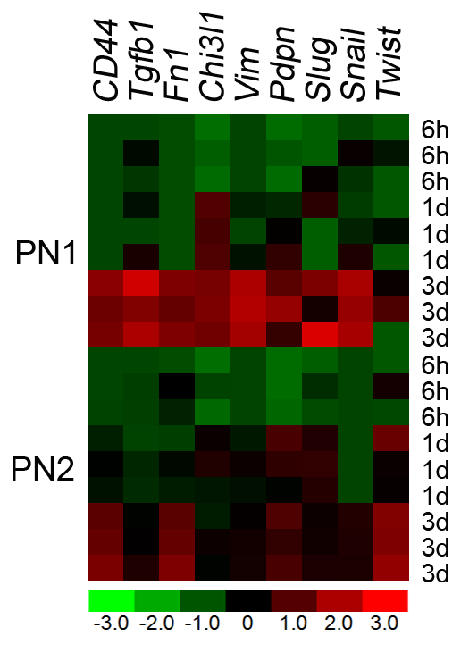
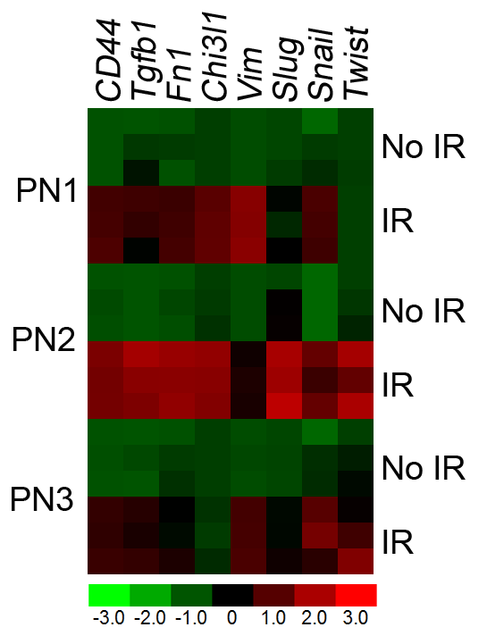
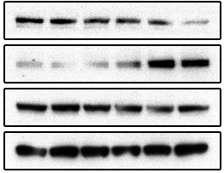
Suppl. Figure 3.
A
PN1
PN2
6hr
1d
3d
5d
6hr
1d
3d
IR
–
+
–
+
–
+
–
+
IR
–
+
–
+
–
+
B
CD44
Tgfb1
Fn1
Chi3l1
Pdpn
Slug
Snail
Twist
Time
Vim
6h
3.0
PN1
1d
2.0
3d
1.0
Fold change mRNA expression IR/NIR
0
6h
-1.0
PN2
1d
-2.0
3d
-3.0
C
GBM5
D
NIR
IR
PDGFRα
pSTAT3
STAT3
GAPDH

