Slide 1
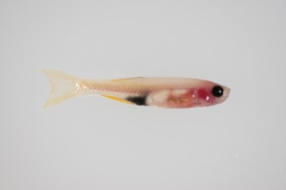
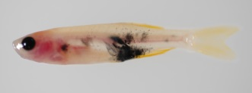
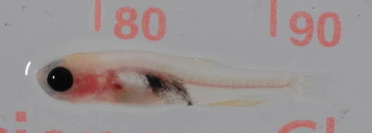
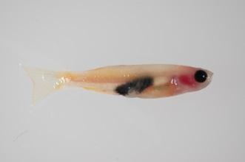

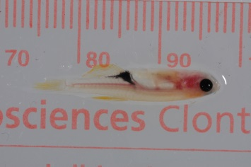
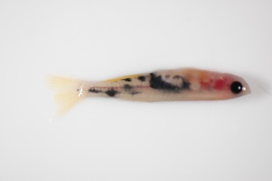
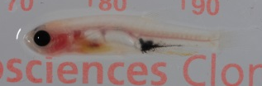
Donor tumor 1
Donor tumor 2
Donor tumor 3
Recipient 1
Recipient 2
Recipient 3
Supplemental Figure 1: Metastatic behavior of primary melanoma transplants. Transgenic melanomas from mitf-BRAF^{V600E};p53^{-/-} fish were generated and then 500,000 cells were transplanted into multiple casper recipients. Fish were imaged using brightfield imaging. Each donor fish gave rise to a heterogeneous patterns of both primary growth and metastatic spread, prompting the need to develop stable cell lines from donor tumors.

Slide 2
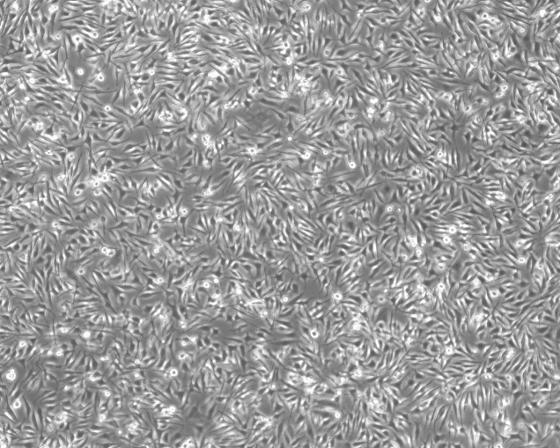
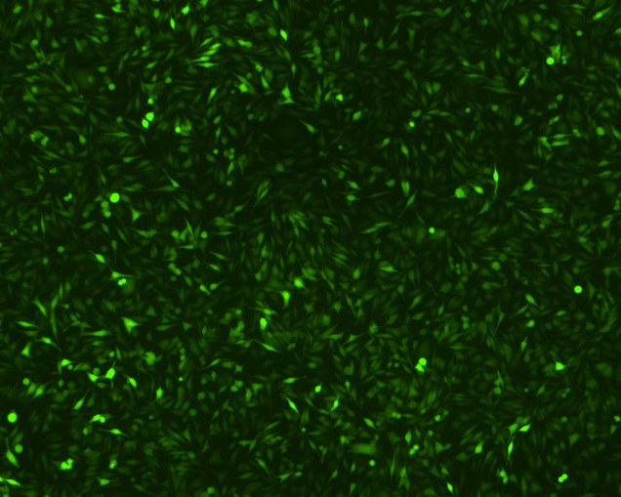
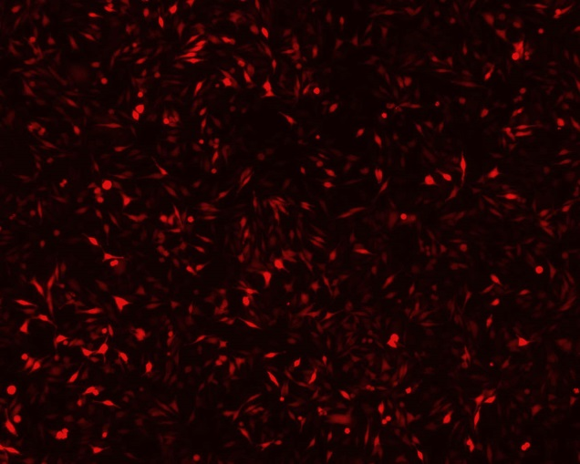
Brightfield
EGFP
tdTomato
Supplemental Figure 2: Demonstration of cDNA overexpression in the ZMEL1 line. The parental ZMEL1-GFP line (left) was nucleofected with an expression plasmid consisting of the zebrafish ubb (ubiquitin) promoter driving EGFP-2A-tdTomato. The cells were FACS sorted to purity by 3 rounds of successive sorting for tdTomato, yielding cells that were both GFP and tdTomato positive.

Slide 3
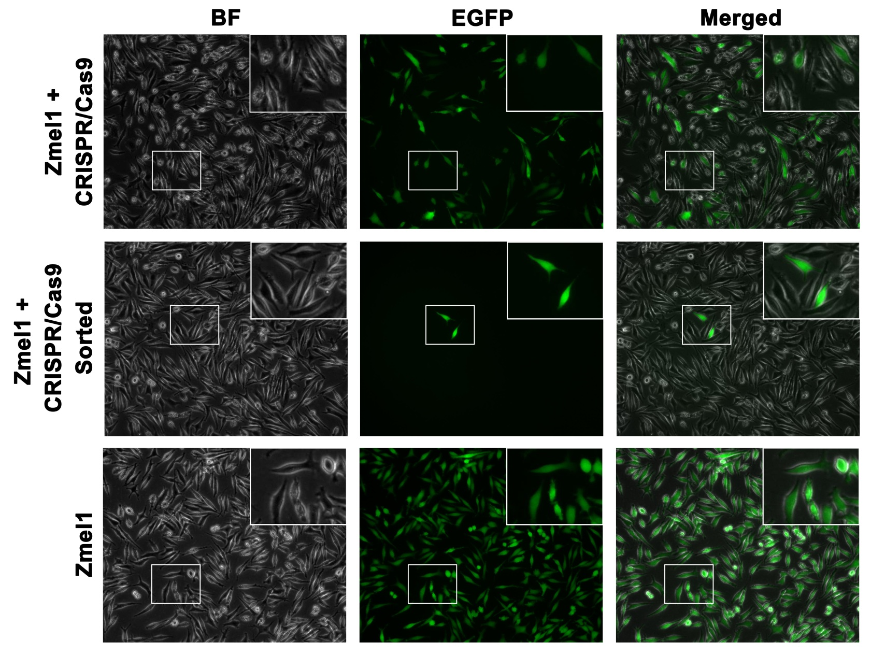
Supplemental Figure 3: Demonstration of CRISPR/Cas9-mediated mutation in the ZMEL1 line. The parental ZMEL1-GFP (bottom) line was nucleofected with a CMV-Cas9 construct along with a zebrafish U6-driven guide RNA against GFP. Within 1-2 weeks (top) GFP negative cells could be easily discerned, and with a single round of FACS (middle) could be enriched to over 99% GFP negative purity. Inset images are 2X magnification views of the boxed area.

Slide 4
Supplemental Figure 4: SURVEYOR assay was performed to assess mutation rates in ZMEL1 cells nucleofected with CRISPR/Cas9 constructs. Hybridized samples before (H) and after (Nu) SURVEYOR Nuclease treatment were analyzed by gel electrophoresis. (a) Assay positive and negative controls, and (b) Zmel1 cells with and without CRISPR/Cas9. Increased mutation of EGFP was observed at day 28 post-nucleofection compared to day 8 post-nucleofection. Expected uncut PCR product sizes are (a) 633 bp and (b) 403 bp.

Slide 5
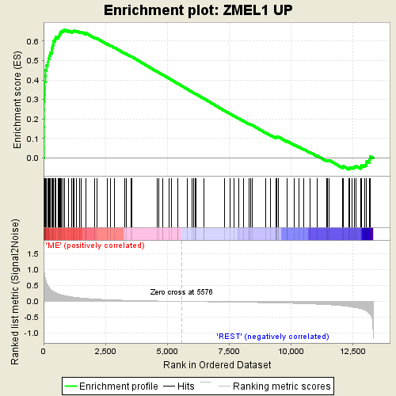
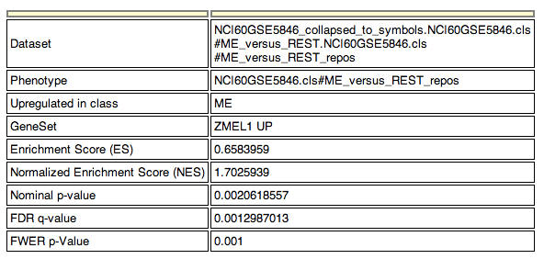
Supplemental Figure 5: Gene Set Enrichment Analysis (GSEA) for the ZMEL1 transcriptional signature compared to the NCI60 human cancer cell lines (dataset NCI60GSE5846). Genes upregulated in ZMEL1 (compared to pooled normal RNA) are strongly enriched in the melanomas subset (“ME”) of the NCI60 compared to all other tumors (“REST”).

Slide 6
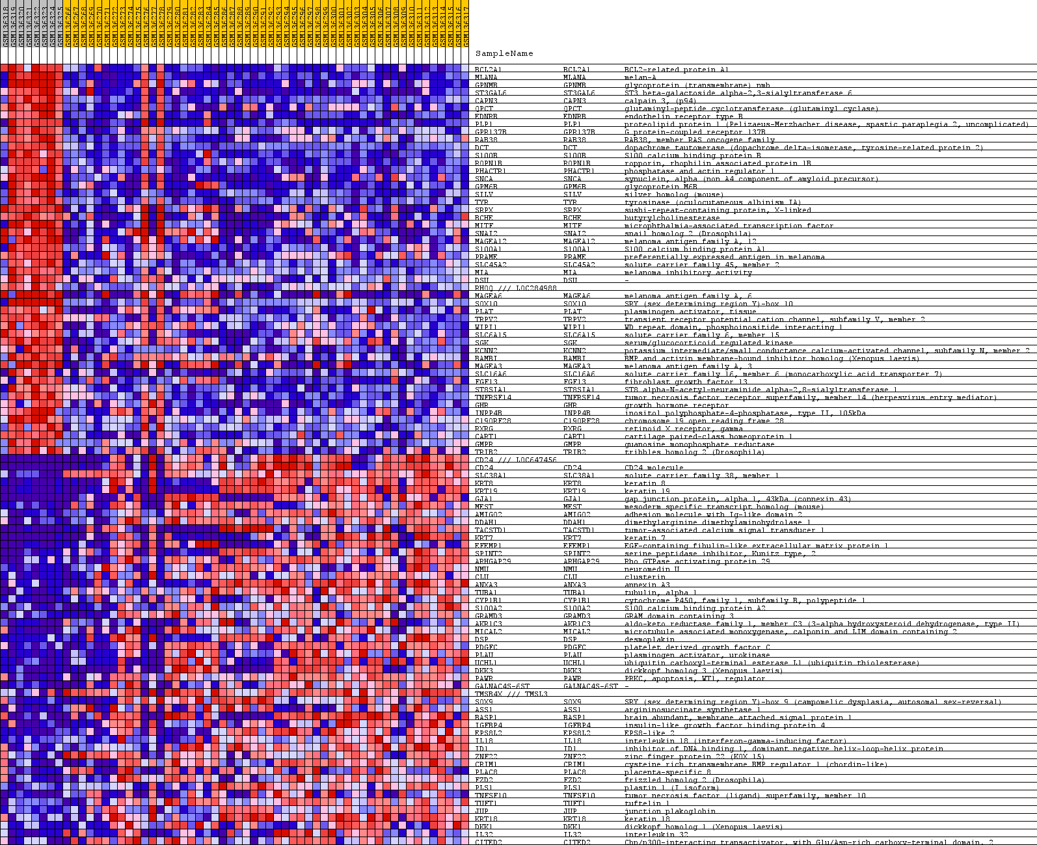
Melanomas
Rest of NCI60
Supplemental Figure 6: Heatmap plot of the GSEA analysis described in Supplemental Figure 3 and in the text, showing strong enrichment of both up (red) and down (blue) regulated genes in melanomas compared to the rest of the NCI60 dataset. Please see Supplemental Table 1 (“GSEA” tabs) for full listing of genes shown here.

Slide 7
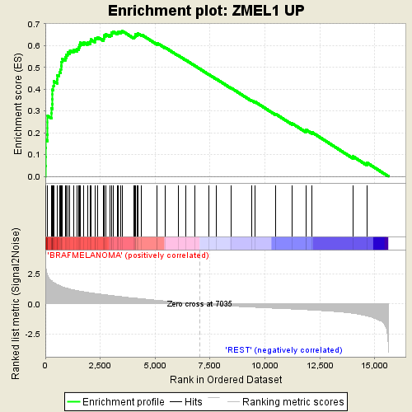
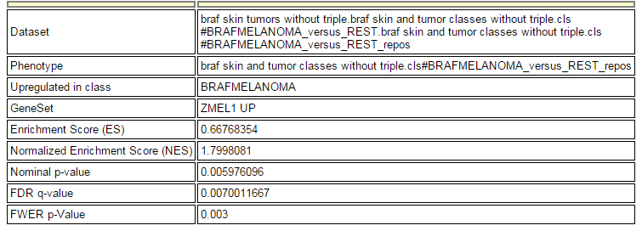
Supplemental Figure 7: Gene Set Enrichment Analysis (GSEA) for the ZMEL1 transcriptional signature compared to the original transgenic mitf-BRAF;p53 tumors from which they are derived (derived from GEO dataset GSE24528). Genes upregulated in ZMEL1 (compared to pooled normal RNA) are strongly enriched in the melanomas compared to skin (“REST”).

Slide 8
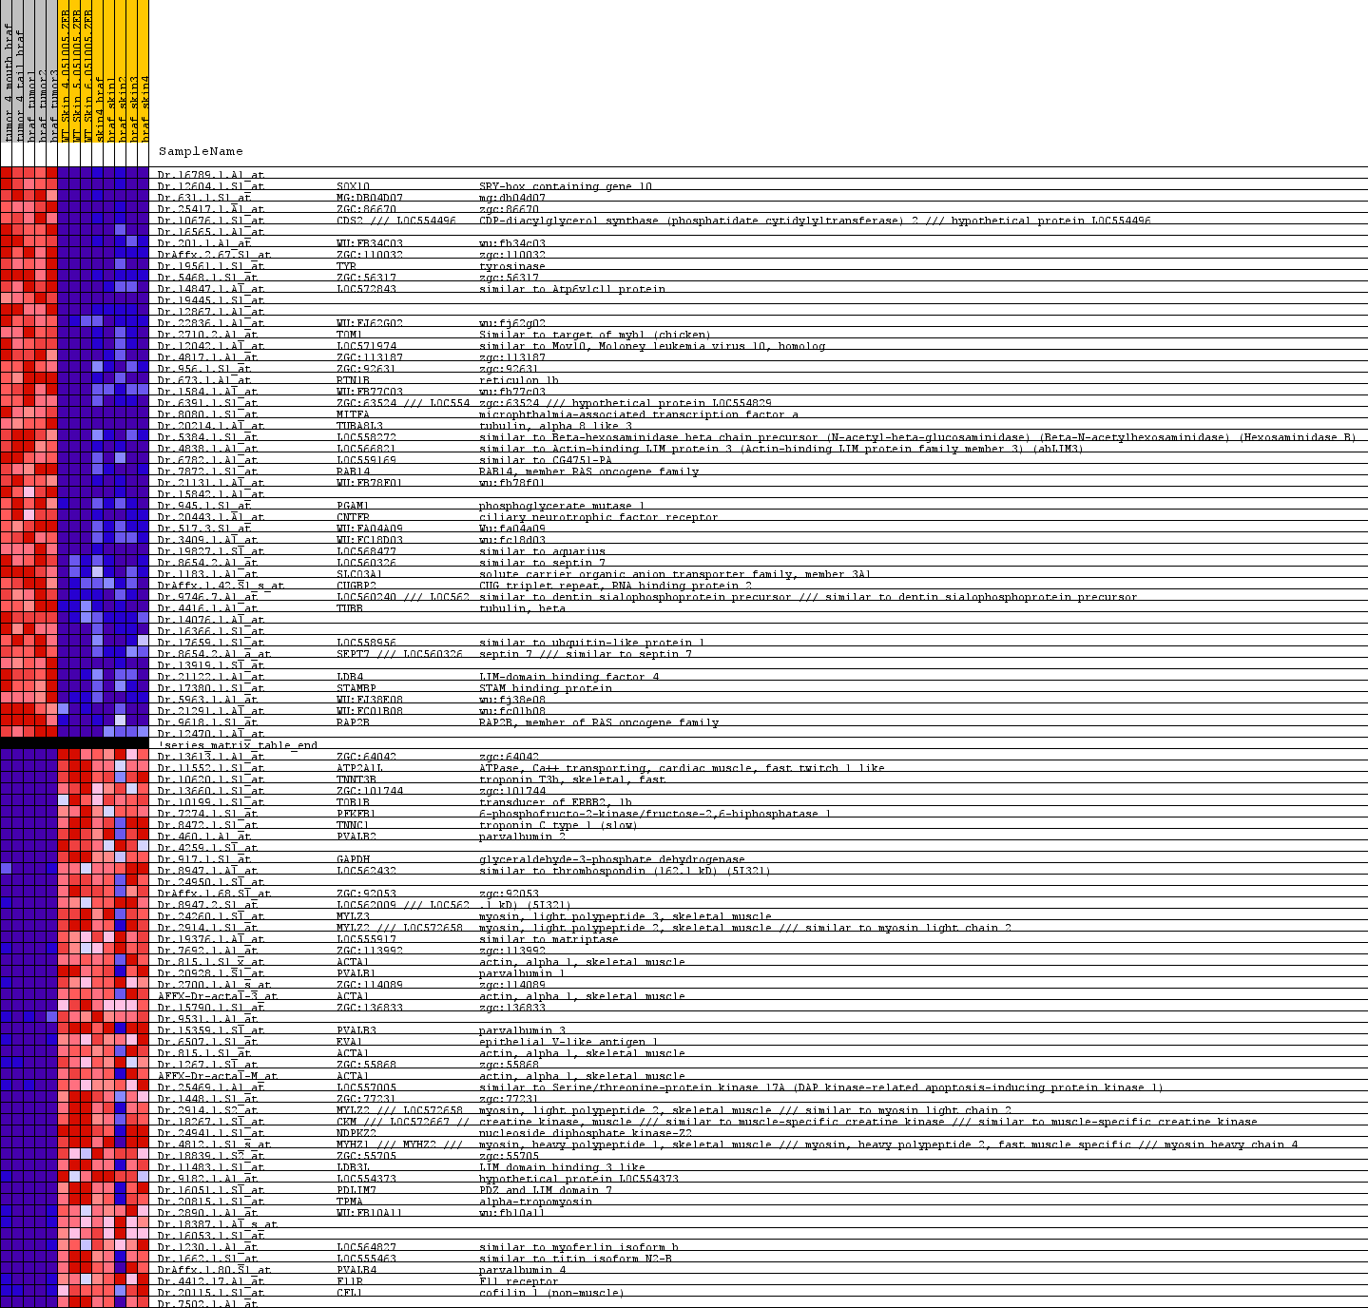
Transgenic
Melanomas
Skin
Supplemental Figure 8: Heatmap plot of the GSEA analysis described in Supplemental Figure 7 and in the text, showing strong enrichment of both up (red) and down (blue) regulated genes in the ZMEL1 line compared to the original transgenic mitf-BRAF;p53 tumors from which they are derived.

Slide 9
Supplemental Figure 9: Ingenuity Pathway Analysis of the ZMEL1 expression signature. Shown are the “canonical” pathways showing significant enrichment in the ZMEL1 dataset. Amongst the most enriched genes (circled) in the upregulated ZMEL1 dataset are those involved in melanocyte and pigment cell biology (circled).

Slide 10
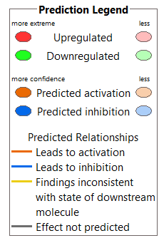
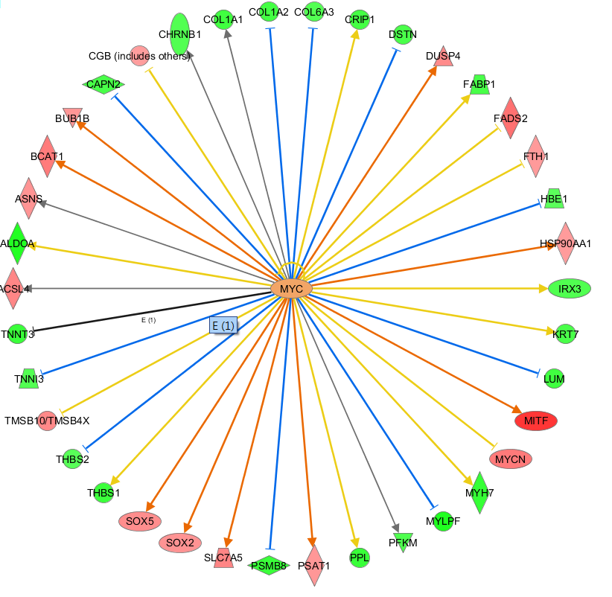
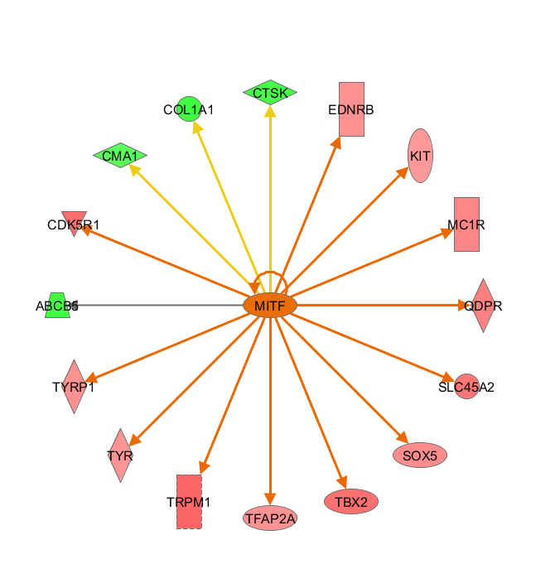
Supplemental Figure 10: Ingenuity Pathway Analysis of the ZMEL1 expression signature. Shown are significant “networks” of genes uncovered within the dataset, which includes genes regulated by MYC (left) and those regulated by MITF (right). The MYC signature is likely due to constitutive BRAF^{V600E} activity, whereas the MITF signature reflects the melanocytic lineage from which melanoma is derived.

Slide 11
Supplemental Figure 11: Heatmap of metastatic spread over 14 days when cells are transplanted dorsally. Metastatic burden increases in an anterior direction over time, and is directly proportional to the extent of tumor burden at day 1 post transplant. The color bar to the right indicates the probability of finding a GFP lesion.

Slide 12
Group |  |  | Tumor assessment by H&E staining |  |  |  |  | Tumor assessment by anti-GFP staining
PBS control
 | PBS-fish 1 |  | negative |  |  |  |  | negative
 | PBS-fish 2 |  | negative |  |  |  |  | negative
 | PBS-fish 3 |  | negative |  |  |  |  | negative
1x10⁵ cells
 | 1x10⁵-fish 1 |  | primary tumor present, no metastases |  |  |  |  | primary tumor present, no metastases
 | 1x10⁵-fish 2 |  | primary tumor present, no metastases |  |  |  |  | primary tumor present, no metastases
 | 1x10⁵-fish 3 |  | primary tumor present, no metastases |  |  |  |  | primary tumor present, no metastases
5x10⁵ cells
 | 5x10⁵-fish 1 |  | primary tumor present, +kidney metastases |  |  |  |  | primary tumor present, +kidney metastases
 | 5x10⁵-fish 2 |  | primary tumor present, +kidney metastases |  |  |  |  | primary tumor present, +kidney metastases
 | 5x10⁵-fish 3 |  | primary tumor present, no metastases |  |  |  |  | primary tumor present, no metastases
 | 5x10⁵-fish 4 |  | primary tumor present, +kidney metastases |  |  |  |  | primary tumor present, +kidney metastases
1x10⁶ cells
 | 1x10⁶-fish 1 |  | primary tumor present, +kidney metastases |  |  |  |  | primary tumor present, +kidney metastases
 | 1x10⁶-fish 2 |  | primary tumor present, no metastases |  |  |  |  | primary tumor present, possible spleen metastasis
 | 1x10⁶-fish 3 |  | primary tumor present, no metastases |  |  |  |  | primary tumor present, no metastases
Supplemental Figure 12: Histologic assessment of fish (n=13) transplanted with either PBS (control) or 10⁵, 5x10⁵, or 10⁶ cells.

Slide 13
Supplemental Figure 13: Histology of the kidney marrow from a stable transgenic mitfa-BRAF^{V600E};p53^{-/-} melanoma bearing fish. On the left is H&E staining, where the black arrows point out mitotic figures and abnormal nuclei. On the right is the same section stained with an anti-crestin riboprobe (blue stained areas), which is specific for neural crest derived melanomas.

Slide 14

Supplemental Figure 14: Derivation of the µ score for quantifying metastatic burden in individual fish.

Slide 15
Supplemental Figure 15: Calculation of the metastasis initiating cell (MIC) frequency using the intended number of transplanted cells, in contract to the actual number of cells estimated at day 1 (see Main Figure 5 for this data).

Slide 16
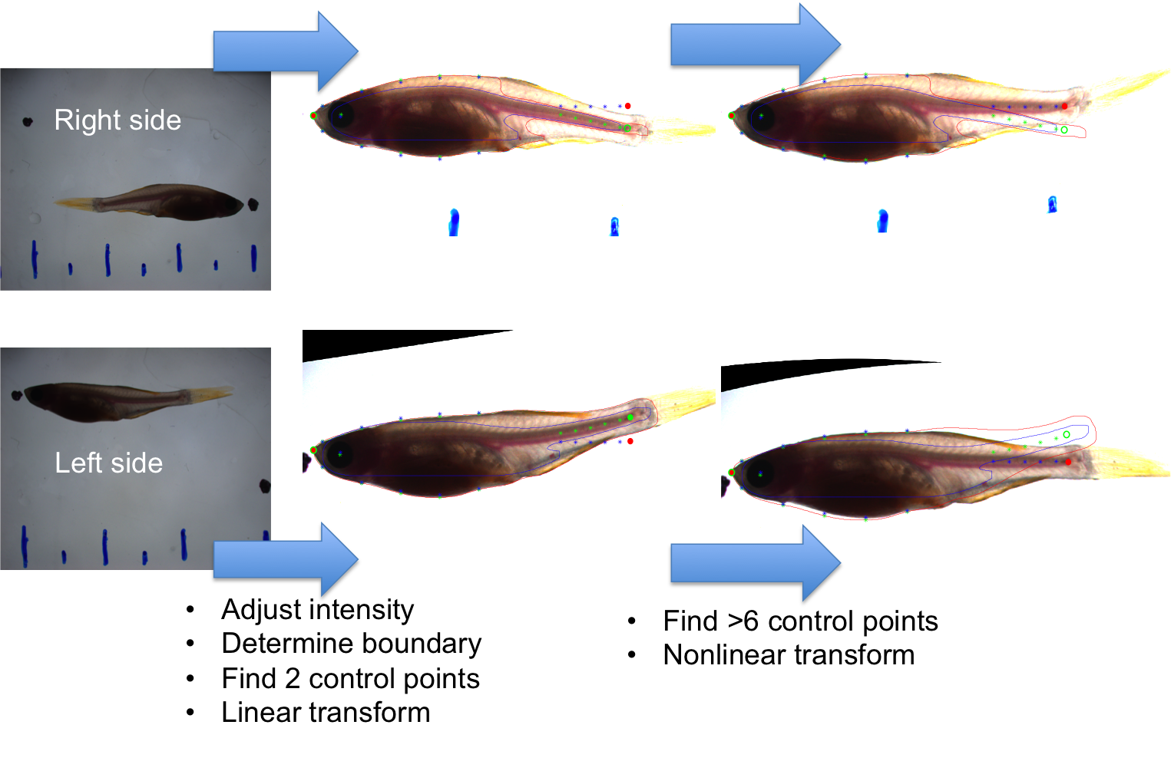
Supplemental Figure 16: Schematic overview of bright field image processing: (Left panel) Image intensity was adjusted, the right side images where flipped horizontally and the boundary of the fish body was determined. Control points (input points) at tip of ‘nose’ and the fish body major axis were determined. Nose input points where translated to (20,250) and fish body major axis rotated to horizontal. (Middle panel) Green: Input points at center of eye, tip of ‘nose’, equally spaced along boundary of front body, along spine in tail and at end of spine. Blue and red: corresponding base points, for nonlinear transformation of image. Note x-coordinates are the same for both input points and base points for both right side and left side images. Base point y-coordinates are averages of each of the y-coordinates of the input points in the right and left side image. (Right panel) Final transformed result.

Slide 17
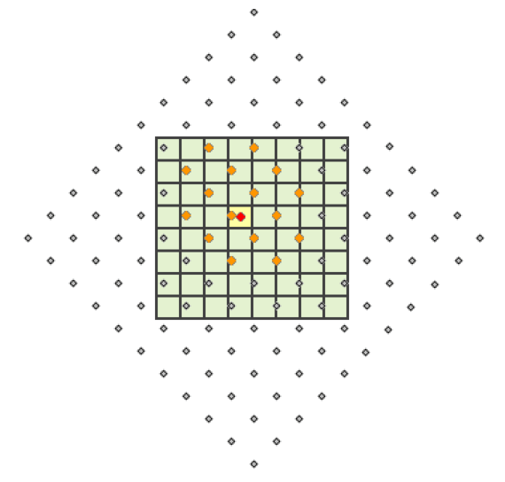
Supplemental Figure 17: Determining pixel intensities in the transformed images: The image transform maps the location of each pixel onto new coordinates in a new square pixel grid. Old grid is show with dots, and new grid is shown with checkered box. Intensity of a pixel in the new grid (focal pixel marked with red dot) is determined using a weighted average (by performing bicubic interpolation, see [2]) of the pixel intensities from the old image of the 16 nearest points (shown in orange) to the focal pixel center in the new pixel grid.

Slide 18
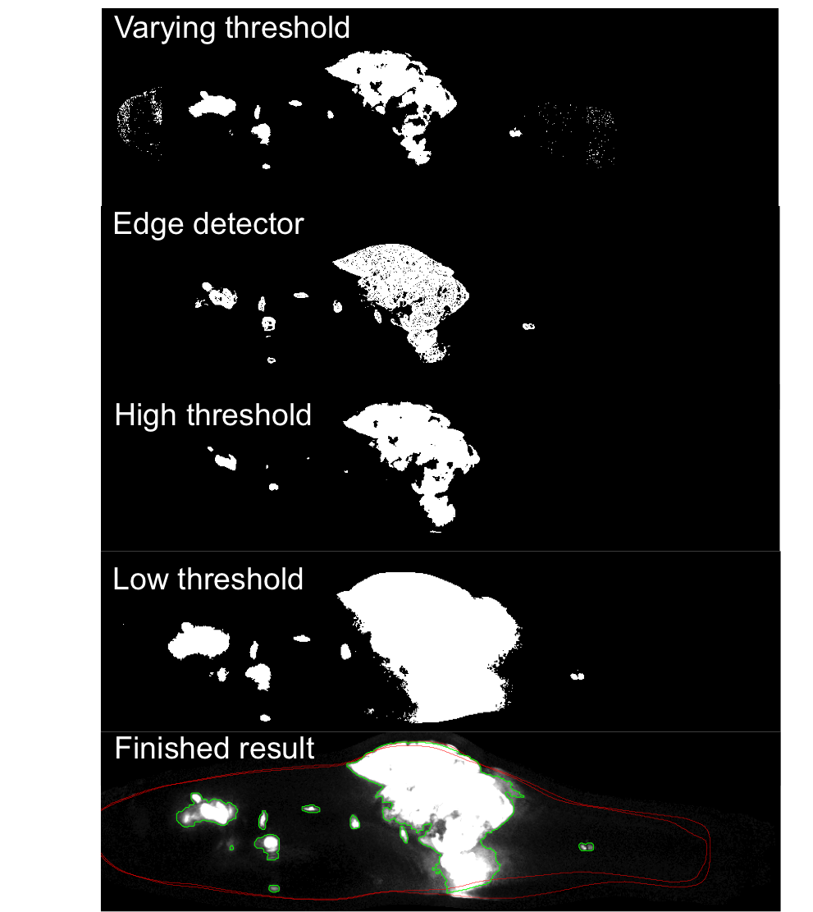
Supplemental Figure 18: Segmentation of GFP images: (Varying threshold): Thresholding of the original GFP image using a different threshold for each pixel column through the fish body. (Edge detection): Thesholding of an image where intensities where given by the local change in pixel intensity of the original GFP image. (High threshold): Thresholding of the original image using a high threshold (~20% of the max). Pixels found to be positive (white) in this image where always included in final result. (Low threshold): Thresholding of the original image using a relatively low threshold (~5% of the max). Pixels found to be negative (black) in this image where never included in final result.

Slide 19
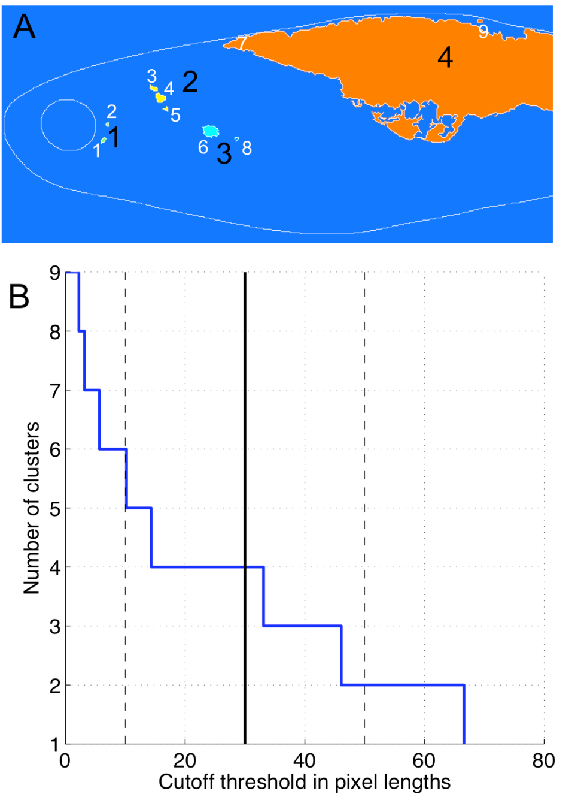
Supplemental Figure 19: Clustering of close objects: (A): An example of how 9 connected pixel regions (objects) in the segmented image where clustered in to 4 clusters by counting all objects closer than 30 pixels apart as part of the same cluster. Note that even though object 3 and 5 are more than 30 pixels apart they still end up belonging to cluster 2 since they are both closer than 30 pixels apart from object 4. (B): Plot illustrating how the number of clusters varies with the choice of cut off threshold for the particular segmented image show in (A). Note that when the threshold is varied by ±10 pixels the number of clusters varies by approx. ±2.

Slide 20
A Day 7
B Day 14
C Day 14 divided
Supplemental Figure 20: Separating merged tumors/metastases: (A) Three distinct clusters of objects at day 7 grow to merge into one cluster at (B) day 14, (yellow primary, red and blue metastases, fish ID # 68). (C) Result of partitioning algorithm.

