Slide 1
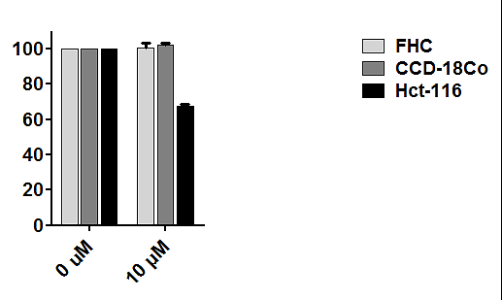
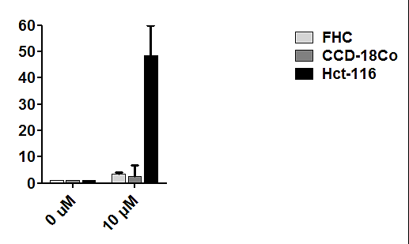















Supplementary Figure 1
A
*
*
Cell viability (%)
Apoptosis (%)
SC43 (μM)
0 10
SC43 (μM)
0 10
B
FHC
CCD-18Co
Hct-116
SC43 (μM)
0 1 5 10
0 1 5 10
0 10
p-STAT3
STAT3
1.0 1.0 1.0 1.0
1.0 1.0 0.7 0.75
1.0 0.1
Mcl-1
1.0 1.0 1.0 1.0
1.0 1.0 1.0 1.0
1.0 1.0
PARP
1.0 1.0 1.0 1.01
1.0 1.0 1.0 1.0
1.0 0.01

β-actin
0.0 0.0 0.0 0.0
0.0 0.0 0.0 0.0
0.0 0.3
1.0 1.0 1.0 1.0
1.0 1.0 1.0 1.0
1.0 1.0
Supplementary Figure 1. The effect of SC-43 on normal colon cells. (A) Cell viability and apoptosis were measured in the normal colon cells, including epithelial cells FHC and fibroblast cells CCD-18Co, compared with cancer cells Hct-116 after treatment with or without 10 μM of SC-43 for 48 h (cell viability) and 24 h (apoptosis). SC-43 was added to the cells maintained in medium with 10% FBS. The data from cell viability and apoptosis assay are shown as mean±s.d. of three independent experiments, made in triplicate. *P<0.05. (B) Western blotting of p-STAT3^{Tyr705}, the cleaved fragments of PARP, and Mcl-1 in cells (maintained in medium with 10% FBS) 24 h after treatment with SC-43 as indicated. β-actin was used as a loading control. The cleaved fragments of PARP are indicated by arrows.
Cell culture of normal colon cells
FHC (ATCC®CRL-1831TM) normal colon epithelial cell line was maintained in DMEM:F12 medium supplemented with 10mM HEPES, 10 ng/ml cholera toxin, 0.005 mg/ml insulin, 0.005 mg/ml transferrin, 100ng/ml hydrocortisone and 10% fetal bovine serum. CCD-18Co (ATCC®CRL-1459TM) normal colon fibroblast cell line was maintained in Eagle’s Minimum Essential medium supplemented with 10% fetal bovine serum. Cells were then incubated at 37°C in a humidified 5% CO2 atmosphere.

Slide 2
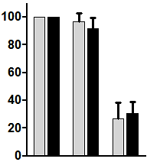
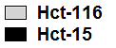


Supplementary Figure 2
Raf-1 activity (%)
*
*
SC-43
-
-
+
-
-
+
Regorafenib
Hct-15

p-MEK1
Hct-116

p-MEK1
Supplementary Figure 2. The effect of regorafenib and SC-43 on Raf-1 kinase activity in CRC cells. Raf-1 kinase activity was measured in Hct-116 and Hct-15 cells 24 h after treatment with or without 5 μM of regorafenib or SC-43. The results are shown as mean±s.d. of three independent experiments. *P<0.05.
Raf-1 kinase assay
Raf-1 kinase activity was determined using Raf-1 Kinase Assay Kit (Millipore, Billerica, MA, USA) according to the manufacturer’s instructions .

