Slide 1
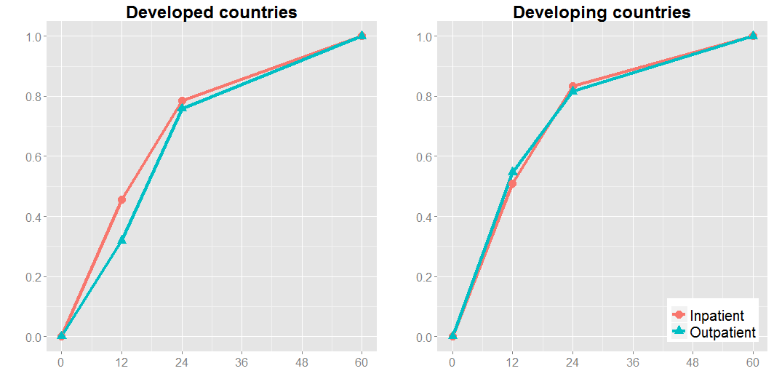
Cumulative proportion of pediatric norovirus cases
Age (months)

