Slide 1
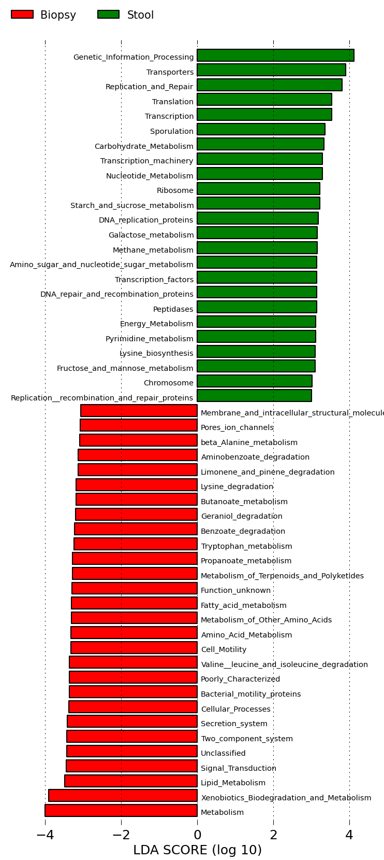
*
Figure S4
Notes:
Figure S3. Predicted microbial functional pathways enriched in the mucosal microbiome and luminal microbiome, respectively, at a higher level of KEGG annotation. The red asterisk highlights benzoate degradation pathway, which has previously been shown to be associated with colitis. The threshold of log LDA used was 3.0.

