Slide 1
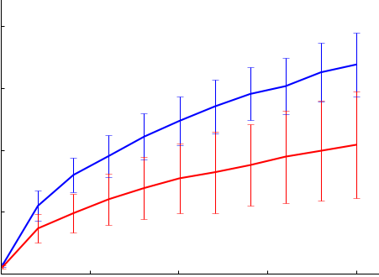
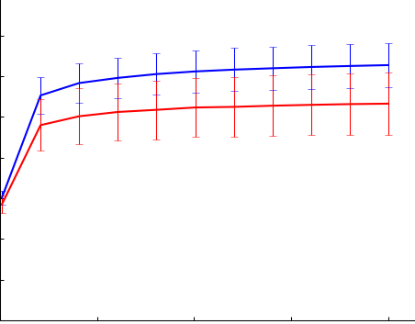
A
B
1000
800
Stool
***
Biopsy
800
chao1
600
600
400
400
200
200
0
0
Biopsy
500
1000
1500
2000
Stool
C
Sequences per sample
Stool
D
8
***
7
Biopsy
6
6
5
Shannon index
Shannon index
4
4
3
2
2
1
500
1000
1500
2000
0
Stool
Biopsy
Sequences per sample
Figure S2
Notes:
Figure S1. Rarefaction curves generated for (A) chao1 and (C) Shannon index showed significantly higher species richness and evenness in the luminal microbiome. Similar findings were obtained when the comparisons were repeated in paired manner (B, D).

