Slide 1
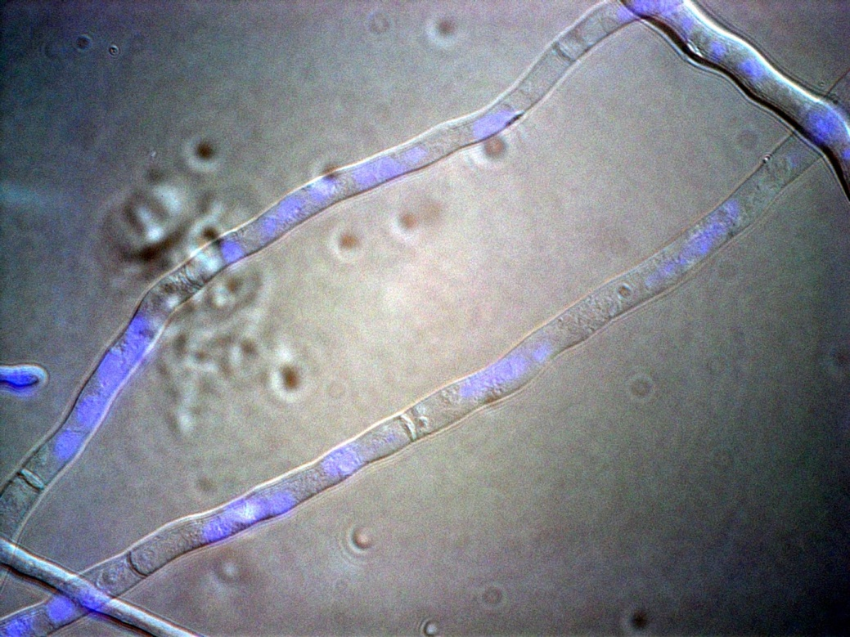
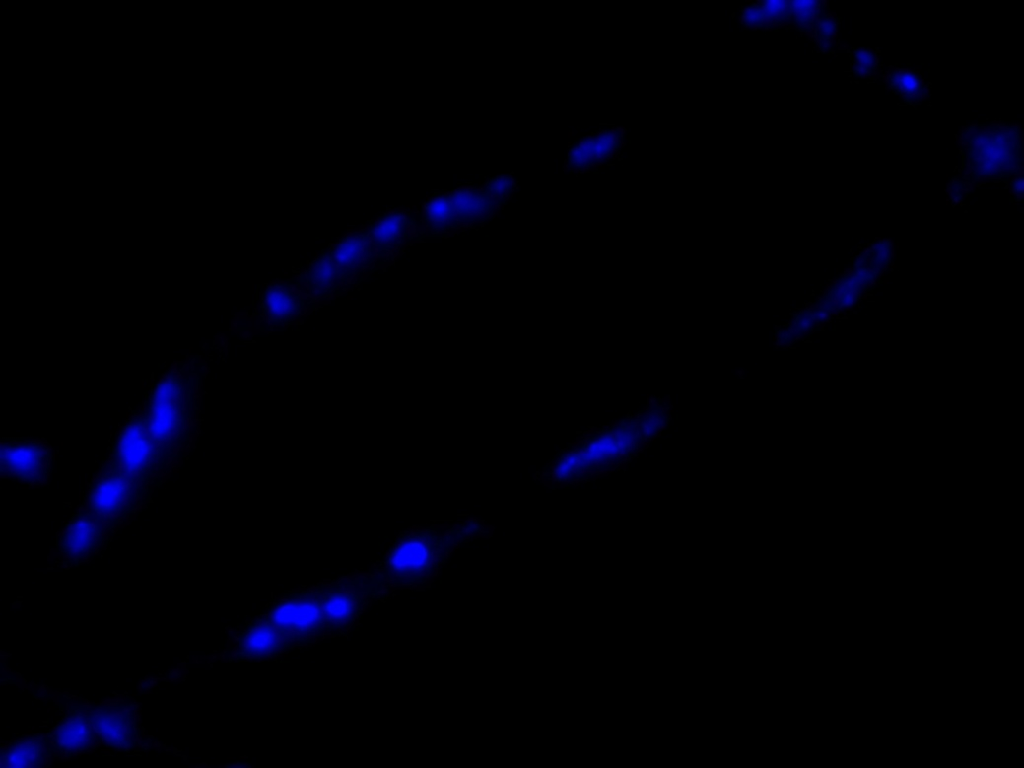
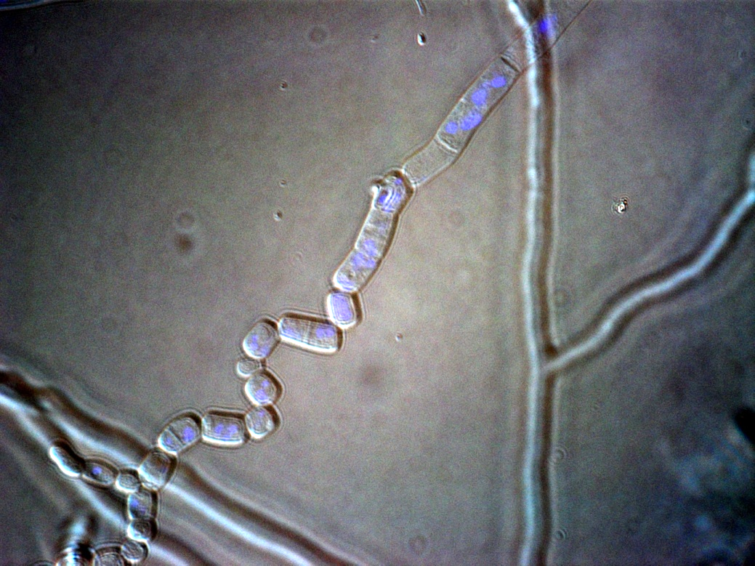
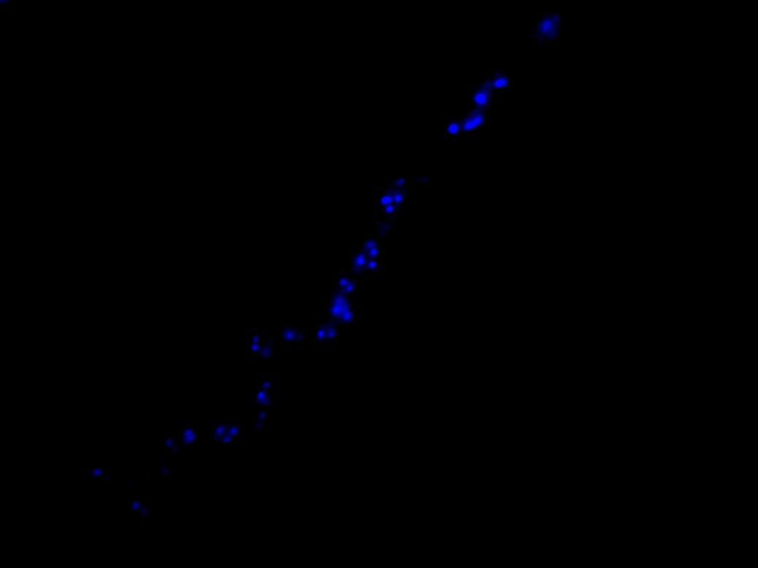
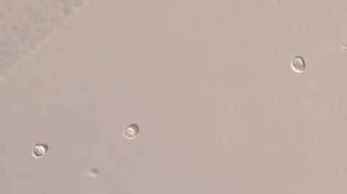
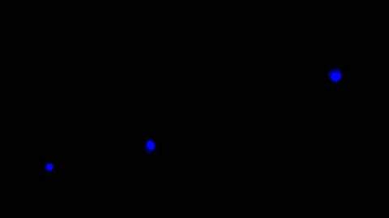
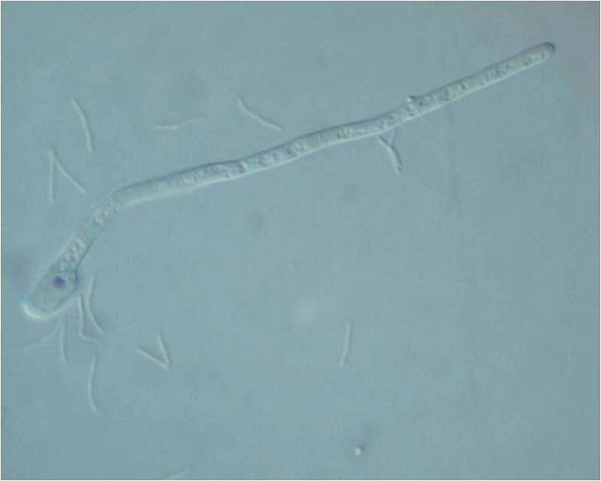
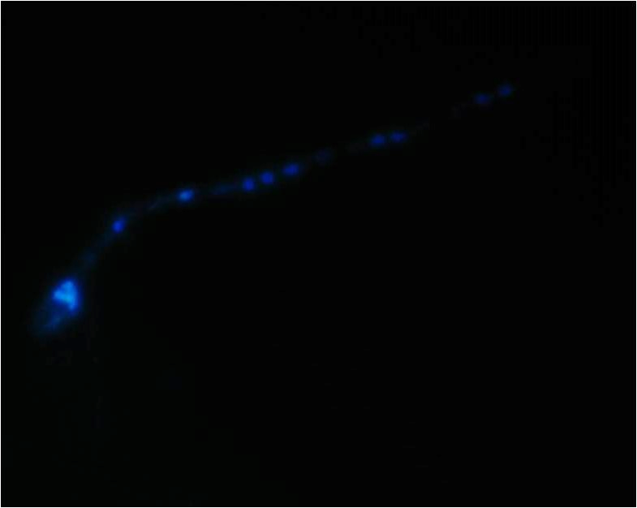
(a)
(b)
(c)
(d)
S1 Fig. DAPI staining to reveal the number of nuclei present in different life stages of Phellinus noxius. DAPI-stained (a) mycelium, (b) arthrospores, (c) basidiospores, and (d) a germinating basidiospore examined in the light- (left) and fluorescent-field (right) under microscope. (Scale bars, 10 µm)

