Slide 1
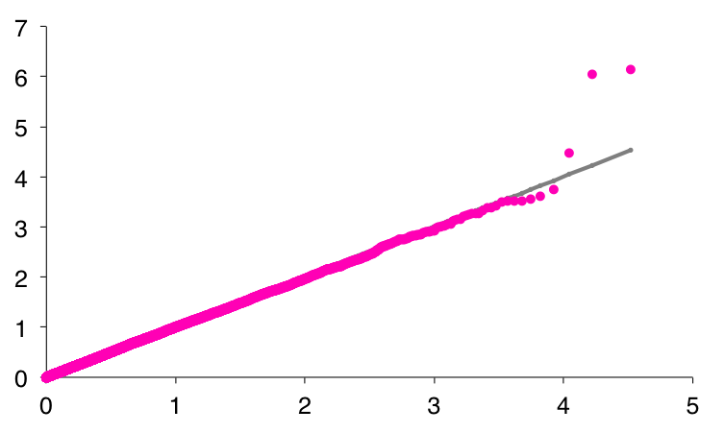
Observed - log10 (P)
Expected - log10 (P)
Additional file 2. Sasaki. et al.

