Slide 1
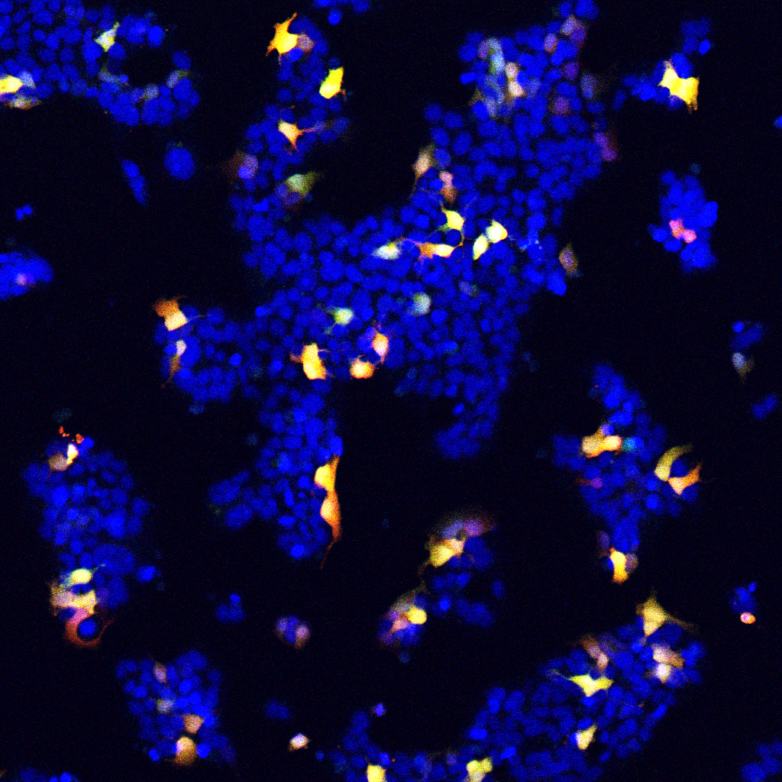
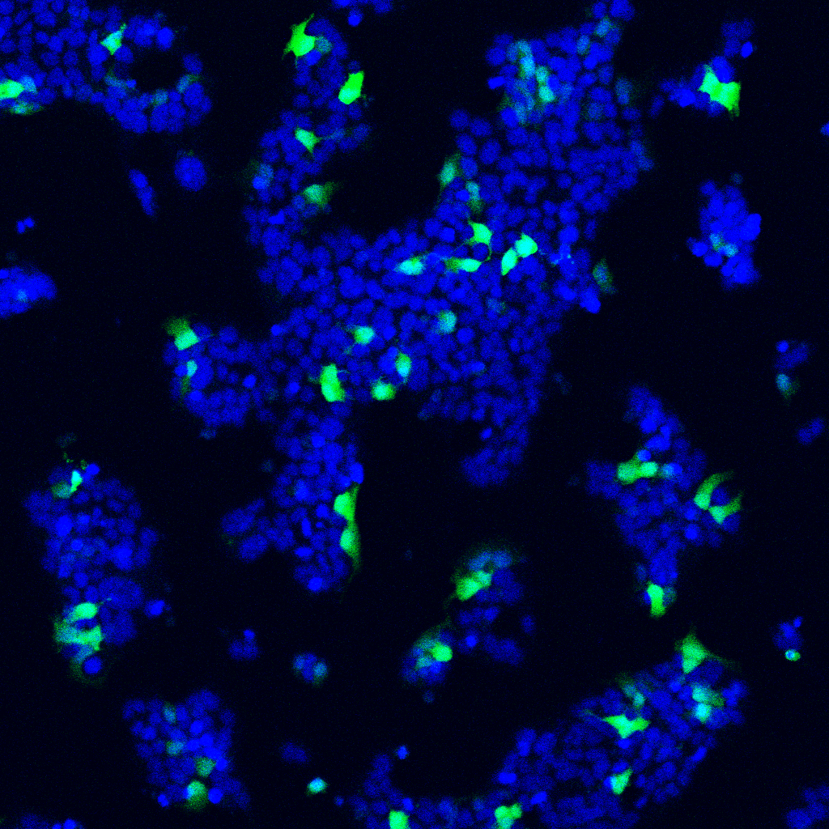
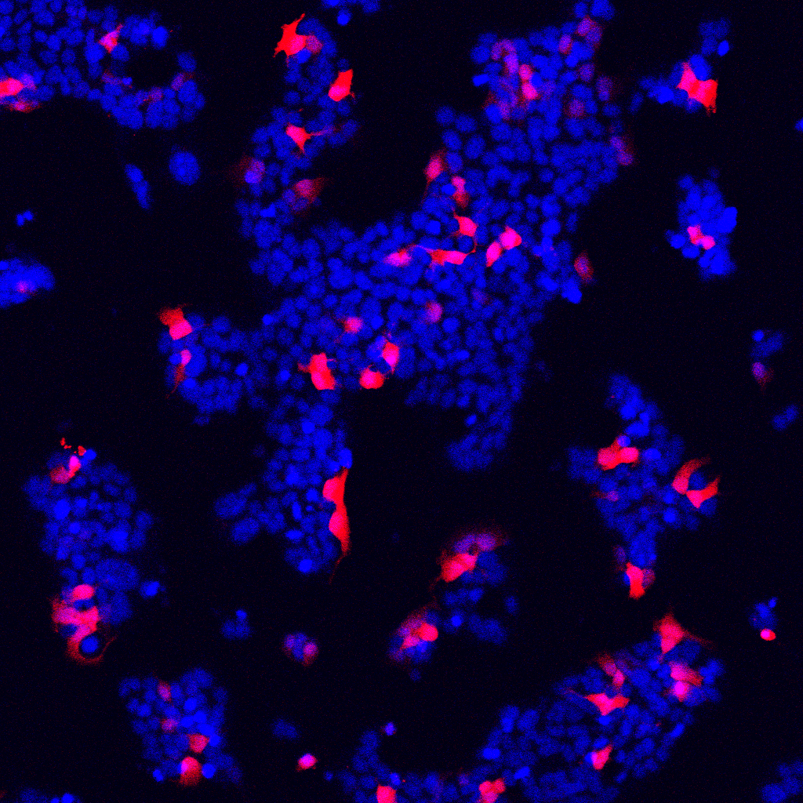
A
B
average transfection efficiency=8.8±1.62 %
Transfection efficiency (%)
Exp1
Exp 2
Exp 3
Exp 4
Exp 5
100 µm
C
D
Additional file 5. Sasaki. et al.

