Slide 1
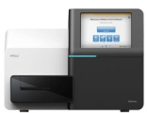
Base calling:
Primary analysis
Alignment:
Secondary analysis
BWA-GATK
Variant calling:
Tertiary analysis
Haplotype
Caller
Unified
Genotyper
VarScan
MuTect
Lofreq
Annotation: Alamut-Batch
Database integration: CANDiD
Biological analysis:
Quaternary analysis
Requests
Filtration
Comparative analysis
BAPT:
Bioinformatic
Analysis
Pipeline
Toolkit
Final interpretation
BAPT

