Slide 1
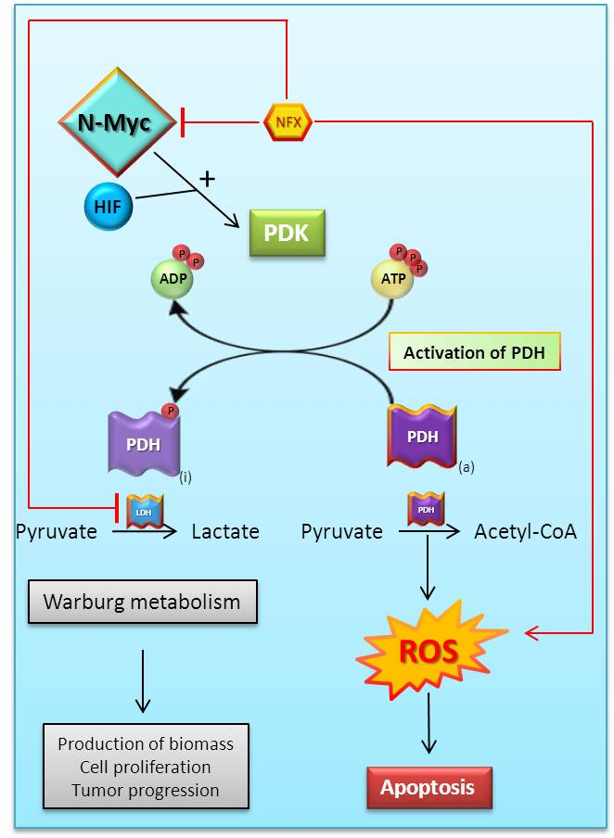
Supplementary Fig. 1. Schematic view.
Abbreviations: Acetyl-CoA, acetyl coenzyme A; ADP, adenosine diphosphate, ATP, adenosine triphosphate; HIF, hypoxia-inducible factor 1α; LDH, lactate dehydrogenase; NFX, nifurtimox; N-Myc, v-myc myelocytomatosis viral related oncogene, neuroblastoma derived (avian); PDH, pyruvate dehydrogenase; PDK, pyruvate dehydrogenase kinase; ROS, reactive oxygen species.

