Slide 1
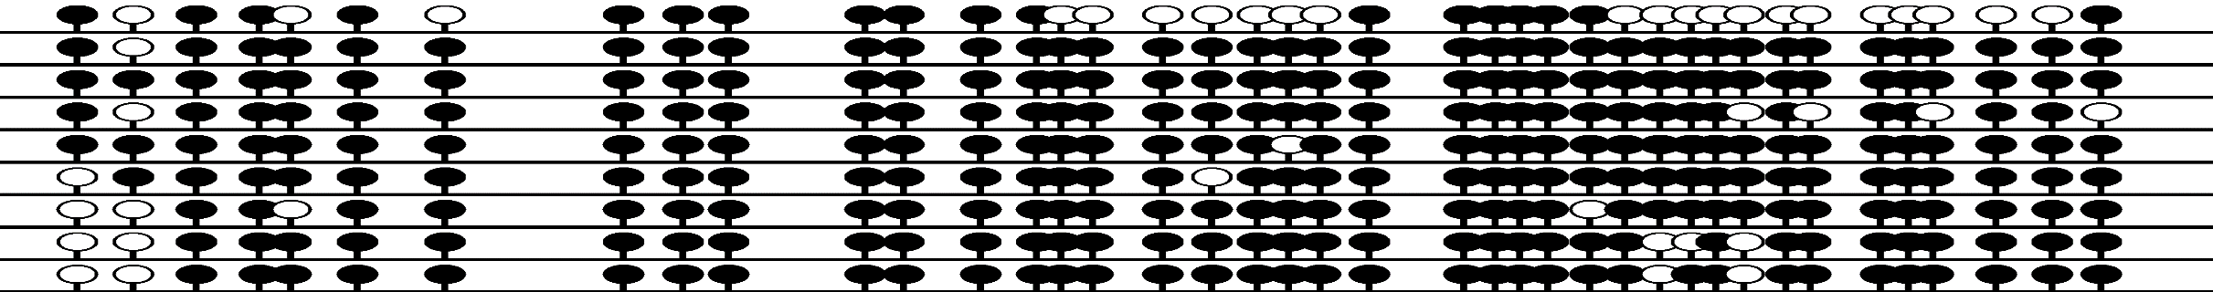
SLC16A5
Supplementary Figure S5a
5’UTR
+ EX1
EX2
EX3
EX4
EX5
EX6
EX7
CpG Island 629 bp
PROBE
CHOR-12
β=0.18
MI= 16.6%
PROBE
CHOR-18
β=0.70
MI= 100%
PROBE
CHOR-11
β=0.81
MI= 100%

Slide 2
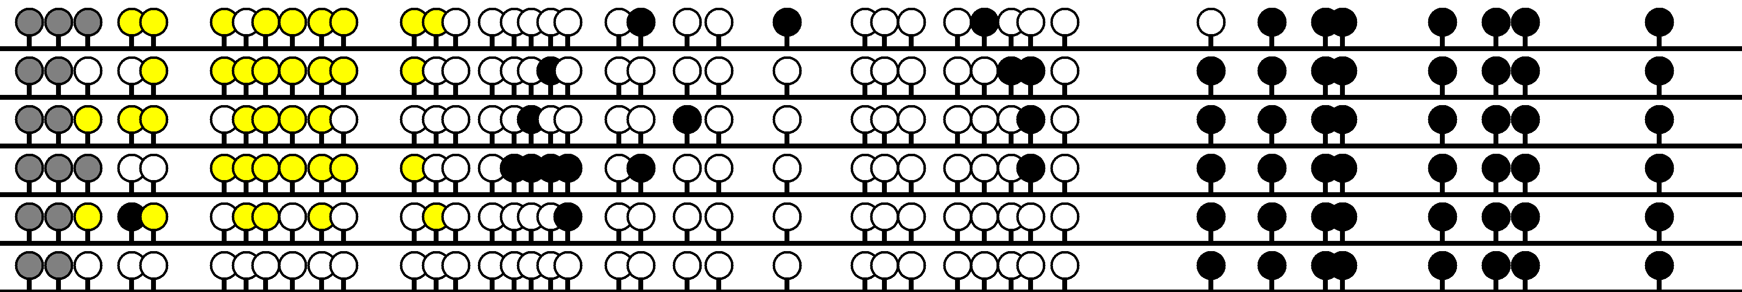
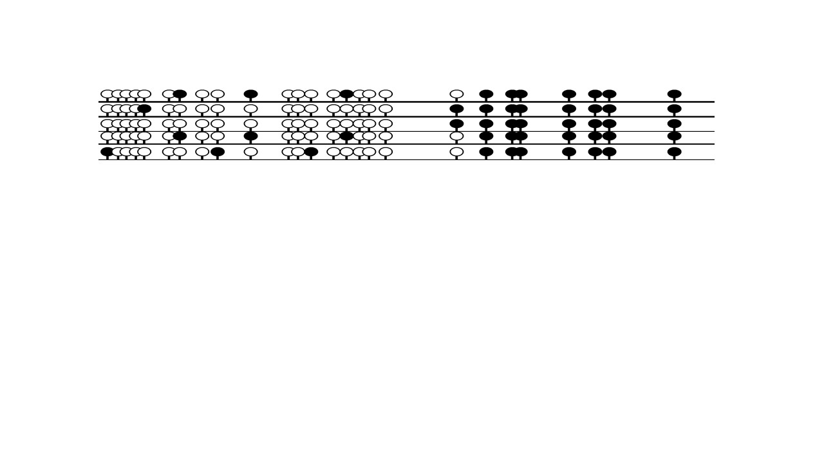
CHOR-1
RAB32
Supplementary Figure S5b
5 UTR
+ EX1
EX2
EX3
CpG Island 945 bp
PROBE
β=0.67
MI= 100%
PROBE
CHOR-18
β=0.58
MI= 100%

