Slide 1
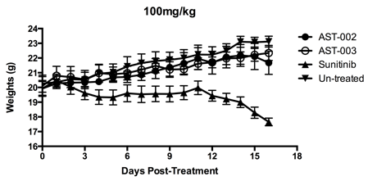
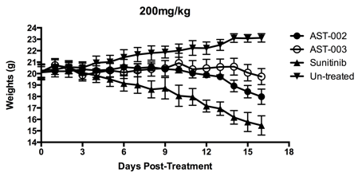
Supplementary Figure 3a.
100 mg/kg
200 mg/kg
24
22
20
18
16
24
22
20
18
16
14
AST-002
AST-003
Sunitinib
Vehicle
AST-002
AST-003
Sunitinib
Vehicle
Body weights (g)
Body weights (g)
0 3 6 9 12 15 18
0 3 6 9 12 15 18
Days of Treatment
Days of Treatment

Slide 2
Supplementary Figure 3b.
22
20
18
16
14
Body weight (g)
0 5 10 15
Days of Treatment

