Slide 1
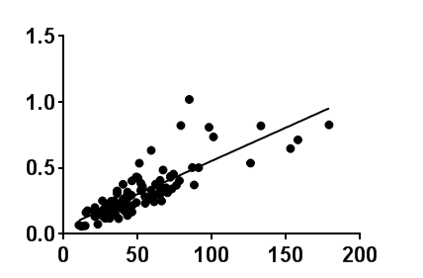
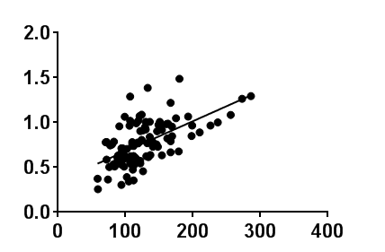
Additional file 1: Figure S1
R²=0.68
P＜0.0001
R²=0.36
P＜0.0001
EPA/AA
DHA/AA
EPA level (μg/mL)
DHA level (μg/mL)

Slide 2
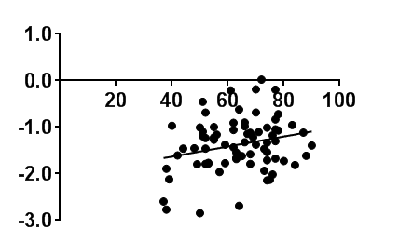
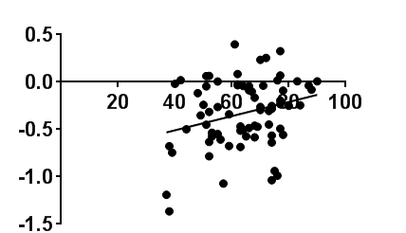
Additional file 1: Figure S2
EPA/AA (log)
DHA/AA (log)
R²=0.06
P=0.04
R²=0.07
P=0.02
Age of ACS onset (years)
Age of ACS onset (years)

