Slide 1
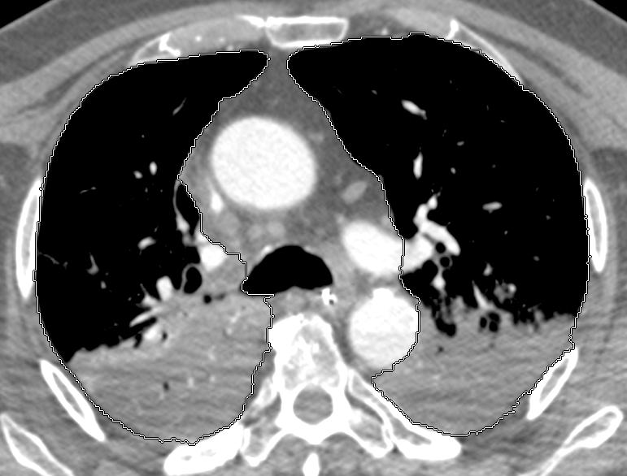
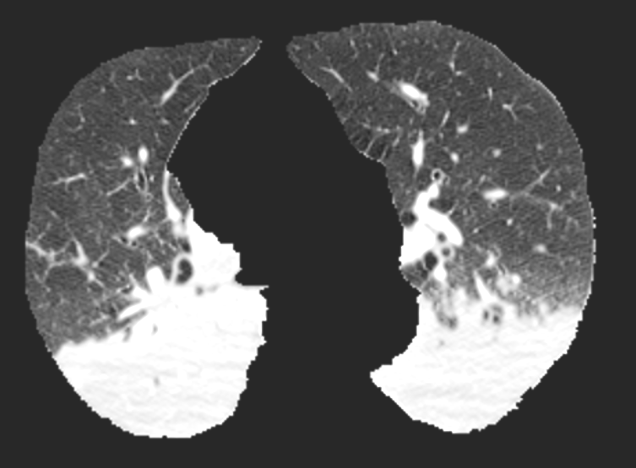
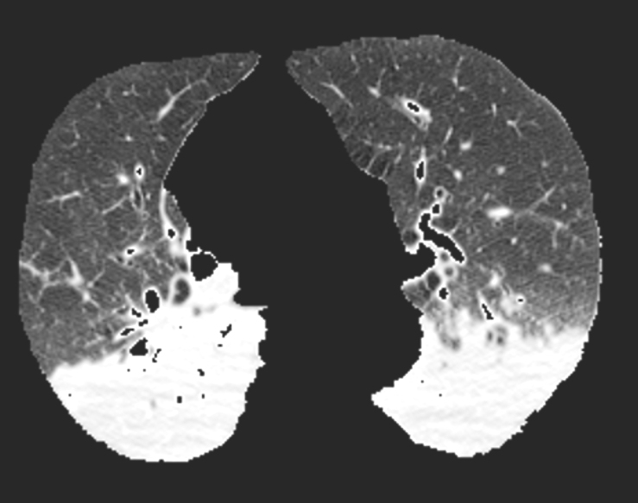
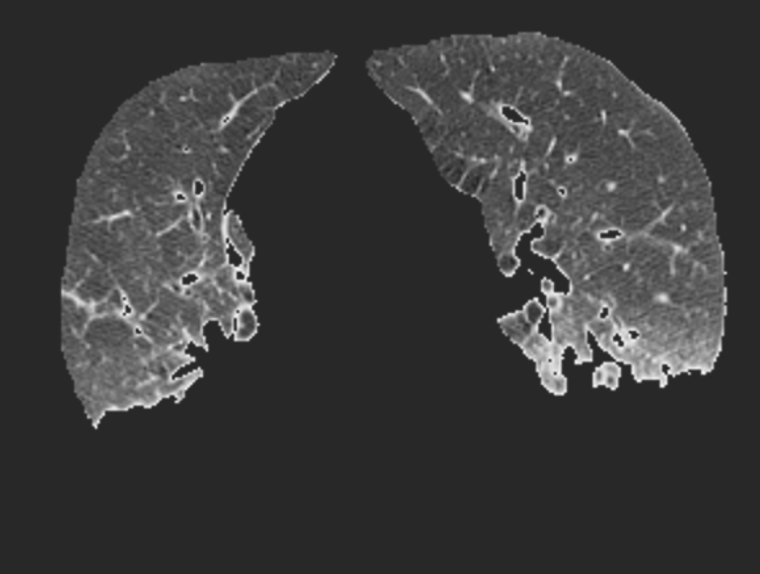
A
B
C
D
Notes:
Figure S1. In a first step to analyze CT images (A), lung contours were manually delineated from chest wall, mediastinum and pleural effusion. This resulted in the crude lung volume (B). Real lung volume (C) was obtained by excluding large vessels (densities above 150HU on enhanced scans) and bronchi lumen and hyperinflated lungs (densities below -900HU). Then, normally aerated lung was defined as having a density below -100HU (D).

