Slide 1
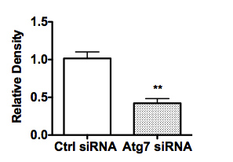
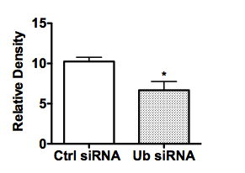
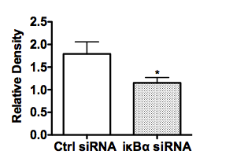
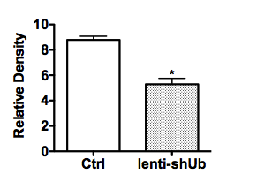
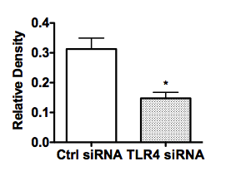

A
Ctrl siRNA
Ub siRNA
C
Ctrl siRNA
Atg7 siRNA
Atg7
Ub
GAPDH
B
Ctrl siRNA
GAPDH
IκBα siRNA
IκBα
Ctrl
Lenti-sh Ub
GAPDH
E
Ub
D
Ctrl siRNA
TLR4 siRNA
TLR4
β-actin
GAPDH
Supplementary Figure 1

